Slide 1

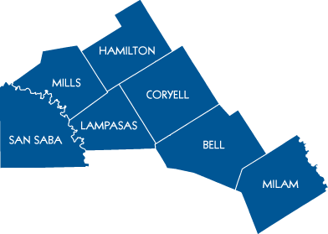
eGrants 101 Grant Writing Class
Jesse Hennage

Slide 2
Introduction/Purpose
Central Texas Council of Governments Public Safety Department Overview
Highlight important items in the Funding Announcements
Criminal Justice
Homeland Security
Application development

Slide 3
Learning Objectives
Understand the functions of the CTCOG Public Safety Department
Understand the available annual Criminal Justice and Homeland Security funding through the Office of the Governor Public Safety Office
Learn the basic fundamentals for writing and managing a grant (Based off the Texas eGrants platform)

Slide 4
Public Safety

Slide 5

Homeland Security Program
Purpose
Began after September 11th attacks, multiple reporting agencies.
The Homeland Security program is designated by the Office of the Governor's Homeland Security Grants Division (HSGD) for regional coordination efforts within the seven-county region.
The program provides technical assistance to applicants seeking Homeland Security grant funding opportunities and the management of Regional Emergency Operations Plans.
• Hazard Mitigation – planning for natural disasters
• Homeland Security – planning for man-made threats
• Emergency Management – planning for a coordinated, multi-agency response effort

Slide 6
Homeland Security Advisory Committee (HSAC)
HSAC Membership
Membership for the committee is composed of participants from around the seven-county region, who are appointed by CTCOG's Executive Committee.
Committee members review Homeland Security grant applications submitted through the office of the governor and prioritize applications based on needs and gaps previously identified in the Regional Strategic Plan.

Slide 7

Criminal Justice Program (CJD)
Purpose
The Criminal Justice Program is designated by the Office of the Governor's Criminal Justice Division (CJD) for regional coordination efforts within the seven-county region.
The program provides technical assistance to applicants for CJD grant funding opportunities to include Justice Assistance, Juvenile Justice, Victim of Crimes, and Violence Against Women services-related programming.

Slide 8
Criminal Justice Advisory Committee (CJAC)
CJAC Membership
  Membership for the committee is composed of participants from around the seven-county region, who are appointed by CTCOG's Executive Committee.
  Committee members must reside or work in the jurisdiction they are to represent and should represent one of the following disciplines: municipalities, counties, citizens or parents, substance abuse prevention, education, juvenile services, law enforcement, mental health, nonprofit organizations, prosecution and courts, and victim services.
  The Criminal Justice Advisory Committee review and update the Regional Strategic Criminal Justice Plan annually.
  Committee members review Criminal Justice grant applications submitted the office of the governor and prioritize applications based on needs and gaps identified in the regional strategic plan.

Slide 9

Peace Officer Training Program (POT)
Purpose
CTCOG coordinates Law Enforcement training with guidance from the Texas Commission on Law Enforcement (TCOLE). The focus of our training program is to provide basic, intermediate, advanced, and specialized training that will improve and enhance knowledge skills and abilities, and to increase officer and public safety.
Peace officers are required by state legislature to attend a minimum of 40 hours of training in a two-year reporting period.

Slide 10
Peace Officer Training Advisory Board (TAB)
The Training Advisory Board is a requirement by Texas Commission on Law enforcements. The board shall be responsible for advising the development of curricula and any other related duty that may be required by CTCOG or TCOLE. As specific duties, the board shall:
Effectively discharge its responsibilities and otherwise comply with current TCOLE rules;
Advise on the need to study, evaluate and identify specific training needs;
Advise on the determination of the types, frequency, and location of courses to be offered; and
Advise on the establishment of the standards for admission, prerequisites, minimum and maximum class size, attendance, and retention.

Slide 11
9-1-1 Program

Slide 12

9-1-1/Public Safety Answering Points
Purpose
12 Public Safety Answering Points (PSAP)
Commission on State Emergency Communications (CSEC), State Agency
Funded by you - $.50 per month charge on your phone
Responsible for purchase of all call taking equipment in seven-county region including Fort Hood
Operational support for PSAP supervisors and call takers
Mitigate any 9-1-1 equipment failures, man-made or disaster related
Review and implement technology changes

Slide 13
9-1-1/Public Safety Answering Points
Work closely with nearby Councils of Government such as Brazos Valley and Heart of Texas
Coordinate training for PSAP supervisors and call-takers
Attend meetings with vendors, state/local officials and individuals to determine 9-1-1 needs, improvements and future goals
Responsible for public education of 9-1-1
  Disseminate various items for Public Safety personnel to distribute to local schools

Slide 14
Geographic Information System (GIS) Program

Slide 15
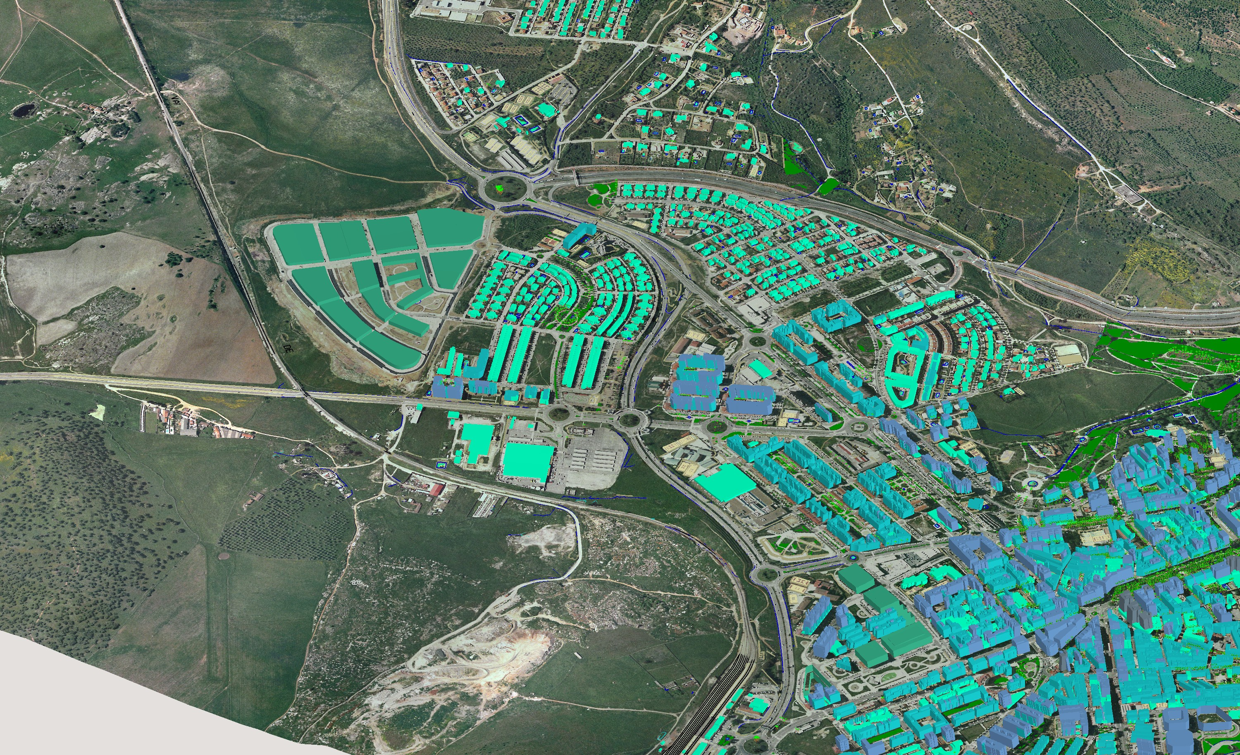
9-1-1 Data Services
911 Spatial Data Maintenance
Perform routine maintenance on the 911 GIS data within the CTCOG region
  These include but are not limited to:
    Fire, Police, EMS Regions (ESN Boundaries)
    PSAP (Public Safety Answering Points) Boundaries
    MSAG (Master Street Address Guide) Boundaries
    Address (Location) Points
    Road (Location) Centerlines
    Municipal Boundaries
    County Boundaries

Slide 16
Mapping and Data Service
Create maps and provide data to elected officials and first responders
Offer an interactive web mapping portal for the CTCOG region.

Slide 17
Addressing Services
CTCOG is the Addressing authority for seven counties and 27 cities providing the following service:
  Create and verify 911 addresses for rural, city, and subdivision addressing
  Update postmaster and computer assisted dispatch (CAD) with new addresses
  Create private roads
Work closely with County Commissioners and other public officials for identification of County Road changes, Private Road naming and any other changes that promote accurate and timely emergency response.
Work closely with other 911 addressing agencies within our region including Temple, Belton, Killeen, Harker Heights, Copperas Cove, and Fort Hood to ensure our region meets state compliance for the deployment of NG911

Slide 18
Public Safety Contacts
Uryan Nelson
Director of Planning and Regional Services
Jwana Sartor
Office Manager
Cindy Finnegan
Special Projects Coordinator
Jesse Hennage
Assistant Director of Planning/Public Safety
Office (254) 770-2365
jesse.hennage@ctcog.org
Helen Hill Yancey
Public Safety Manager
Sunshine Martinez
Public Safety Training Coordinator
Ryan Riley
Generalist
Alissa Spruill
9-1-1 Program Coordinator
Jesse Cathell
GIS Manager
Tanja Broom
GIS Analyst
Jennifer Leisey
Addressing Coordinator/GIS Technician
Seth Speer
GIS Analyst

Slide 19
Criminal Justice & Homeland Security Programs

Slide 20
Criminal Justice Division (CJD)
Justice Programs
Final Date to Submit and Certify an Application 2/13/2025 at 5:00pm CST

Slide 21
Criminal Justice Grant Program (JAG)
Purpose
  The purpose of this announcement is to solicit applications for projects that promote public safety, reduce crime, and improve the criminal justice system.
Eligible Organizations
Applications may be submitted by state agencies, public and private institutions of higher education, independent school districts, Native American tribes, councils of governments, non-profit corporations (including hospitals and faith-based organizations), and units of local government, which are defined as a non-statewide governmental body with the authority to establish a budget and impose taxes.
  Project Period
  Projects must begin on or after 10/01/2025 and may not exceed a 12-month project period.
  Funding Levels
  Minimum: $10,000
  Maximum: None
  Match Requirement: None

Slide 22
Criminal Justice Grant Program (JAG)
Eligible Purpose Areas
Funding may be used to provide additional personnel, equipment, supplies, contractual support, training, technical assistance, and information systems for criminal justice purposes, including for any one or more of the following:
1. Law enforcement – Includes championing a supportive, professional, respected law enforcement system with specialized resources that are adaptive and flexible to ever-changing crimes and situations.
State Priority Areas include:
a. Intelligence-based Investigations (Violent Crime, Border Crime, Gangs)
b. Community Policing Programs
c. Specialized Officer Training
d. Officer Wellness Programs
2. Prosecution and Courts – Includes fostering an informed, collaborative, and multi-disciplinary system that ensures appropriate penalties offenders and services for the community and victims.
State Priority Areas include:
a. Pre-trial Diversion Programs
b. Reduce Evidence Testing Backlog
c. Courtroom Personnel Training

Slide 23
Criminal Justice Grant Program (JAG)
3. Crime Prevention and Education – Includes cultivating an individualized, understanding-based system that takes a multi-pronged approach, infused with basic life skills and alternative tracks to crime prevention.
State Priority Areas include:
a. Life-skills Training Programs
b. Community-based Prevention Programs
4. Corrections and Community Corrections – Includes promoting an assessment-driven, treatment-focused system that targets an individual’s risk and needs appropriately.
State Priority Areas Include:
a. Probation/Parole Officer Training
b. Risk/Needs Assessment for Diversion Programs
c. Jail/Prison-based Co-occurring Treatment

Slide 24
Criminal Justice Grant Program (JAG)
5. Reentry Programs; and
6. Assessment and Evaluation Programs.
Note: “Criminal Justice Purposes” is defined as activities pertaining to crime prevention, control, or reduction, or the enforcement of the criminal law, including, but not limited to, police efforts to prevent, control, or reduce crime or to apprehend criminals, including juveniles, activities of courts having criminal jurisdiction, and related agencies (including but not limited to prosecutorial and defender services, juvenile delinquency agencies and pretrial service or release agencies), activities of corrections, probation, or parole authorities and related agencies assisting in the rehabilitation, supervision, and care of criminal offenders, and programs relating to the prevention, control, or reduction of narcotic addiction and juvenile delinquency.

Slide 25
Criminal Justice Grant Program (JAG)
Priorities
● Officer training, including de-escalation, domestic violence, and sexual assault
● Equipment upgrades including safety and investigative equipment
● Crime Victim Services
● Advancement in weapons for non-lethal options
● Relationships between law enforcement and mental health partners
● Additional mental health officers
● Masters level or higher mental health clinicians on teams to address domestic issues related to domestic violence or disability-based crisis (MH, Autism, Dementia, etc.)/mental health services
● Proactive patrol and positive community contacts

Slide 26
Justice Assistance Grant (JAG) Program Opportunity Snapshot
  FY25 Grant Data
      11 total grant applications requesting $346,356
      FY25 Reasonable Budget Expectation was $188,092
      CJAC was able to fund 7 grants
      Funding for FY26 is expected to remain similar to FY25

Slide 27
Juvenile Justice & Truancy Prevention Grant Program
Purpose
The purpose of this announcement is to solicit applications for projects that prevent violence in and around school; and to improve the juvenile justice system by providing mental health services, truancy prevention and intervention through community-based and school programs.
Eligible Organizations
Applications may be submitted by independent school districts, Native American tribes, councils of governments, non-profit corporations (including hospitals and faith-based organizations), and units of local government, which are defined as a non-statewide governmental body with the authority to establish a budget and impose taxes. All applications submitted by local law enforcement agencies/offices must be submitted by a unit of government affiliated with the agency, including an authorizing resolution from that unit of government. For example, police departments must apply under their municipal government, and community supervision and corrections departments, district attorneys, and judicial districts must apply through their affiliated county government (or one of the counties, in the case of agencies that serve more than one county). Juvenile specialty courts authorized under Chapter 121 of the Texas Government Code and statewide projects are not eligible to apply under this announcement.
Project Period
Projects must begin on or after 09/01/2025 and may not exceed a 12-month project period.
Funding Levels
Minimum: $10,000
Maximum: None
Match Requirement: None

Slide 28
Juvenile Justice & Truancy Prevention Grant Program
Eligible Purpose Areas
Mental Health Services. Programs providing mental health services for youth in custody in need of such services including, but are not limited to assessment, development of individualized treatment plans, and discharge plans.
School Programs. Education programs or supportive services in traditional public schools and detention/corrections education settings to encourage youth to remain in school; or alternative learning programs to support transition to work and self-sufficiency, and to enhance coordination between correctional programs and youth’s local education programs to ensure the instruction they receive outside school is aligned with that provided in their schools, and that any identified learning problems are communicated.
Community-Based Programs and Services. These programs and services are those that work pre- and post-confinement with a) parents and other family members to strengthen families to help keep youth in their homes; b) youth during confinement and their families to ensure safe return of youth home and to strengthen the families; and c) parents with limited English-speaking ability.

Slide 29
Juvenile Justice & Truancy Prevention Grant Program
Eligible Purpose Areas
Truancy Prevention. Education programs and/or related services designed to prevent truancy including prevention services for children considered at-risk of entering the juvenile justice system and intervention services for juveniles engaged in misconduct.
Juvenile Case Managers. Individuals designated to provide services in court cases involving juvenile offenders including assisting the court in administering the court's juvenile docket and supervising the court's orders in juvenile cases. May also provide prevention services to a child considered at-risk of entering the juvenile justice system and intervention services to juveniles engaged in misconduct before cases are filed.

Slide 30
Juvenile Justice & Truancy Prevention Priorities
Substance abuse services
Mental health services including family counseling
Diversion from the juvenile justice system
Training Programs
Addressing lack of detention and residential beds for youth
Restorative Justice Model implementation versus punishment only
Proactive engagement with youth
Renewal of [Belton] curfew ordinance
Proactive juvenile contacts
Community based programs
Improving the juvenile justice system

Slide 31
Juvenile Justice & Truancy Prevention Grant Program
  FY25 Grant Data
      3 total Juvenile Justice grant applications requesting $54,003
      FY25 Reasonable Budget Expectation was $53,452 Juvenile Justice
      2 total Truancy Prevention grant applications requesting $78,671
      FY25 Reasonable Budget Expectation was $78,599 Truancy Prevention

Slide 32
Criminal Justice Division (CJD)
Victims Services
Final Date to Submit and Certify an Application 2/13/2025 at 5:00pm CST

Slide 33
General Victim Assistance Grant Program (VOCA)
Purpose
The purpose of this program is to provide services and assistance directly to victims of crime to speed their recovery and aid them through the criminal justice process. Services may include the following:
Responding to the emotional and physical needs of crime victims;
Assisting victims in stabilizing their lives after a victimization;
Assisting victims to understand and participate in the criminal justice system; and
Providing victims with safety and security.
This solicitation is for programs seeking to provide general victim services to broad categories of victim populations that may include victims of commercial sexual exploitation or trafficking, including long-term residential (shelter) for children and transition-age youth. Information about other related funding opportunities is provided below and on the Funding Opportunities tab of the eGrants homepage:
Community Based Services for Commercially Sexually Exploited Youth, FY2026. Projects to support community-based programs for children and transition-aged youth (non-CSEY Advocate programs).
Specialized Advocacy for Commercially Sexually Exploited Youth, FY2026. Projects to support advocacy services for children and transition-aged youth within the CSEY Advocacy model.
Agencies applying for funds to support a CASA or Children’s Advocacy Center program must apply through either Texas CASA, Inc. or Children’s Advocacy Centers of Texas.

Slide 34
General Victim Assistance Grant Program (VOCA)
Eligible Organizations
Applications may be submitted by state agencies, public and private non-profit institutions of higher education, independent school districts, Native American tribes, councils of governments, non-profit corporations (including hospitals and faith-based organizations) and units of local government, which are defined as a non-statewide governmental body with the authority to establish a budget and impose taxes (includes hospital districts). Other local governmental agencies should apply through an associated unit of local government.

Slide 35
General Victim Assistance Grant Program (VOCA)
Project Period
Projects selected for funding must begin on or after 10/01/2025
Funding Levels
Minimum: $10,000
Maximum: No Maximum
Match Requirement: 20%
Note: Applicants are strongly cautioned to only apply for the amount of funding they can responsibly expend in the grant period. PSO will be tracking expenditure rates throughout the life of the grants and may take action to avoid large de-obligations at the end of grant periods.

Slide 36
General Victim Assistance Grant Program (VOCA)
Eligible Activities and Costs
The following list of eligible activities and costs apply generally to all projects under this announcement.
Crisis Services;
Forensic Interviews (with parameters, see RFA);
Legal Advocacy;
Multi-Disciplinary Teams and Case Coordination;
Peer Support Groups;
Professional Therapy and Counseling;
Protective Order Assistance;
Shelter Programs;
Victim-Offender Meetings
Transitional Housing
Victim Notification Systems

Slide 37
General Victim Assistance Grant Program (VOCA) Priorities
Access to training, counseling, support services
Staff housing, financial assistance, counseling
Domestic violence funding, sexual assault funding, training
Provision of services to survivors of crime
Being victim-centered (making sure the voice of the victim is heard)
Shelter, food, and supplies

Slide 38
General Victim Assistance Grant Program (VOCA)
  FY25 Grant Data
      14 total grant applications requesting over $1,837,594
      FY25 Reasonable Budget Expectation was $1,802,090
      CJAC was able to fund all 14 grants, most scaled
      One grant defunded later in the year
      Potential for slight decrease in funding

Slide 39
Violence Against Women Justice and Training Program (VAWA)
Final Date to Submit and Certify an Application 2/13/2025 at 5:00pm CST

Slide 40
Violence Against Women Justice and Training Program Opportunity Snapshot
Purpose
The purpose of this funding is to solicit applications for projects that promote a coordinated, multidisciplinary approach to improve the justice system’s response to violent crimes against women, including domestic violence, sexual assault, dating violence, and stalking.
Eligible Organizations
Applications may be submitted by state agencies, public and private non-profit institutions of higher education, independent school districts, Native American tribes, councils of governments, non-profit corporations (including hospitals and faith-based organizations) and units of local government, which are defined as a non-statewide governmental body with the authority to establish a budget and impose taxes (includes hospital districts). Other local governmental agencies should apply through an associated unit of local government.
Non-profit applicants seeking to provide direct services to victims of crime are not eligible under this solicitation and should apply under the General Victim Assistance Program Funding Announcement.
Project Period
Projects must start on or after 09/01/2025
Funding Levels
Minimum: $5,000
Maximum: No Maximum
Match Requirement: 30% (Note: Victim service providers and Native American tribes are exempt from the match requirement.)

Slide 41
Violence Against Women Justice and Training Program Opportunity Snapshot
FY25 Grant Data
      1 total grant application requesting $187,000
      FY25 Reasonable Budget Expectation was $67,732 (RBE)

Slide 42
Criminal Justice Requirements
Eligibility Requirements
90% criminal history disposition reporting
Local units of governments must comply with the Cybersecurity Training requirements described in Section 772.012 and Section 2054.5191 of the Texas Government Code
Eligible applicants operating a law enforcement agency must be current on reporting complete UCR data and the Texas specific reporting mandated by 411.042 TGC, to the Texas Department of Public Safety (DPS) for inclusion in the annual Crime in Texas (CIT) publication
Eligible applicants must be registered in the federal System for Award Management (SAM) database and have an UEI (Unique Entity ID) number assigned to its agency (to get registered in the SAM database and request an UEI number, go to https://sam.gov/)

Slide 43
Criminal Justice Competitive Grant Process
Application Process
For eligible local and regional projects:
  Applicants must contact their applicable regional council of governments (COG) regarding their application.
  Each of Texas’ 24 COGs holds its own application planning workshops, workgroups, and/or subcommittees and facilitates application prioritization for certain programs within its region. Failure to comply with regional requirements imposed by the COG may render an application ineligible.
State agencies, and other organizations proposing projects to increase preparedness statewide, may submit applications directly to PSO.
All applicants must access PSO’s grant management website at https://eGrants.gov.texas.gov to register and apply for funding.

Slide 44
Criminal Justice Division (CJD)
Non-Competitive Grants
Final Date to Submit and Certify an Application 2/13/2025 at 5:00pm CST

Slide 45
FY25 Non-Competitive Grants
ALERRT Travel Assistance $2.9 Million
Body Worn Camera Program $10 Million
Bullet-Resistant Shield $250k
County Essential Services Grant Program (Invitation Only)
County Solutions to Address Commercial Sexual Exploitation (Counties Only)
Crime Stoppers Assistance Fund $400,000
District Attorney Testing of Forensic Evidence Grant Program $2 Million
First Responder Mental Health Program
Internet Crimes Against Children Grant Program $800,000
Paul Coverdell Forensic Sciences Improvement Program $2 Million
Project Safe Neighborhoods
Residential Substance Abuse Treatment (RSAT) Grant Program $6 Million
Rifle-Resistant Body Armor Grant $10 Million
Sexual Assault Evidence Testing Grant Program $2 Million
Sexual Assault Forensic Exam (SAFE)-Ready Facilities Program $3 Million
Specialized Advocacy for Commercially Sexually Exploited Youth (Now VOCA)
Specialty Courts Program
State Crisis Intervention Program
Statewide Solutions to Address Commercial Sexual Exploitation

Slide 46
FY26 Homeland Security Reasonable Budget Expectation
FY25 Grant Data
      16 total grant applications requesting over $1,345,646
      FY25 Reasonable Budget Expectation was $305,925
      HSAC was able to fund 5 grants, most scaled
      Potential for slight decrease in funding
FY26 Estimate $300,000
LETPA $105,000 @35%
CTCOG Planning Grant $130,000
CodeRed $60,000
SHSP Remaining $110,000 (LETPA included)

Slide 47
Road to Homeland Security/Criminal Justice Grants
August 31/TBD – HSGD award notices ready for release
August 1/TBD – OOG/HSGD Review complete
June/TBD – CJD notifies applicants of project status
June 1/TBD - Preliminary Review Report (PRR) Issues Resolved
Late May/TBD – CTCOG sends funding recommendation email to CJD applicants
May/TBD – HSGD Schedule and conduct individual conference calls with each COG
Early May/TBD – CJ priority listings due to CJD
May 1/TBD - HSGD initial grant review complete
Mid April/TBD - CJAC scores applications
March 31/TBD – SHSP Priority Listings due to HSGD
March/April/TBD – HSAC scores applications
March 15/TBD – Applications batched to COG
February 13 – ALL Applications due in eGrants by 5:00 PM
January 10 – Bell County Workshop
January 9 – Hamilton County Workshop
January 8 – Coryell County Workshop
January 7 – Lampasas and Mills County Workshops
January 6 – Milam and San Saba County Workshops
December 16 – Public Safety Office releases funding availability

Slide 48
Questions?
Break

Slide 49

Application Development Workshop
State Homeland Security Grant Program (SHSP)

Slide 50

Table of Contents

Slide 51
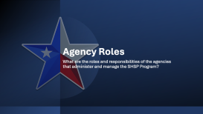






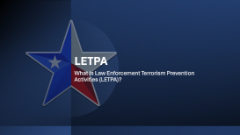




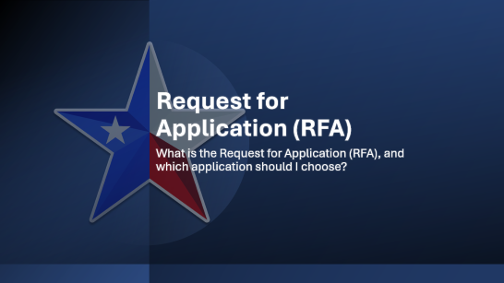



The State Homeland Security Grant Program
Click on the slides below to access the section you'd like to view.

Slide 52




























Application Walkthrough
Is there any way someone can walk me through the application?
Click on the slides below to access the section you'd like to view.

Slide 53
Program Overview
What is the State Homeland Security Grant Program?

Slide 54
(1) What is the State Homeland Security Grant Program?
The State Homeland Security Grant Program (SHSP) is included in a suite of grants that make up the Homeland Security Grant Program (HSGP). These grant programs assist state, local, tribal and territorial governments efforts in preventing, protecting against, mitigating, and responding to acts of terrorism and other threats. This grant provides grantees with the resources required for implementation of the National Preparedness System and working toward the National Preparedness Goal of a secure and resilient nation. These grant programs are part of a comprehensive set of measures authorized by Congress and implemented by the Department of Homeland Security (DHS) to help strengthen the Nation’s communities against potential terrorist attacks.
The purpose of the SHSP is to support state, tribal and local preparedness activities that address high-priority preparedness gaps across all core capabilities where a nexus to terrorism exists. All investments must be consistent with capability targets set during the Threat and Hazard Identification and Risk Assessment (THIRA) process, and gaps identified in the Stakeholder Preparedness Review (SPR).
The SHSP is intended to support investments that improve the ability of jurisdictions to:
Prevent a threatened or an actual act of terrorism;
Protect its citizens, residents, visitors, and assets against the greatest threats and hazards;
Mitigate the loss of life and property by lessening the impact of future catastrophic events;
Respond quickly to save lives, protect property and the environment, and meet basic human needs in the aftermath of a catastrophic incident

Slide 55
Key Concepts
What key concepts should I know before applying?

Slide 56
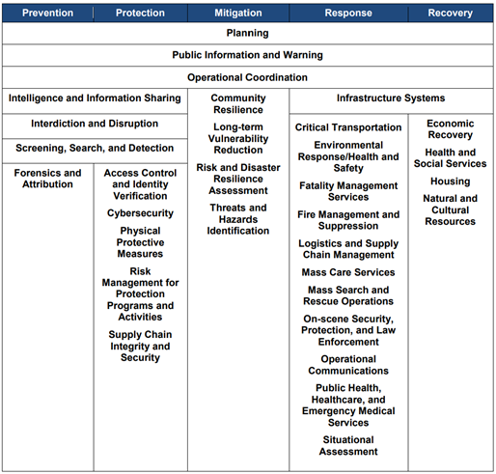
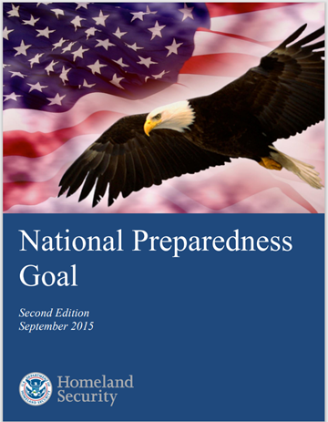
2.(A) The National Preparedness Goal, Mission Areas and Core Capabilities
Each applicant must have a basic understanding of how the State Homeland Security Grant Program is designed to function. One of the most important documents an applicant will need when applying is the National Preparedness Goal. The National Preparedness Goal (the Goal) defines the Goal as:
”A secure and resilient Nation with the capabilities required across the whole community to prevent, protect against, mitigate, respond to, and recover from the threats and hazards that pose the greatest risk.”
The Goal essentially defines what it means for all communities to be prepared collectively for the threats and hazards that pose the greatest risk to the nation.
The Goal identifies 32 distinct activities, called core capabilities, needed to address the risks.
The Goal organizes these core capabilities into five categories, called mission areas.

Slide 57
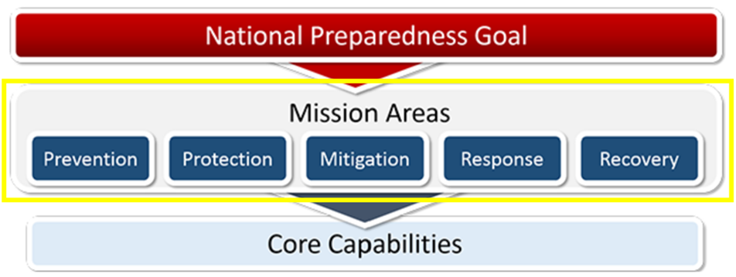
2.(A) The National Preparedness Goal, Mission Areas and Core Capabilities
The Goal’s five mission areas include:
Prevention: Prevent, avoid, or stop an imminent, threatened, or actual act of terrorism.
Protection: Protect our citizens, residents, visitors, and assets against the greatest threats and hazards in a manner that allows our interests, aspirations, and way of life to thrive.
Mitigation: Reduce the loss of life and property by lessening the impact of future disasters.
Response: Respond quickly to save lives, protect property and the environment, and meet basic human needs in the aftermath of an incident.
Recovery: Recover by prioritizing the timely restoration, strengthening, and revitalization of infrastructure, housing, and a sustainable economy, while also addressing the health, social, cultural, historical, and environmental aspects of communities impacted by an incident.
The funding guidelines established within the federal Notice of Funding Opportunity(NOFO) support four of the five mission areas—Prevention, Protection, Mitigation, and Response—and associated core capabilities within the Goal. While Recovery is part of “The Goal”, it is not explicitly part of the Homeland Security Grant Program.

Slide 58

2.(A) The National Preparedness Goal, Mission Areas and Core Capabilities
Core Capabilities are the essential functions defined by FEMA as critical to the success of each mission area.
Some Core Capabilities may overlap two or more mission areas, and some are only applicable to one.
When an application is submitted to the Public Safety Office(PSO), applicants are required to identify which core capability gap this project will sustain or enhance. The commonly addressed core capability gaps are:
Interdiction and Disruption
Planning
Operational Communications
Intelligence and Information Sharing
Screening, Search and Detection
Community Resilience
Operational Coordination
Environmental Response/Health and Safety
Cybersecurity
Physical Protective Measures
Public Information and Warning

Slide 59
2.(A) The National Preparedness Goal, Mission Areas and Core Capabilities
Definitions of commonly used core capabilities:
Interdiction and Disruption - Delay, divert, intercept, halt, apprehend, or secure threats and/or hazards.
  Project Examples: Special Weapons And Tactics (SWAT) and Bomb Squad training or equipment (e.g., Night Vison, Body Armor, Robots, Armored Vehicles, Bomb Suits)
Planning - Conduct a systematic process engaging the whole community as appropriate in the development of executable strategic, operational, and/or tactical-level approaches to meet defined objectives.
  Project Examples: Salaries for Planning personnel and contractors to create local and regional anti-terror plans.
Operational Communications - Ensure the capacity for timely communications in support of security, situational awareness, and operations, by any and all means available, among and between affected communities in the impact area and all response forces.
  Project Examples: Mobile, portable, and base radios. Communications infrastructure (e.g., Towers, Repeaters)

Slide 60
2.(A) The National Preparedness Goal, Mission Areas and Core Capabilities
Intelligence and Information Sharing - Provide timely, accurate, and actionable information resulting from the planning, direction, collection, exploitation, processing, analysis, production, dissemination, evaluation, and feedback of available information concerning physical and cyber threats to the United States, its people, property, or interests; the development, proliferation, or use of WMDs; or any other matter bearing on U.S. national or homeland security by local, state, tribal, territorial, Federal, and other stakeholders. Information sharing is the ability to exchange intelligence, information, data, or knowledge among government or private sector entities, as appropriate.
  Project Examples: Fusion Center Analysts and Intelligence Investigation software
Screening, Search and Detection - Identify, discover, or locate threats and/or hazards through active and passive surveillance and search procedures. This may include the use of systematic examinations and assessments, bio surveillance, sensor technologies, or physical investigation and intelligence.
  Project Examples: Explosive Detection K9’s, Radiological Detection Equipment, Chemical Detection Equipment, Small Unmanned Aircraft System (SUAS), SUAS Detection equipment and Automated License Plate Readers.

Slide 61
2.(A) The National Preparedness Goal, Mission Areas and Core Capabilities
Community Resilience - Enable the recognition, understanding, communication of, and planning for risk and empower individuals and communities to make informed risk management decisions necessary to adapt to, withstand, and quickly recover from future incidents.
  Project Examples: Community Emergency Response Team (CERT) Programs and Community Preparedness Campaigns
Operational Coordination - Establish and maintain a unified and coordinated operational structure and process that appropriately integrates all critical stakeholders and supports the execution of core capabilities.
  Project Examples: Incident Command System (ICS) training, Emergency Operations Center equipment upgrades, Web EOC, Multi-Agency incident command vehicles (Mobile EOC)
Environmental Response/Health and Safety - Conduct appropriate measures to ensure the protection of the health and safety of the public and workers, as well as the environment, from all-hazards in support of responder operations and the affected communities.
  Project Examples: HazMat Team Personal Protective Equipment (PPE) and Training, CBRNE PPE

Slide 62
2.(A) The National Preparedness Goal, Mission Areas and Core Capabilities
Cybersecurity - Protect (and, if needed, restore) electronic communications systems, information, and services from damage, unauthorized use, and exploitation.
  Project Examples: Cybersecurity assessment/plan, Network firewalls, Anti-Virus Software, Cyber Incident Response Team Training Encryption of software and networks
Physical Protective Measures - Implement and maintain risk-informed countermeasures, and policies protecting people, borders, structures, materials, products, and systems associated with key operational activities and critical infrastructure sectors.
  Project Examples: Fencing, Fixed Area Lighting, Alarms, Bollards, Security Cameras, Impact Resistant Gates/Doors/Windows
Public Information and Warning - Deliver coordinated, prompt, reliable, and actionable information to the whole community through the use of clear, consistent, accessible, and culturally and linguistically appropriate methods to effectively relay information regarding any threat or hazard and, as appropriate, the actions being taken, and the assistance being made available.
  Project Examples: Public Information Officer (PIO) training, Integrated Public Alert and Warning Systems, Public Address Systems, Sirens, Electronic message signs for public alerts

Slide 63
2.(B) - The Threat and Hazard Identification and Risk Assessment (THIRA) and the Stakeholder Preparedness Review (SPR)
The Threat and Hazard Identification and Risk Assessment (THIRA) is a three-step risk assessment process developed by your COG that helps communities understand their risks and what they need to do to address those risks by answering the following questions:
  What threats and hazards can affect our community?
  If they occurred, what impacts would those threats and hazards have on our community?
  Based on those impacts, what capabilities should our community have?
The outputs from this process lay the foundation for determining a community’s capability gaps as part of the Stakeholder Preparedness Review.
The Stakeholder Preparedness Review (SPR) is a self-assessment of a jurisdiction’s current capability levels against the targets identified in the Threat and Hazard Identification and Risk Assessment (THIRA). Using the targets from the THIRA, jurisdictions identify their current capability and how that capability changed over the last year, including capabilities lost, sustained, and built.
In simpler terms, the THIRA assists in identifying threats within your COG region, while the SPR helps determine the resources you need or have to manage those threats. When submitting SHSP applications to the PSO, you must specify the particular threat addressed by the project as outlined in your region’s THIRA and the capability gaps it fills according fills according to capability gaps that are listed in your region’s most recent SPR. You can request a copy of your regional THIRA and SPR from your Council of Governments.
For questions regarding the THIRA and SPR process, you may contact:
Brandon Gentry
Strategic Planner
Texas Office of Homeland Security
6100 Guadalupe St.
Austin TX 78752
512.424.0031 (O)
512.815.6985 (C)
brandon.gentry@dps.texas.gov

Slide 64
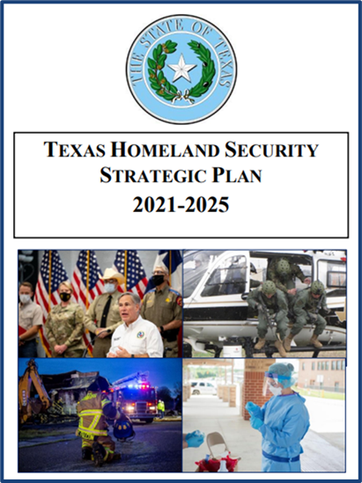
2.(C) - Texas Homeland Security Strategic Plan
The Texas Homeland Security Strategic Plan 2021-2025 is the state’s framework for establishing homeland security priorities and focusing its broad range of efforts to develop, sustain, and employ homeland security capabilities. This strategy is intended to serve as a guide for managing homeland security risk in Texas by developing and sustaining capabilities, planning for their employment, and coordinating action at the state, regional, local, tribal, and private sector levels.
The Texas Homeland Security Strategic Plan is made up of Goals, Objectives and Priority Actions that align with the five homeland security mission areas. This document serves to reflect the state’s most significant homeland security priorities and will serve to focus our homeland security activities, to include investment and resourcing efforts.
Goals – Goals are the general strategic ends toward which Texas will continually work; they serve to orient our long-term homeland security efforts.
Objectives – Objectives support each Goal and describe a result, event, or outcome to be achieved over the next five years. Objectives serve to focus the application of resources.
Priority Actions - Priority Actions support each Objective and describe specific initiatives and activities needed to accomplish the Objective.

Slide 65
Agency Roles
What are the roles and responsibilities of the agencies that administer and manage the SHSP Program?

Slide 66
(3) – What are the roles and responsibilities of the agencies that administer and manage the SHSP Program?
Federal Emergency Management Agency (FEMA) – FEMA is the federal awarding agency and manages the Homeland Security Grant Program at the federal level.
Texas Public Safety Office, Preparedness Programs – Serves as the State Administrative Agency (SAA) for the State of Texas. The SAA is the only eligible entity that can apply for SHSP funding. The SAA manages the SHSP program at the state level and issues subawards to “subrecipients” across the State.
Council of Governments (COG) – Serves to coordinate the states SHSP efforts at a regional level. Each of the 24 regional COGs is responsible for the following:
  Establish and maintain a regional Homeland Security Advisory Committee (HSAC).
  Facilitate the prioritization of applications submitted with the region, by the regional HSAC.
  Complete the regional Threat and Hazard Identification and Risk Assessment (THIRA) and Stakeholder Preparedness Report (SPR)

Slide 67
Eligibility
Who is eligible to apply?

Slide 68
(4) – Who is eligible to apply?
Eligible Organizations:
State agencies;
Regional councils of governments;
Units of local government;
Nonprofit organizations;
Universities or Colleges; and
Federally recognized Native American tribes.
Units of Local Governments is defined by 6 U.S.C. § 101(13) as a:
County
Municipality
City
Town
Township
Local Public Authority
School district
Special district
Intrastate district
Council of governments (regardless of whether the council of governments is incorporated as a nonprofit corporation under State law)
Regional or interstate government entity
Agency or instrumentality of a local government

Slide 69
(4) – Who is eligible to apply?
Applicants must comply with the following eligibility requirements:
Cybersecurity Training - Local units of governments must comply with the Cybersecurity Training requirements described in Section 772.012 and Section 2054.5191 of the Texas Government Code. Local governments determined to not be in compliance with the cybersecurity requirements required by Section 2054.5191 of the Texas Government Code are ineligible for OOG grant funds until the second anniversary of the date the local government is determined ineligible. Government entities must annually certify their compliance with the training requirements using the Cybersecurity Training Certification for State and Local Governments. A copy of the Training Certification must be uploaded to your eGrants application. For more information or to access available training programs, visit the Texas Department of Information Resources Statewide Cybersecurity Awareness Training page.
Criminal History Reporting - Entities receiving funds from PSO must be located in a county that has an average of 90% or above on both adult and juvenile dispositions entered into the computerized criminal history database maintained by the Texas Department of Public Safety (DPS) as directed in the Texas Code of Criminal Procedure, Chapter 66. The disposition completeness percentage is defined as the percentage of arrest charges a county reports to DPS for which a disposition has been subsequently reported and entered into the computerized criminal history system.
Uniform Crime Reporting Program (UCR) - Eligible applicants operating a law enforcement agency must be current on reporting complete UCR data and the Texas specific reporting mandated by 411.042 TGC, to the Texas Department of Public Safety (DPS) for inclusion in the annual Crime in Texas (CIT) publication. To be considered eligible for funding, applicants must have submitted a full twelve months of accurate data to DPS for the most recent calendar year by the deadline(s) established by DPS. Due to the importance of timely reporting, applicants are required to submit complete and accurate UCR data, as well as the Texas-mandated reporting, on a no less than monthly basis and respond promptly to requests from DPS related to the data submitted.
Sexual Assault Evidence Tracking Program (Track-Kit) - In accordance with Texas Government Code, Section 420.034, any facility or entity that collects evidence for sexual assault or other sex offenses or investigates or prosecutes a sexual assault or other sex offense for which evidence has been collected, must participate in the statewide electronic tracking system developed and implemented by the Texas Department of Public Safety. Visit DPS’s Sexual Assault Evidence Tracking Program website for more information or to set up an account to begin participating.

Slide 70
(4) – Who is eligible to apply?
Applicants must comply with the following eligibility requirements (cont.):
SAM - Eligible applicants must be registered in the federal System for Award Management (SAM) database and have an UEI (Unique Entity ID) number assigned to its agency (to get registered in the SAM database and request an UEI number, go to https://sam.gov/).
Core Capabilities and the National Preparedness Goal - All capabilities being built or sustained must have a clear link to one or more Core Capabilities in the National Preparedness Goal.
NIMS - Grantees are required to maintain adoption and implementation of the National Incident Management System (NIMS). The NIMS uses a systematic approach to integrate the best existing processes and methods into a unified national framework for incident management across all homeland security activities including prevention, protection, response, mitigation, and recovery. Grantees must use standardized resource management concepts for resource typing, credentialing, and an inventory to facilitate the effective identification, dispatch, deployment, tracking and recovery of resources.
Emergency Management Plans - Cities and counties must have a current emergency management plan or be a legally established member of an inter-jurisdictional emergency management program with a plan on file with the Texas Division of Emergency Management (TDEM). Plans must be maintained throughout the entire grant performance period. If you have questions concerning your Emergency Management Plan (preparedness) level, contact your Emergency Management Coordinator (EMC) or your regional Council of Governments (COG). For questions concerning plan deficiencies, contact TDEM at tdem.plans@tdem.texas.gov.

Slide 71
Timeline
When can I apply and what are some other dates I should know?

Slide 72
(5) – When can I apply and what are some other dates I should know?
STATE APPLICATION TIMELINE
Q: When can I apply?
A:
Although the dates may vary slightly each year, the PSO typically initiates the application cycle by releasing the Request for Applications (RFA) in mid-December. Once the RFA is posted, the eGrants system opens for submissions, with application periods usually closing in mid-February.
Q: When does the PSO release awards to those selected for funding?
A: The PSO typically releases subawards for acceptance late September – mid October.
Applications available in eGrants | December
Applications due to the Public Safety Office | February
*Please refer to RFA for exact dates and times

Slide 73
Request for Application (RFA)
What is the Request for Application (RFA), and which application should I choose?

Slide 74
(6) - What is the Request for Application (RFA), and which application should I choose?
The RFA notices inform potential applicants about available funding opportunities. They include details such as the purpose of the application, key dates, eligible activities and costs, prohibitions, and other essential information.
Each year, three SHSP RFAs are posted on the eGrants website. You must select the program that best aligns with your project and organization type. These RFAs are:
  SHSP – Regular
  SHSP – LETPA (Law Enforcement Terrorism Prevention Activities)
  SHSP – NPA (Competitive National Priority Area Projects)

Slide 75
(6) - What is the Request for Application (RFA), and which application should I choose?
SHSP Regular | SHSP LETPA | SHSP Competitive NPA
This RFA requests applications to enhance anti-terrorism efforts across the state by investing in the following areas: Community Preparedness and Resilience Emergency Operations Centers and Technology Information and Intelligence Sharing/Cooperation Interoperable Emergency Communications Homeland Security Planning Protection of Soft Targets/Crowded Places Support of First Responder Capabilities. Combating Domestic Violent Extremism | This RFA requests applications to enhance Law Enforcement Terrorism Prevention Activities (LETPA) efforts across the state by investing in the following areas: Emergency Operations Centers and Technology Information and Intelligence Sharing/Cooperation Homeland Security Planning Protection of Soft Targets/Crowded Places Support of First Responder Capabilities. Combating Domestic Violent Extremism | This RFA requests applications for specific National Priority Area (NPA) projects that fall into specific investment areas. In FY2024, Project that fall under the national Priority Areas of “Combating Domestic Violent Extremism” and “Enhancing Election Security” where requested. The competitive solicitation investment areas may change from year to year. (The SHSP Competitive NPA is not covered in this presentation.)

Slide 76
(6) - What is the Request for Application (RFA), and which application should I choose?
Each RFA will request certain types of projects called “Investment Areas”. Each application is required to fall into one of these Investment Areas. The Investment Areas are:
Combating Domestic Violent Extremism- Projects that address domestic violent extremism through open-source intelligence analysis, information sharing, threat assessment programs, suspicious activity reporting and awareness programs. Examples include, but are not limited to, intelligence gathering and analysis of misinformation campaigns on social media and other open-source platforms, public education programs leveraging social media that are focused on preventing radicalization, training on indicators and behaviors indicative of domestic violent extremists, and suspicious activity reporting of targeted violence that threatens public safety.
Community Preparedness and Resilience - Support participation and outreach of integrated efforts to recognize, understand, communicate, and mitigate risk and improve resilience. Ensure vulnerability assessment plans are in place and use findings to develop plans for long-term recovery.
Emergency Operations Center Technology and Enhancements - Support for new or existing Emergency Operation Centers tasked with maintaining a unified and coordinated operational structure to ensure services are provided across agencies and jurisdictions during a state of emergency or disaster.

Slide 77
(6) - What is the Request for Application (RFA), and which application should I choose?
Each RFA will request certain types of projects called “Investment Areas”. Each applicant is required to fall into one of these Investment Areas. The Investment Areas are (cont.):
Enhancing Election Security - Projects that secure, protect, and manage risks to election infrastructure from foreign or domestic influence to weaken the integrity of elections. Election infrastructure includes: • Voter registration databases and associated IT systems • IT infrastructure and systems used to manage elections (such as the counting, auditing and displaying of election results, and post-election reporting to certify and validate results) • Voting systems and associated infrastructure • Storage facilities for election and voting system infrastructure • Polling places, to include early voting locations.
Information and Intelligence Sharing/Cooperation - Projects to enhance intelligence collection, integration, analysis, and information sharing capabilities. Projects that support cooperation among state, federal and local partners in all aspects of homeland security, such as counterterrorism, cybersecurity border security, immigration enforcement, and other areas critical to homeland security operations and the prevention of, preparation for, protection against, and response to acts of terrorism. Examples include but are not limited to: Fusion center operations; Sharing information with all DHS components, fusion centers, and other entities designated by DHS; Cooperation with DHS officials and other entities designated by DHS in intelligence, threat recognition and analysis; Joint training and planning with DHS officials and other entities designated by DHS.
Interoperable Emergency Communications - Building capabilities to meet P-25 standards and support existing capabilities through life cycle replacement of equipment. Projects must align with the Statewide Communication Interoperable Plan (SCIP) and comply with other requirements as determined by the Statewide Interoperability Coordinator (SWIC).

Slide 78
(6) - What is the Request for Application (RFA), and which application should I choose?
Each RFA will request certain types of projects called “Investment Areas”. Each applicant is required to fall into one of these Investment Areas. The Investment Areas are (cont.):
Planning - Homeland Security - Development of state and regional risk and preparedness assessments. Core capability development planning, to include typing and tracking of equipment and special response teams. Planning and execution of training and exercises focused on terrorism prevention, protection and response. Multi-jurisdictional operational planning to include plans for regional operational coordination of terrorism prevention, protection, and response capabilities. Maintaining or updating Emergency Operations Plans.
Protection of Soft Targets/Crowded Places - Projects to enhance security of locations such as transportation centers, parks, restaurants, shopping centers, special event venues, and similar facilities. Examples include but are not limited to: Operational overtime; Physical security enhancements such as cameras, screening equipment, lighting, access controls, fencing; and Projects to purchase equipment needed by, or secure training for, law enforcement and other emergency management personnel in order to prevent, protect, or respond to incidents at these types of locations.
Support of First Responder Capabilities - Projects supporting first responder training and equipment needs, including the purchase of PPE and closely related investments to protect first responders and provide them with the resources needed in the prevention, protection and response to terrorism, active shooter, or other similar incidents.

Slide 79
LETPA
What is Law Enforcement Terrorism Prevention Activities (LETPA)?

Slide 80
(7) - What is Law Enforcement Terrorism Prevention Activities (LETPA)?
Law Enforcement Terrorism Prevention Activities (LETPA) are expenditures intended to build capabilities and meet resource requirements of law enforcement and supporting agencies in order to fulfill their unique and central role in preventing and protecting against acts of terrorism.*
Currently 35% of SHSP funding must be for those projects that can be categorized as LETPA.
Though these expenditures must have a law enforcement terrorism nexus, not all projects have to be for law enforcement.
Not all expenditures for Law enforcement can be considered LETPA.
These projects should be for “Prevention” of terrorism.
*Abstract definition based on multiple DHS documents.

Slide 81
(7) - What is Law Enforcement Terrorism Prevention Activities (LETPA)?
In order for a project to be considered LETPA it must contain the following three elements:
  The activities requested in the application are for or in support of law enforcement.
  The activities requested in the application must be to Prevent or Protect from acts of terrorism (Not Response)
  Must align with an allowable Core Capability.
The activities requested in your application must align with one of the following Core Capabilities:
  Planning
  Public Information and Warning
  Operational Coordination
  Intelligence and Information Sharing
  Interdiction and Disruption
  Screening, Search and Detection
  Forensics and Attribution

Slide 82
(7) - What is Law Enforcement Terrorism Prevention Activities (LETPA)?
The Core Capabilities most commonly used for LETPA projects are as follows:
Interdiction and Disruption - Delay, divert, intercept, halt, apprehend, or secure threats and/or hazards.
Intelligence and Information Sharing - Provide timely, accurate, and actionable information resulting from the planning, direction, collection, exploitation, processing, analysis, production, dissemination, evaluation, and feedback of available information concerning physical and cyber threats to the United States, its people, property, or interests; the development, proliferation, or use of WMDs; or any other matter bearing on U.S. national or homeland security by local, state, tribal, territorial, Federal, and other stakeholders. Information sharing is the ability to exchange intelligence, information, data, or knowledge among government or private sector entities, as appropriate.
Screening, Search and Detection - Identify, discover, or locate threats and/or hazards through active and passive surveillance and search procedures. This may include the use of systematic examinations and assessments, biosurveillance, sensor technologies, or physical investigation and intelligence.
Operational Coordination - Establish and maintain a unified and coordinated operational structure and process that appropriately integrates all critical stakeholders and supports the execution of core capabilities.
Public Information and Warning - Deliver coordinated, prompt, reliable, and actionable information to the whole community through the use of clear, consistent, accessible, and culturally and linguistically appropriate methods to effectively relay information regarding any threat or hazard and, as appropriate, the actions being taken, and the assistance being made available.

Slide 83
(7) - What is Law Enforcement Terrorism Prevention Activities (LETPA)?
What are some examples of LETPA projects?
The purchase of Law Enforcement SWAT equipment when performing the core capability of Interdiction and disruption of terrorist activities.
The funding of a law enforcement fusion center analysist when performing the core capability of intelligence and information sharing in order to identify potential terrorist plots
The purchase of X-Ray and bomb disabling robots for a Fire Department Bomb Squad that is working in conjunction with law enforcement to perform the screening search and detection core capability to identify explosive devices and disarm them before doing damage to persons and property.
Radiation Detection Equipment used by a Hazardous Materials Team when conducting the core capability of screening, search and detection of Weapons of Mass Destruction (WMD) or Dirty Bombs.
Training and the purchase of body armor for EMS personnel assigned to a SWAT team as tactical medics when performing the core capability of interdiction.

Slide 84
(7) - What is Law Enforcement Terrorism Prevention Activities (LETPA)?
Allowable LETPA Activity | Source
Building and sustaining preventive radiological and nuclear detection capabilities, including those developed through the Securing the Cities initiative; | IB473, PGM 2023
Coordination of regional full-scale training exercises (federal, state, and local law enforcement participation) focused on terrorism-related events | FY2023 HSGP NOFO
Delay, divert, intercept, halt, apprehend, or secure threats and/or hazards. These threats and hazards include people, materials, or activities that pose a threat to the Nation, including domestic and transnational criminal and terrorist activities and the malicious movement and acquisition/transfer of chemical, biological, radiological, nuclear, and explosive (CBRNE) materials and related technologies. | National Protection Framework
Development of countering violent extremism programs, projects, and initiatives, addressing prevention, intervention, and diversion efforts, including training on roles of law enforcement and how to effectively partner with law enforcement; developing and promoting training specifically for law enforcement executives and frontline officers on potential behaviors and indicators of violent extremism and how to appropriately analyze and report them; supporting community and law enforcement engagement strategies such as table top exercises, round table events, town hall meetings, and peer to peer activities; funding for existing and/or expansion of law enforcement community relations efforts, support for the development of community engagement plans, and joint projects to increase the awareness of violent extremist threats and community mitigation solutions. | PGM 2023, IB473
Efforts to enhance coordination between fusion centers and other intelligence, operational, analytic, or investigative efforts including, but not limited to, Joint Terrorism Task Forces, Field Intelligence Groups, High Intensity Drug Trafficking Areas, Regional Information Sharing Systems Centers, criminal intelligence units, real-time crime analysis centers, and DHS intelligence, operational, analytic, and investigative entities | IB473, FY2023 HSGP NOFO, PGM 2023
Establishing, enhancing, and staffing with appropriately qualified personnel state, local, and regional fusion centers that comply with the guidelines established under section 210A(i) of the Homeland Security Act of 2002, as amended; | IB473
Identify, discover, or locate threats and/or hazards through active and passive surveillance and search procedures. These activities may include the use of systematic examinations and assessments, biosurveillance, sensor technologies, or physical investigation and intelligence. | National Protection Framework
Implementation and maintenance of the Nationwide Suspicious Activity Reporting (SAR) Initiative, including training for front-line personnel on identifying and reporting suspicious activities, tips/leads, and online/social media-based threats, as well as the execution and management of threat assessment programs to identify, evaluate, and analyze indicators and behaviors indicative of terrorism, targeted violence, threats to human life, and other criminal activity; | IB473, PGM 2023, FY2023 HSGP NOFO
Implementation of the “If You See Something, Say Something®” campaign to raise public awareness of indicators of terrorism and terrorism-related crime and associated efforts to increase the sharing of information with public and private sector partners, including nonprofit organizations. | FY2023 HSGP NOFO, IB473
Increase physical security, through law enforcement personnel and other protective measures, by implementing preventive and protective measures at critical infrastructure sites or at-risk nonprofit organizations; | FY2023 HSGP NOFO, IB473, PGM 2023

Slide 85
(7) - What is Law Enforcement Terrorism Prevention Activities (LETPA)?
Allowable LETPA Activity (Continued) | Source
Information sharing and analysis | IB473
Integration and interoperability of systems and data, such as computer aided dispatch (CAD)and record management systems (RMS), to facilitate the collection, evaluation, and assessment of suspicious activity reports, tips/leads, and online/social media-based threats; | FY2023 HSGP NOFO, IB473, PGM 2023
Intelligence analysis and information sharing capabilities, including the maturation and enhancement of designated state and major urban area fusion centers, to include reporting of tips, leads, and suspicious activity reports, information sharing and analysis, threat recognition, terrorist interdiction, and intelligence analyst training and salaries (subject to certain conditions); | IB473
Law enforcement Chemical, Biological, Radiological, Nuclear, and high yield Explosives detection and response capabilities, such as bomb detection/disposal capability development, sustainment, or enhancement, including canine teams, robotics platforms, and x-ray technology | FY2023 HSGP NOFO, IB473, PGM 2023
Management and operation of activities that support the execution of the intelligence process and fusion centers, including but not limited to Fusion Liaison Officer programs, security programs to protect the facility, personnel, and information, and the protection of privacy, civil rights, and civil liberties; | PGM 2023, IB473
Management and operation of activities that support the execution of the intelligence process and fusion centers, including but not limited to: Fusion Liaison Officer (FLO) programs, security programs to protect the facility, personnel, and information, and the protection of privacy, civil rights, and civil liberties | PGM 2023
Maturation and enhancement of designated state and major urban area fusion centers, including information sharing and analysis, threat recognition, terrorist interdiction, and intelligence analyst training and salaries (subject to certain conditions); | FY2023 HSGP NOFO, PGM 2023
Monitor, analyze, and assess the positive and negative impacts of changes in the operating environment as it pertains to threats and hazards to public safety, health, and security. Share analysis results through | National Protection Framework
Overtime expenses consistent with a state homeland security plan, including for the provision of enhanced law enforcement operations in support of federal agencies, including for increased border security and border crossing enforcement | IB473
Paying salaries and benefits for personnel, including individuals employed by the grant recipient on the date of the relevant grant application, to serve as qualified intelligence analysts; | IB473

Slide 86
NPA
What are the National Priority Areas and why are they important?

Slide 87
(8) - What are the National Priority Areas and why are they important?
The National Priority Areas (NPA) are investment areas prioritized by the Department of Homeland Security in order to address the most serious threats to the nation. FEMA will identify the priority areas and percentage requirements each year and publishes this information in the Federal HSGP Notice Of Funding Opportunity (NOFO). In FY2024, FEMA required 30% of SHSP and UASI funds to be spent on projects that support these National Priority Areas. There are six national priorities and the 30% may be determined in any combination of the six, with the exception of a 3% minimum needing to be expended in support of Enhancements to Election Security.
The six National Priority Area’s are:*
Combating Domestic Violent Extremism
Community Preparedness and Resilience
Enhancing Cybersecurity (Not accepting applications for FY25 SHSP)
Election Security (3% Minimum*)
Information and Intelligence Sharing/Cooperation
Protection of Soft Targets/Crowded Places
The following slides will provide the supported core capabilities and sample project examples.
*Based on FY 2024 NOFO; subject to change by FEMA.

Slide 88
(8) - What are the National Priority Areas and why are they important?
National Priority Area: Combating Domestic Violent Extremism
Core Capabilities: Interdiction and disruption
Intelligence and information sharing
Planning
Public information and warning
Operational coordination
Risk management for protection programs and activities
Example Activities:
  The salary of a fusion center analyst focused on domestic terrorism
  Projects aimed at countering DVEs online
  Open-source analysis of misinformation campaigns, targeted violence and threats to life, including tips/leads, and online/social media-based threats
  Projects to bolster sharing and leveraging intelligence and information
  Projects to support threat assessment programs to identify, evaluate, and analyze indicators and behaviors indicative of domestic violent extremists
  Training and awareness programs (e.g., through social media, suspicious activity reporting [SAR] indicators and behaviors) to help detect and prevent radicalization
  Sovereign Citizens awareness training
  Staff and outreach efforts related to Preventing Violent Extremism (PVE) programs
  Training and awareness programs (e.g., through social media, SAR indicators and behaviors) to educate the public on misinformation campaigns and resources to help them identify and report potential instances of domestic violent extremism
  Equipment for first responders to Prevent, Protect and Respond to domestic violent extremist terrorist attacks (e.g., active shooter scenarios, CBRNE Threats)

Slide 89
(8) - What are the National Priority Areas and why are they important?
National Priority Area: Community Preparedness and Resilience
Core Capabilities: Planning
Public Information and Warning
Community Resilience
Risk Management for Protection Programs and Activities
Mass Care Services
Intelligence and Information Sharing
Risk and Disaster Resilience Assessment
Long Term Vulnerability Reduction
Example Activities:
  Community Emergency Response Team programs
  Volunteer or donations management projects
  “Ready” campaigns for community preparedness and resilience
  Mass care and sheltering plans, exercises, or training
  Emergency response planning, homeland security strategies
  Alert and warning systems, planning or training
  Critical infrastructure database management
  See something, say something campaigns
  Vulnerability reduction at critical infrastructure and key resources
  Educational programming to guide schools and students on how to create emergency kits and family communications plans for disasters
  Execute ‘You are the Help Until the Help Arrives’ workshops in concert with community-based organizations to bolster individual preparedness

Slide 90
(8) - What are the National Priority Areas and why are they important?
National Priority Area: Election Security
Core Capabilities: Cybersecurity
Intelligence and information sharing
Planning
Long-term vulnerability reduction
Situational assessment
Infrastructure systems
Example Activities:
  Physical/site security measures – e.g., locks, shatter proof glass, alarms, etc.
  General election security navigator support
  Cyber navigator support
  Cybersecurity risk assessments, training, and planning
  Projects that address vulnerabilities identified in cybersecurity risk assessments
  Alternative backups, encrypted backups, network segmentation, software to monitor/scan, and endpoint protection
  Distributed Denial Of Service protection
  Migrating online services to the “.gov” internet domain
  Online harassment and targeting prevention services
  Public awareness/preparedness campaigns discussing election security and integrity measures

Slide 91
(8) - What are the National Priority Areas and why are they important?
National Priority Area: Information and Intelligence Sharing/Cooperation
Core Capabilities: Intelligence and information sharing
Interdiction and disruption
Planning
Public information and warning
Operational coordination
Risk management for protection programs and activities
Example Activities:
  Fusion center intelligence analyst salaries, or fusion center planning, equipment, training, exercises
  TLO training or equipment
  Intelligence and counter terrorism planning and training
  Projects involving information sharing with all DHS components; other operational, investigative, and analytic entities; and other federal law enforcement and intelligence entities
  Projects involving cooperation with DHS officials and other entities designated by DHS in intelligence, threat recognition, assessment, analysis, and mitigation
  Projects involving the identification, assessment, and reporting of threats of violence

Slide 92
(8) - What are the National Priority Areas and why are they important?
National Priority Area: Protection of Soft Targets/Crowded Places
Core Capabilities: Operational coordination
Public information and warning
Intelligence and information sharing
Interdiction and disruption
Screening, search, and detection
Access control and identity verification
Physical protective measures
Risk management for protection programs and activities
Example Activities:
  Operational overtime
  Physical security enhancements (i.e., Cameras, lighting, gates, bollards, fencing, etc.)
  Security screening equipment for people and baggage
  Access control Systems
  Unmanned aircraft system detection technologies
  Special event security planning and exercises
  Public information and warning systems at soft targets and crowded places
  Bomb squad and hazardous materials team equipment and training to conduct screening, search, and detection operations at soft targets and crowded places
  Equipment for first responders to Prevent, Protect and Respond to terrorist attacks against Soft Targets and Crowded Places (e.g., active shooter scenarios, CBRNE Threats)

Slide 93
How to Apply

Slide 94
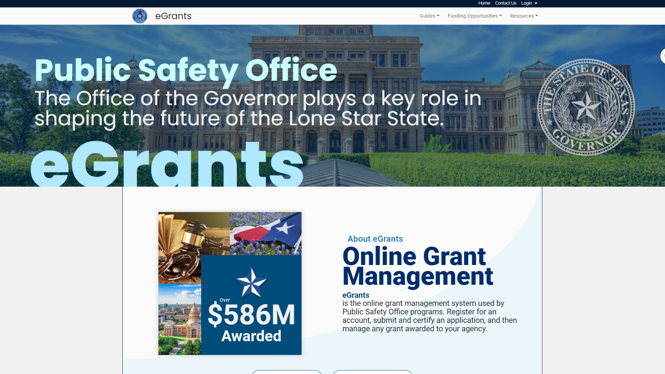

Slide 95

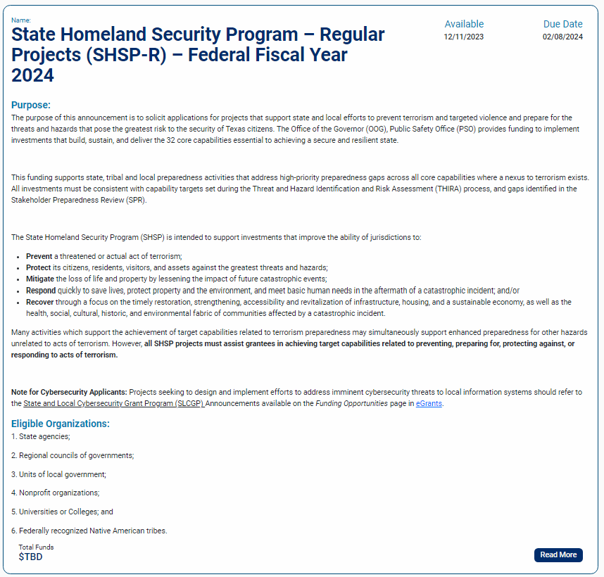
Funding Announcements – Request for Applications (RFA)
Click here to view Active Funding Opportunities
The Request for Applications (RFA) can be found on the eGrants homepage under the Funding Opportunities tab and selecting “Active Funding Opportunities”. Scroll down to find the State Homeland Security Program Regular or LETPA.
Applicants are highly encouraged to read the RFA “Announcement” very carefully.
Click ‘Read More’ to view the funding announcement

Slide 96

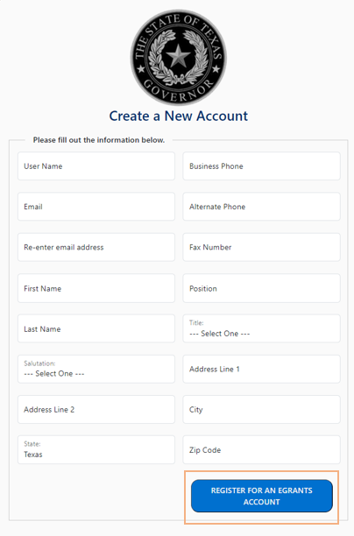
Application Process – eGrants User Account Registration
The Public Safety Office utilizes an Electronic Grant management System know as eGrants Home | eGrants (texas.gov)
eGrants is used to administer all grants made by the PSO.
Applications to the PSO are only accepted though eGrants.
SHSP organizations will need to identify and designate at least three (3) grant officials and register for eGrants User accounts.

Slide 97
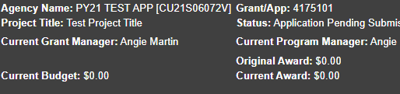

Navigating eGrants
Grant ID
Grant Count ID
Grant Number
Seven-digits consisting of a five-digit Grant ID and a two-digit Grant Count ID.
A grant count ID of “01” indicates a first year project.
A grant count ID greater than “01” indicates the project is a continuation of a previously funded project.
Tabs
eGrants is organized by tabs.
Shows applications and grants assigned to the user
Contains the user's contact information
eGrants application creation process begins here
Update password before it expires every 90 Days

Slide 98
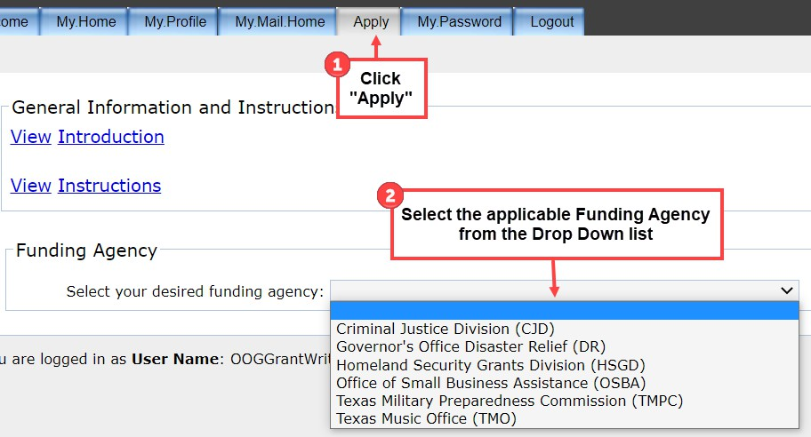
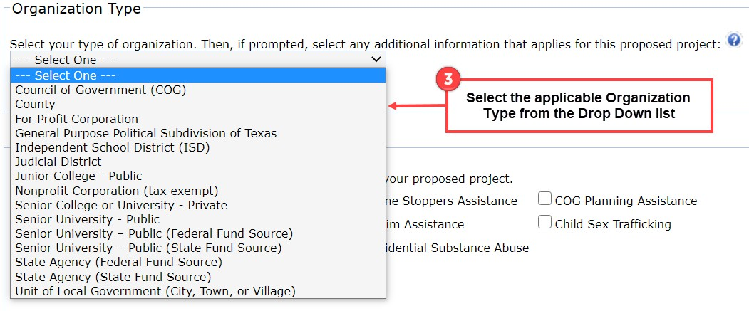
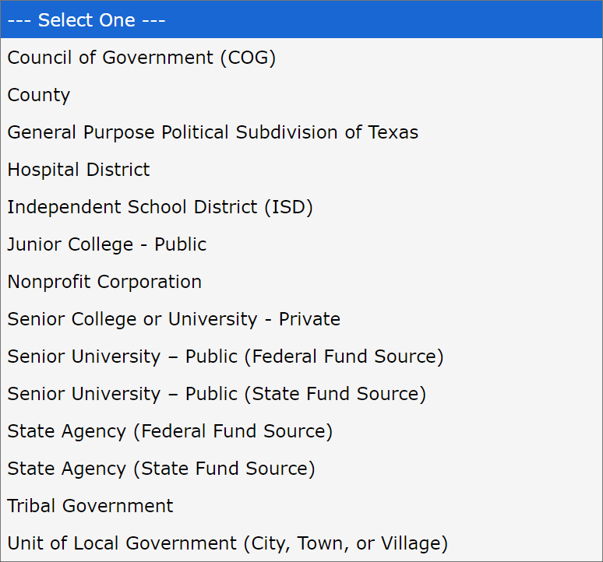


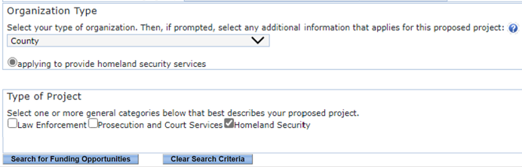
Create an Application
The Office of the Governor’s Public Safety Office (PSO) accepts applications for a wide range of State and Federal grant programs. To find the State Homeland Security Grant Program (SHSP) funding opportunities in eGrants, please follow these steps below:
1
3
2
The Funding agency for the SHSP is the “Homeland Security Grants Division”. The applicable PSO “Funding Agency” for each funding opportunity is identified on the title page of the Funding Announcement located here:
Funding Opportunities | eGrants (texas.gov)
4
5
Click “Search for Funding Opportunities”

Slide 99

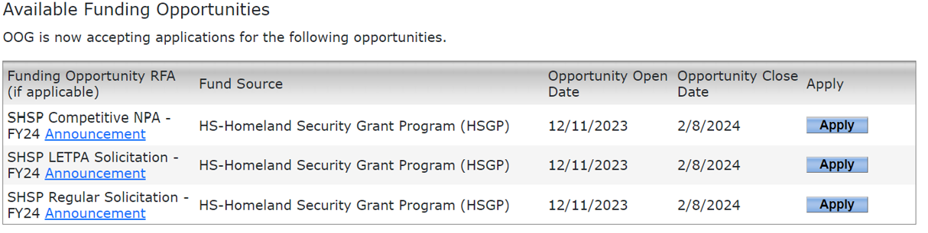
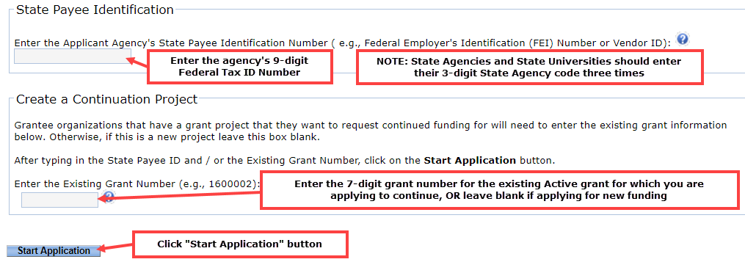
Create an Application
If no grant programs display, click "Clear Search Criteria" and try different selections on the “Type of Project” categories.
Also, review the Funding Announcement to verify the program sought is currently open.
Click “Apply”

Slide 100
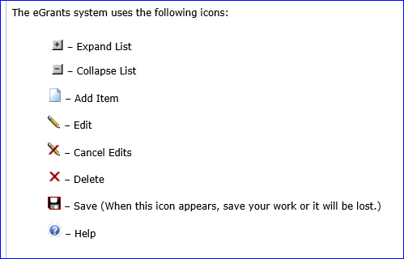
Navigating eGrants
Used on the Budget Tab to create and edit budget line items
Used on the Activities and Measures Tab to enter and save data into the appropriate fields
buttons are used for saving information
entered on each tab
Notes Box (bottom of each tab):
To view all Notes on the grant, go to the Summary/Grant.Issues tab. The Notes feature is used for multiple purposes:
During application review, the Grant Manager (GM) may use this box to type a question or describe an item needing correction;
Provide decisions regarding eligibility/allowability of activities or costs;
Document changes made to entries on the tab; or
An area for applicants to respond to inquiries made by the GM.
The eGrants Notes boxes are not the most effective method of communicating with a PSO GM when you are seeking technical assistance or in need of prompt information. GM’s do not receive notification when Notes are entered and will not see your note until the next time they open your application. A more effective method for routine communications is to send an email to the GM.

Slide 101
Profile Details Tab

Slide 102
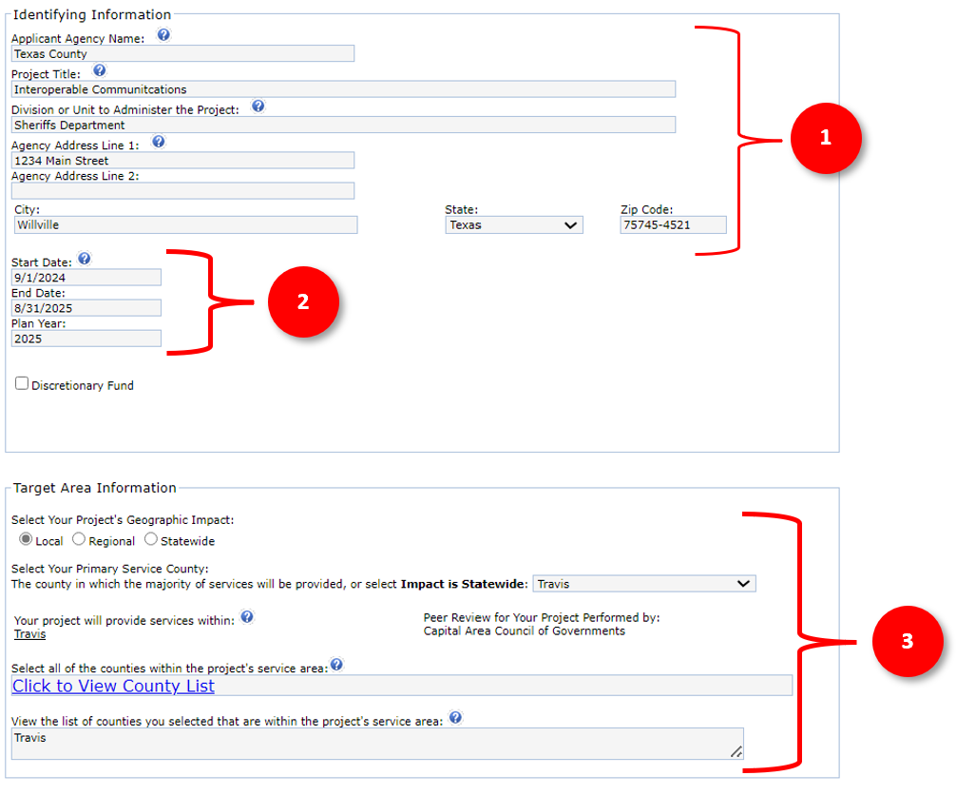
Profile / Details Tab
The Profile Details tab is where you will enter the basic information about the applying organization, the length of time the proposed project will take to complete, and the area this project will benefit.

Slide 103
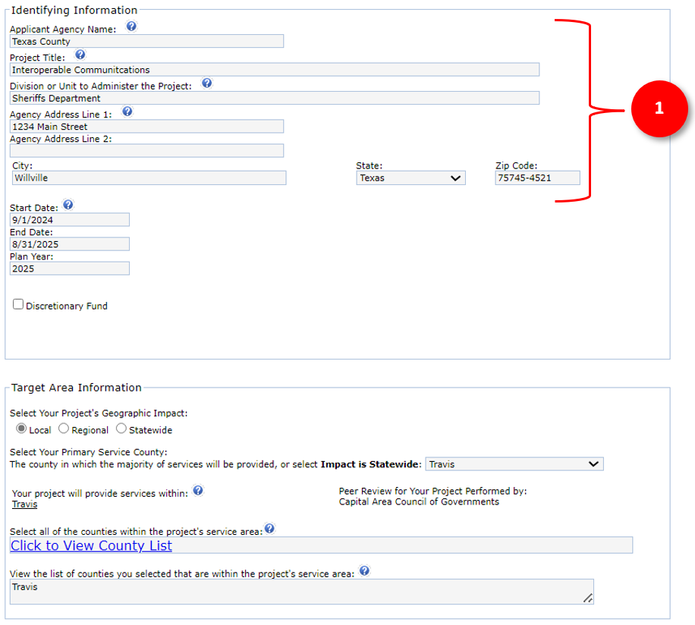
Profile / Details Tab
The Identifying Information section requests the following information:
Applicant Agency Name
  Applicants enter the legal name of the agency requesting funding. Local governments should enter the legal name of a city (“Sample, City of”) or county government (“Sample County”). Applicants should use this standard format so all records within the system can be located by Agency Name in a consistent manner.
Project Title
  The project title should provide an indication of what the project is (Examples: Interoperable Communications, Planning, Fusion Center Sustainment, Special Team Sustainment, etc.).
Division or Unit to Administer the Project
  This information tells the PSO who, within the applying agency will be administering the grant.
Agency Address
This is the physical address for the applying agency and must include the zip code plus four. (Applicants can get this information from the local post office if it is unknown).
Agency Address Line 1
Enter the physical address for this project. If your organization is required to keep this information confidential, please enter a mailing address instead for this project.
  *Common Error: Entering 0000 in the zip plus four.

Slide 104
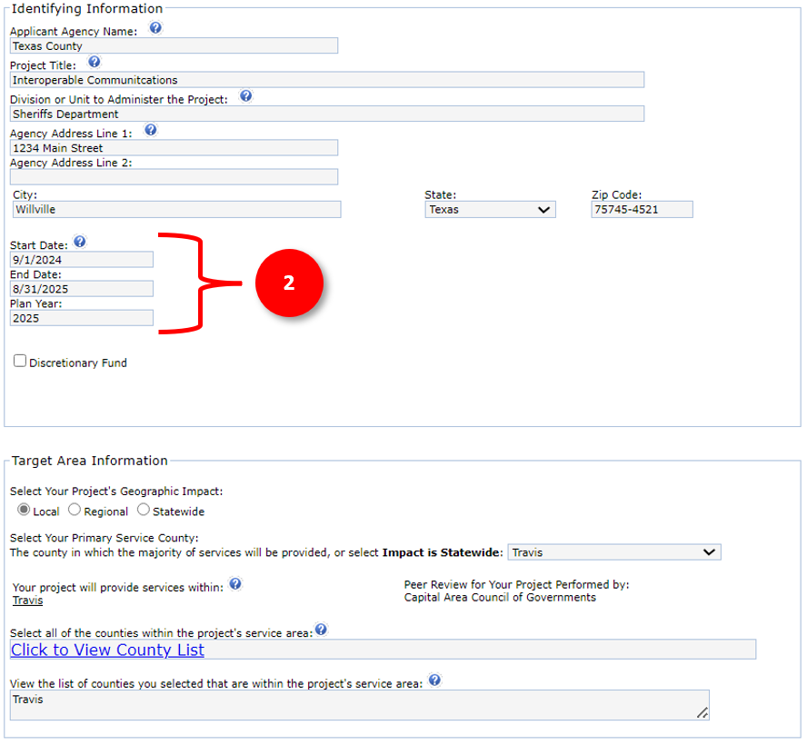
Profile / Details Tab
Project Period of performance Start and end dates:
The period of performance is the time in which the project can be completed.
Start/End Dates
Applications for the FY2025 SHSP must provide a project start and completion date. Project start dates must begin between September 1, 2025, and March 1, 2026, and must be completed no later than August 31, 2027.
Additional guidelines are noted below:
Project periods should be structured so that projects that include grant-funded salaries and/or annual recurring costs do not overlap with the project periods of previous or future grant awards with the same costs
Project periods should be structured so that grants with annual recurring grant-funded expenses are on a 12 or 24-month grant cycle/performance period.
Project periods for equipment only projects are generally awarded for a 6-to-12-month grant period.
HSGD will consider proposed start or end dates following outside of these guidelines on a case-by-case basis.
Awards to subrecipients are typically released in mid October in the year of the application. Applicants should consider a start date of 10/01/2025 as to minimize any loss of performance period if you were considering 9/1/2025.
WARNING: The PSO is unable to provide reimbursements for activities that are incurred before or after the period of performance. Do not begin grant funded activities until you receive the award and are on or past the first day of the Performance period start date.

Slide 105
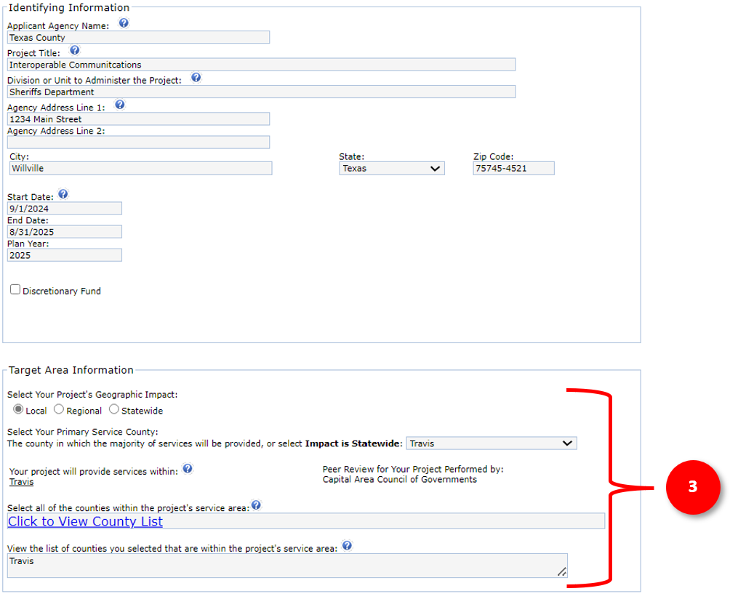
Profile / Details Tab
The Target Area Information section requests the following information:
The Target Area refers to the specific geographical region that the project aims to impact.
Select your Projects Geographic Impact:
Please select the geographical impact of the services or equipment. These are defined as:
  Local – Impacting one County
  Regional – Impacting more than one County
  Statewide – Impacting the entire state (typically state agency projects)
Select Your Primary Service County:
Please select the county where the services or equipment will have the greatest impact or where they will be primarily located.
Select all of the counties within the projects service area:
Please select the all the counties that will be impacted by these grant funded activities.
*NOTE: If the Impact is Local, only one County should be listed under the Service Area. If the Impact is Regional, more than one County should be listed under the Service Area.

Slide 106
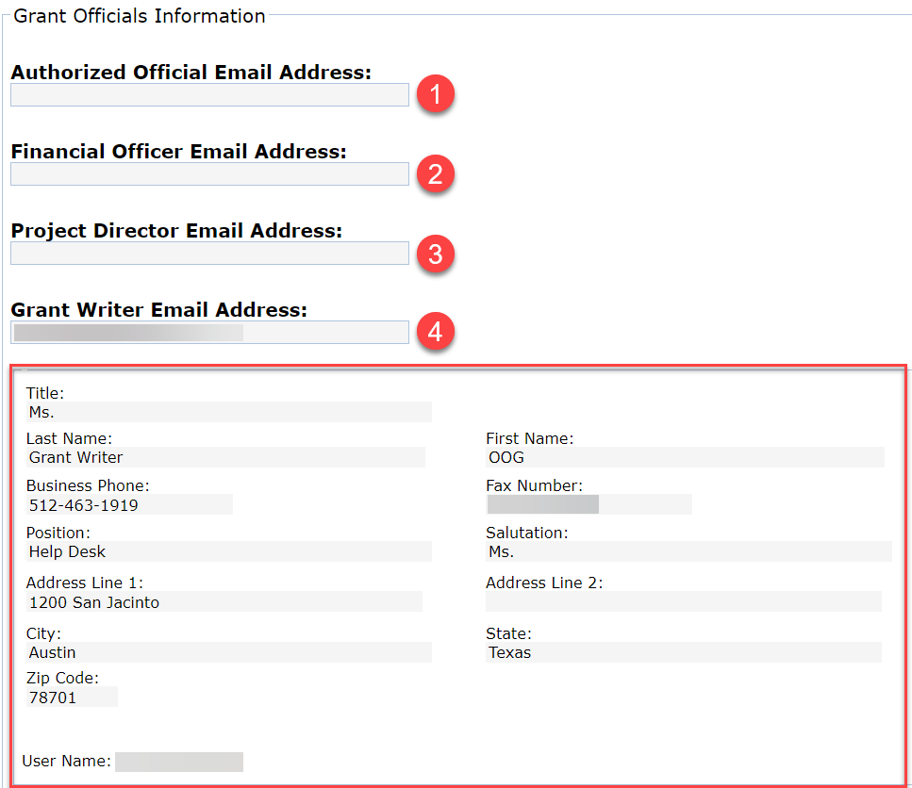
Profile / Details Tab
The Grant Officials Information section requests the following information:
You must assign* four Grant Officials to the application. Insert the email address linked to the designated official’s eGrants account. If the designated official does not have an account, one will need to be established for them. Applicants should use official organizational email addresses only.
These officials must be at least three different people within your organization, the grant writer can be the same person as any of the other officials.
Grant officials must not be related to each other by blood or marriage or have any relationship that creates an actual, potential, or apparent conflict of interest.
*NOTE: Each official must have registered for an eGrants account; you will enter their email address and click “Assign” to link them to the application.

Slide 107
Profile / Details Tab
Authorized Official (AO)
Appointed/authorized by the governing body of the organization.
Authorized individuals are generally the county judge, mayor, chairperson, etc.
Authorized to apply for, accept, reject, alter, or terminate the grant.
Responsible for certifying changes made to applications or grants.
The Authorized Official (AO) is usually a chairman of a non-profit board, executive director, etc.

Slide 108
Profile / Details Tab
Financial Official (FO)
Required to be the chief financial officer (or designee) for the grantee agency.
Responsible for maintaining the financial records to account for all grant funds.
Responsible for requesting funds and the completion of required financial reporting at least quarterly (unless otherwise instructed by the PSO) in eGrants.
The Financial Official (FO) must be either an employee or board member and should be the Chief Financial Officer, Auditor, or Treasurer of the Board for the organization.
Project Director (PD)
Must be an employee of the grantee agency.
Responsible for the day-to-day operations of the project.
Responsible for required programmatic reporting.
The Project Director (PD) must be an employee or member of the organization.

Slide 109
Grant.Vendor Tab

Slide 110
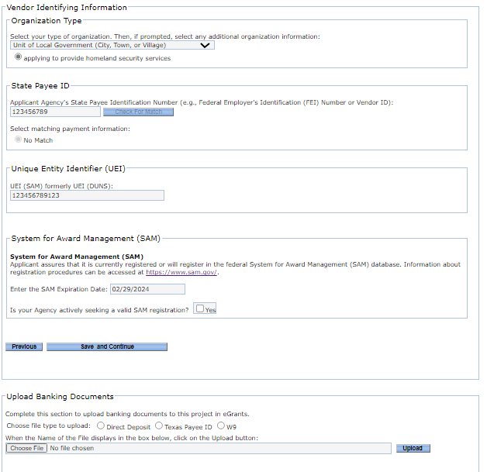
Profile / Grant.Vendor Tab
The Grant Vendor tab will ask you to provide the following information about your organization:
Organization Type – Please select the organization type that most closely aligns.
State Payee ID – This will be one of the following depending on your organization
  EIN: For all ownership codes other than Individual Recipient listed in Section 3, enter a 9-digit Employer Identification Number (EIN) issued by the Internal Revenue Service.
  SSN: For Individual Recipient or Sole Owner without an EIN, enter your 9-digit Social Security number (SSN) issued by the Social Security Administration.
  ITIN: For Individual Recipient or Sole Owner without an EIN, enter your 9-digit Individual Taxpayer Identification Number (ITIN) issued by the IRS.
  Comptroller Assigned Number – 11 digits: FOR STATE AGENCY USE ONLY. A Comptroller Assigned Number is an ID number that is given to a state agency that needs to pay either a foreign entity or a foreign individual who does not have an EIN, SSN or ITIN.
  Current Texas Identification Number – 11 digits: FOR STATE AGENCY USE ONLY. for Award Management (SAM) Expiration
Select Matching Payment Information –Once the State Payee ID is entered click “Check for Match” and if a match is found it will display. Please click the radio button net to the matching enter. If it does not display, click “No Match”.
1
2
3

Slide 111
Profile / Grant.Vendor Tab
The Grant Vendor tab will ask you to provide the following information about your organization:
Unique Entity Identifier (UEI) – Assigned by the Federal System for Award Management(SAM) system. If your Organization does not currently have a UEI number, your agency must obtain one by registering at https://www.sam.gov/.
SAM Expiration Date – Please enter your current SAM expiration date. If you do not currently have a valid SAM registration, but are activity seeking one, please check box next to “Is your Agency actively seeking a valid SAM registration?”
Save and Continue – Please make sure to click the “Save and continue button” to save your progress.
4
5
6

Slide 112
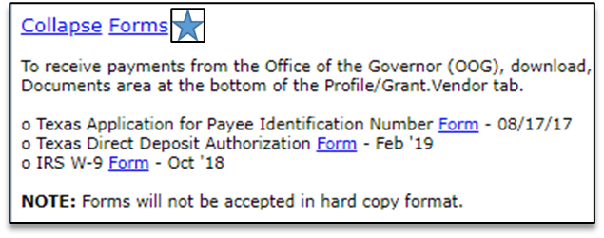
Profile / Grant.Vendor Tab
The Grant Vendor tab will ask you to provide the following information about your organization:
Upload Banking Documents – Applicants are required to upload the following three financial forms:
  Texas Payee ID application
  Direct Deposit Form
  IRS W-9 Form
The financial forms must be complete. Please review and verify all information is correct prior to uploading the files. Incomplete or incorrect information on any of the forms can delay the release of funds if awarded. These forms are the only forms that should be uploaded on this tab. Do not upload these documents into the Upload Files Tab.
*NOTE: The completed forms contain sensitive financial information for your organization and is only used to setup up payment information for applications selected for award. Program staff do not have permissions to view any documentation uploaded on this tab.
7

Slide 113
Narrative Tab

Slide 114
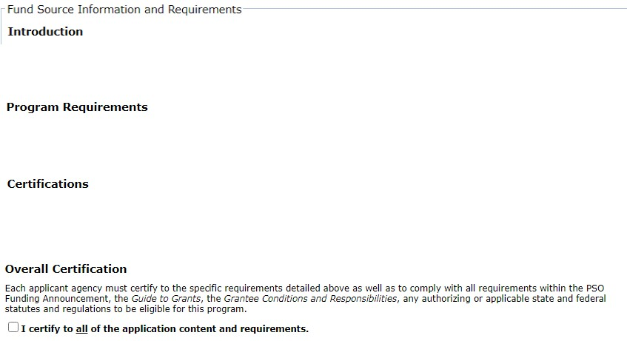
Narrative Tab
The Fund Source Information and Requirements section of the Narrative Tab provides information regarding the program purpose, requirements and responsibilities. Applicants must carefully read and review this information.
The primary purpose of the funding opportunity will be described here.
Includes a list of requirements specific to the funding opportunity or fund source.
Describes rules, laws, guidelines, and other requirements to which the agency must certify for adherence.
NOTE: Applicants must click the
“I certify to all the application content and requirements.” check box prior to submitting the application.

Slide 115
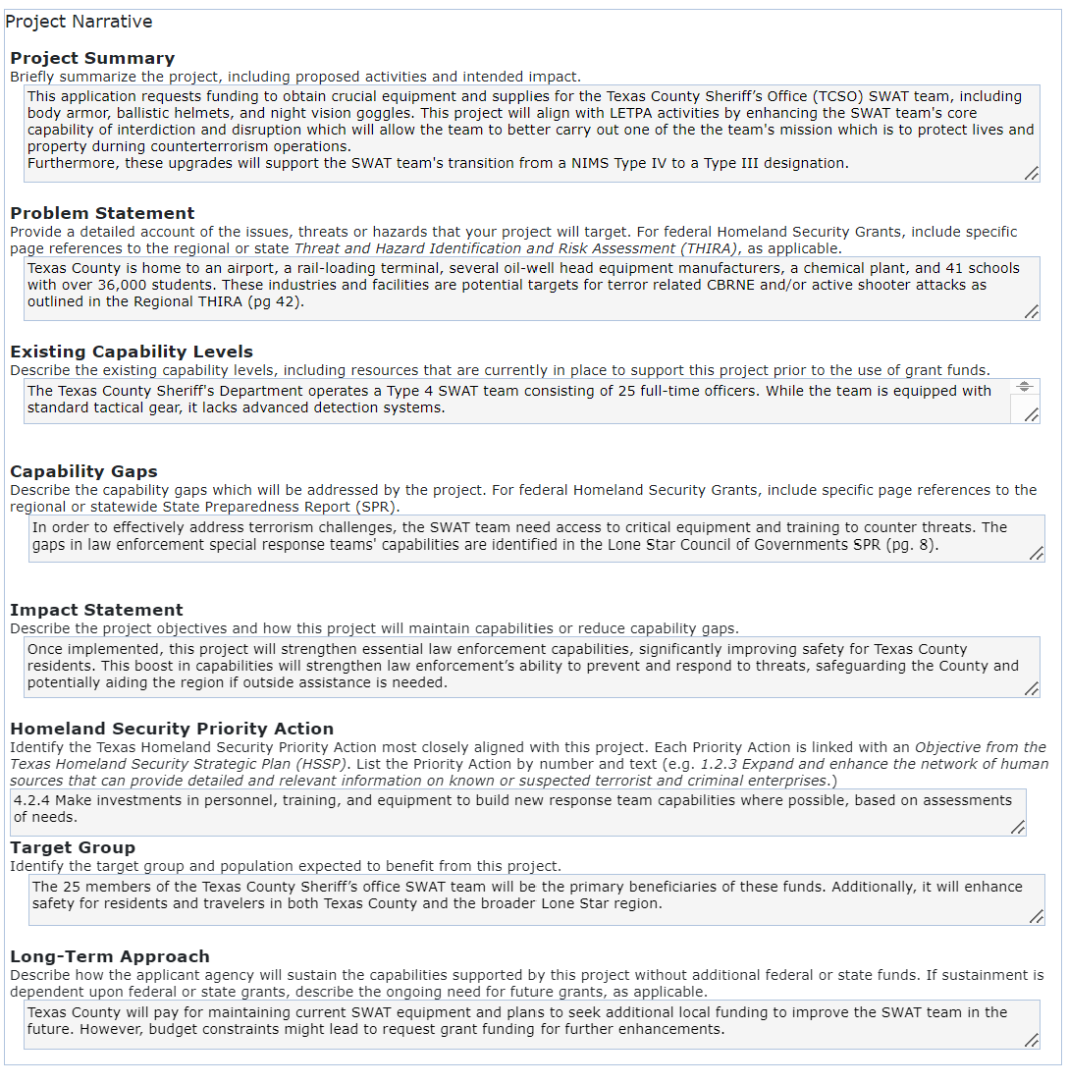
Narrative Tab
Project Narrative
The project narrative is where the applicant provides information regarding what is being requested and why it is needed. The project Narrative is broken into 8 section that ask specific questions. Although there are instructions for each section, simply put, each section is asking the following questions.
1. Project Summary - What are you requesting this grant to fund?
2. Problem Statement - Why is this project necessary to address acts of terrorism and where is that referenced?
3. Existing Capability Levels - What capabilities do you currently have in place to address the "Threat"? In other words, what capabilities do we currently have?
4. Capability Gaps - What Capability Gap will this project address and what and where is this Gap identified in the Regional SPR?
5. Impact - Once completed, what will be the impact in relation to terrorism?
6. Homeland Security Priority Action - Which priority action from the Texas Homeland Security Strategic Plan does this project align with most closely?
7. Target Group – Which group, team, agency or department will have their capabilities enhanced upon the completion of the project?
8. Long-Term Approach - How will the activities being funded be sustained once grant funding ends?

Slide 116
Narrative Tab
SHSP Regular Example
Project Summary Briefly summarize the project, including proposed activities and intended impact.
This project is requesting funds to purchase portable and mobile radios for the City of Masonville Police Department(MPD). These mobile radios will be installed in patrol vehicles and the portable radios will be issued to officers. By enhancing the MPDs operational communications core capability, It will enhance the MPD ability to carry out the response mission area when responding to acts of terrorism.
SHSP LETPA Example
Project Summary Briefly summarize the project, including proposed activities and intended impact.
This application requests funding to obtain crucial equipment and supplies for the Texas County Sheriff’s Office (TCSO) SWAT team, including body armor, ballistic helmets, and night vision goggles. This project will align with LETPA activities by enhancing the SWAT team's core capability of interdiction and disruption which will allow the team to better carry out one of the team's mission which is to protect lives and property during counterterrorism operations. Furthermore, these upgrades will support the SWAT team's transition from a NIMS Type IV to a Type III designation.
The Project Summary must contain the following elements:
Project Description - Provide a brief summary of what you intend to do with the funds being requested.
Mission area and Core Capability - The summary should focus on how the project will affect prevention, protection, mitigation, response and/or recovery from terrorism events. The core capability should also be noted.
LETPA Mission area and Core Capability - LETPA projects may only chose from the protection and prevention mission areas and those allowable core capabilities as defined by FEMA.
Nexus to Terrorism - The purpose of projects funded through HSGP grants must specifically connect to terrorism, not natural disasters. While the project may serve both purposes, the primary purpose for the grant must be terrorism related.
Will this support a NIMS Typed Response Team?
Please be clear and concise. The recommended length of this response is 3-4 Sentences/100 words or less. Additional information will be asked throughout the narrative.

Slide 117
Narrative Tab
SHSP Regular Example
Project Summary Provide a detailed account of the issues, threats or hazards that your project will target. For federal Homeland Security Grants, include specific page references to the regional or state Threat and Hazard Identification and Risk Assessment (THIRA), as applicable.
The City of Masonville’s Police Department must ensure the safety of its residents and travelers. In emergencies, such as a terrorist attack, they might need to mobilize all officers and reservists but lack the funds for enough radios to support this surge. Lone Star Council of Governments THIRA identifies terrorism as a threat on page 8.
SHSP LETPA Example
Project Summary Provide a detailed account of the issues, threats or hazards that your project will target. For federal Homeland Security Grants, include specific page references to the regional or state Threat and Hazard Identification and Risk Assessment (THIRA), as applicable.
Texas County is home to an airport, a rail-loading terminal, several oil-well head equipment manufacturers, a chemical plant, and 41 schools with over 36,000 students. These industries and facilities are potential targets for terror related CBRNE and/or active shooter attacks as outlined in the Regional THIRA (pg. 42).
The Problem Statement must contain the following elements:
1. Terrorism Threat - Please briefly describe what terrorism threats this project will address and how . Since this is a anti-terrorism grant you must reference a corresponding threat related to terrorism in the Applicant’s regional THIRA. This statement should focus on the terrorism threats the project will address.
2. THIRA Reference - Must include reference to the regional THIRA to include page numbers.
Please be clear and concise. The recommended length of this response is 3-6 Sentences/150 words or less. Additional information will be asked throughout the Narrative.

Slide 118
Narrative Tab
SHSP Regular Example
Existing Capability Levels Describe the existing capability levels, including resources that are currently in place to support this project prior to the use of grant funds.
The City of Masonville is currently at an interoperability level 4 with complete radio coverage throughout the city. MPD currently has enough radios to currently meet the needs of each of our shifts, but officers are forced to swap radios at each shift change. While this is adequate under normal conditions, it does not allow for a surge of resources during time of crisis.
SHSP LETPA Example
Existing Capability Levels Describe the existing capability levels, including resources that are currently in place to support this project prior to the use of grant funds.
The Texas County Sheriff's Department operates a Type 4 SWAT team consisting of 25 full-time officers. While the team is equipped with standard tactical gear, it lacks advanced night vision equipment and rifle resistant body armor.
The Existing Capability Levels section should provide a brief overview of the current capabilities or resources available to the Applicant that will support the proposed project. It should address:
1. Capabilities Addressed - What capability will the project enhance, replace, or build upon?
2. Existing Resources - What existing resources will support the project?
Please be clear and concise. The recommended length of this response is 3-4 Sentences/100 words or less. Additional information will be asked throughout the narrative.

Slide 119
Narrative Tab
SHSP Regular Example
Capability Gaps Describe the capability gaps which will be addressed by the project. For federal Homeland Security Grants, include specific page references to the regional or statewide State Preparedness Report (SPR).
MPD currently has 45 Officers, 10 reservists and 12 vehicles. The Department only has 25 portable radios and 8 vehicles with mobile radios. This application is requesting 30 portable radios and 4 Mobile radios which will bolster the terrorism response mission area by addressing regional gaps in the Operational Communications Core Capability identified in the Lone Star Council of Governments SPR listed on page 8.
SHSP LETPA Example
Capability Gaps Describe the capability gaps which will be addressed by the project. For federal Homeland Security Grants, include specific page references to the regional or statewide State Preparedness Report (SPR).
In order to effectively address terrorism challenges, the SWAT team will need access to critical equipment and training to counter threats. The gaps in law enforcement special response teams' capabilities are identified in the Lone Star Council of Governments SPR (pg. 8).
The Capability Gaps section must contain the following elements:
1. Gap Description - Please provide a description of specific gaps the project will address and their connection with gaps discussed in the Stakeholder Preparedness Review (SPR).
2. SPR Reference - Reference the gap as identified in the Regional SPR by providing page number(s).
Please be clear and concise. The recommended length of this response is 3-4 Sentences/100 words or less. Additional information will be asked throughout the narrative.
FUN FACT: FEMA changed the name of the “State Preparedness Report” to “Stakeholder Preparedness Review”!

Slide 120
Narrative Tab
SHSP Regular Example
Impact Statement Describe the project objectives and how this project will maintain capabilities or reduce capability gaps.
Upon completion of this project, the MPD will significantly improve its communication and coordination for large-scale operations, including those involving terrorism. This boost in capabilities will strengthen law enforcement’s ability to prevent and respond to threats, safeguarding the city and potentially aiding the region if outside assistance is needed.
SHSP LETPA Example
Impact Statement Describe the project objectives and how this project will maintain capabilities or reduce capability gaps.
Once implemented, this project will strengthen essential law enforcement capabilities, significantly improving safety for Texas County residents. This boost in capabilities will strengthen law enforcement’s ability to prevent and respond to threats, safeguarding the County and potentially aiding the region if outside assistance is needed.
The Impact Statement section must contain the following elements:
Project purpose - What will the completed project accomplish in relation to terrorism?
Please be clear and concise. The recommended length of this response is 1-3 Sentences/75 words or less. Additional information will be asked throughout the narrative.

Slide 121
Narrative Tab
SHSP Regular Example
Homeland Security Priority Action Identify the Texas Homeland Security Priority Action most closely aligned with this project. Each Priority Action is linked with an Objective from the Texas Homeland Security Strategic Plan (HSSP). List the Priority Action by number and text (e.g. 1.2.3 Expand and enhance the network of human sources that can provide detailed and relevant information on known or suspected terrorist and criminal enterprises.)
4.3.2 Ensure radio systems, equipment, owners, and users are in compliance with the Statewide Communications Interoperability Plan and the Regional Interoperable Communications Plans.
SHSP LETPA Example
Homeland Security Priority Action Identify the Texas Homeland Security Priority Action most closely aligned with this project. Each Priority Action is linked with an Objective from the Texas Homeland Security Strategic Plan (HSSP). List the Priority Action by number and text (e.g. 1.2.3 Expand and enhance the network of human sources that can provide detailed and relevant information on known or suspected terrorist and criminal enterprises.)
4.2.4 Make investments in personnel, training, and equipment to build new response team capabilities where possible, based on assessments of needs.
The Homeland Security Priority Action section must contain the following elements:
1. Homeland Security Priority Action - Must include the Texas Homeland Security Strategic Plan priority that most accurately ties to the project. Please use the following format:
  "1.2.3 Expand and enhance the network of human sources that can provide detailed and relevant information on known or suspected terrorist and criminal enterprises."
The Homeland Security Priority Actions are found in the Texas Homeland Security Strategic Plan 2021-2025.
Applicants/Grantees shall select only ONE action that most accurately ties to the project. Applicants should follow the specific format example provided within the instructional text on the narrative page.
Please be clear and concise. The recommended length of this response is 1 Sentence /25 words or less. Additional information will be asked throughout the narrative.

Slide 122
Narrative Tab
SHSP Regular Example
Target Group Identify the target group and population expected to benefit from this project.
The 55 officers and reservists of the Masonville Police Department will be the main beneficiaries of this project. Additionally, it will enhance safety for residents and travelers in both the City of Masonville and the broader Texas County area.
SHSP LETPA Example
Target Group Identify the target group and population expected to benefit from this project.
The 25 members of the Texas County Sheriff’s office SWAT team will be the primary beneficiaries of these funds. Additionally, it will enhance safety for residents and travelers in both Texas County and the broader Lone Star region.
The Target Group section must contain the following elements:
1. Target Group - The intent is to identify the actual group that will be receiving equipment, training, or salaries funded by the project. For example, if a grant is purchasing equipment for a specialized team, the specialized team is the target group.
2. Population - The population this project will primarily benefit. (City, County, Region)
In some cases, the general population in an area may be the target group.
Please be clear and concise. The recommended length of this response is 1-3 Sentences/75 words or less. Additional information will be asked throughout the narrative.

Slide 123
Narrative Tab
SHSP Regular Example
Long-Term Approach Describe how the applicant agency will sustain the capabilities supported by this project without additional federal or state funds. If sustainment is dependent upon federal or state grants, describe the ongoing need for future grants, as applicable.
While the City would prefer to allocate extra funds to fully address our public safety communication needs, this isn't feasible at present. After purchasing these radios, the city can cover their routine maintenance costs but will likely seek additional grant funding in the future for upgrades or replacements.
SHSP LETPA Example
Long-Term Approach Describe how the applicant agency will sustain the capabilities supported by this project without additional federal or state funds. If sustainment is dependent upon federal or state grants, describe the ongoing need for future grants, as applicable.
Texas County will pay for maintaining current SWAT equipment and plans to seek additional local funding to improve the SWAT team in the future. However, budget constraints might lead to request grant funding for further enhancements.
The Long-Term Approach section must answer the following questions:
1. Describe how the applicant agency will sustain the capabilities supported by this project without additional federal or state funds?
2. If sustainment is dependent upon federal or state grants, describe the ongoing need for future grants, as applicable.
Please be clear and concise. The recommended length of this response is 1-3 Sentences/75 words or less. Additional information will be asked throughout the narrative.

Slide 124
Narrative Examples

Slide 125
Narrative Examples
The PSO would like to provide the following real world narrative examples based on some of our most common project types:
  First Response Teams (LETPA)
  Interoperable Communications
  Community Preparedness
  Intelligence and Information Sharing (LETPA)
  Protection of Soft Targets
  COG Planning
  Emergency Operations Center
Applicants can use these examples as templates when completing the narrative.
The PSO recommends aligning your application closely with the sample narrative examples provided to ensure that all necessary data is collected.

Slide 126
Response Teams - LETPA
Project Type: SWAT Equipment
LETPA: Yes
Investment Area: Support of First Responder Capabilities
Core Capability: Interdiction and Disruption
Capability Gaps
The Lone Star COG regional Stakeholder Preparedness Review identifies planning gaps across all homeland security mission areas. A summary of these gaps is detailed in the planning core capability section of the SPR: In order to effectively address terrorism challenges, the SWAT team need access to critical equipment and training to counter threats. The gaps in law enforcement special response teams' capabilities are identified in the Lone Star Council of Governments SPR (pg. 8).
Impact Statement
Once implemented, this project will strengthen essential law enforcement capabilities, significantly improving safety for Texas County residents. This boost in capabilities will strengthen law enforcement’s ability to prevent and respond to threats, safeguarding the County and potentially aiding the region if outside assistance is needed.
Homeland Security Priority Action
4.2.4 Make investments in personnel, training, and equipment to build new response team capabilities where possible, based on assessments of needs.
Target Group
The 25 members of the Texas County Sheriff’s office SWAT team will be the primary beneficiaries of these funds. Additionally, it will enhance safety for residents and travelers in both Texas County and the broader Lone Star region.
Long-Term Approach
Texas County will pay for maintaining current SWAT equipment and plans to seek additional local funding to improve the SWAT team in the future. However, budget constraints might lead to request grant funding for further enhancements.
Project Summary
This application requests funding to obtain crucial equipment and supplies for the Texas County Sheriff’s Office (TCSO) SWAT team, including body armor, ballistic helmets, and night vision goggles. This project will align with LETPA activities by enhancing the SWAT team's core capability of interdiction and disruption which will allow the team to better carry out one of the team's mission which is to protect lives and property during counterterrorism operations. Furthermore, these upgrades will support the SWAT team's transition from a NIMS Type IV to a Type III designation.
Problem Statement
Texas County is home to an airport, a rail-loading terminal, several oil-well head equipment manufacturers, a chemical plant, and 41 schools with over 36,000 students. These industries and facilities are potential targets for terror related CBRNE and/or active shooter attacks as outlined in the Regional THIRA (pg. 42).
Existing Capability Levels
The Texas County Sheriff's Department operates a Type 4 SWAT team consisting of 25 full-time officers. While the team is equipped with standard tactical gear, it lacks advanced night vision equipment and rifle resistant body armor.
Narrative Examples

Slide 127
Communications
Project Type: Handheld and car mounted radios for Police Dept.
LETPA: No
Investment Area: Interoperable Emergency Communication
Core Capability: Operational Communications
Capability Gaps
MPD currently has 45 Officers, 10 reservists and 12 vehicles. The Department only has 25 portable radios and 8 vehicles with mobile radios. This application is requesting 30 portable radios and 4 Mobile radios which will bolster the terrorism response mission area by addressing regional gaps in the Operational Communications Core Capability identified in the Lone Star Council of Governments SPR listed on page 8.
Impact Statement
Upon completion of this project, the MPD will significantly improve its communication and coordination for large-scale operations, including those involving terrorism. This boost in capabilities will strengthen law enforcement’s ability to prevent and respond to threats, safeguarding the city and potentially aiding the region if outside assistance is needed.
Homeland Security Priority Action
4.3.2 Ensure radio systems, equipment, owners, and users are in compliance with the Statewide Communications Interoperability Plan and Regional Interoperable Communications Plans.
Target Group
The 55 officers and reservists of the Masonville Police Department will be the main beneficiaries of this project. Additionally, it will enhance safety for residents and travelers in both the City of Masonville and the broader Texas County area.
Long-Term Approach
While the City would prefer to allocate extra funds to fully address our public safety communication needs, this isn't feasible at present. After purchasing these radios, the city can cover their routine maintenance costs but will likely seek additional grant funding in the future for upgrades or replacements.
Project Summary
This project is requesting funds to purchase portable and mobile radios for the City of Masonville Police Department(MPD). These mobile radios will be installed in patrol vehicles and the portable radios will be issued to officers. By enhancing the MPDs operational communications core capability, It will enhance the MPD ability to carry out the response mission area when responding to acts of terrorism.
Problem Statement
The City of Masonville’s Police Department must ensure the safety of its residents and travelers. In emergencies, such as a terrorist attack, they might need to mobilize all officers and reservists but lack the funds for enough radios to support this surge. Lone Star Council of Governments THIRA identifies terrorism as a threat on page 8.
Existing Capability Levels
The City of Masonville is currently at an interoperability level 4 with complete radio coverage throughout the city. MPD currently has enough radios to currently meet the needs of each of our shifts, but officers are forced to swap radios at each shift change. While this is adequate under normal conditions, it does not allow for a surge of resources during time of crisis.
Narrative Examples

Slide 128
Community Preparedness
Project Type: Community Emergency Response Team (CERT)
LETPA: No
Investment Area: Community Preparedness and Resilience
Core Capability: Community Resilience
Capability Gaps
Community preparedness initiatives, like CERT teams, play a crucial role in easing the burden on first responders by empowering citizens to handle minor injuries and straightforward rescues on their own or assist their neighbors. This enables first responders to focus on more serious and dangerous situations, leading to better outcomes for both the public and emergency personnel. The goal is to strengthen the terrorism Mitigation Mission Area by addressing regional gaps in the Community Resilience Core Capability, as outlined on Page 8 of the Lone Star Council of Governments SPR.
Impact Statement
Upon completion of this project, a larger portion of Masonville’s citizens will gain a basic understanding of how to protect themselves, their families, and neighbors during emergencies, including acts of terrorism. This improved capability may reduce the demand on first responders for situations that could be managed by trained citizens. Ideally, this will enable first responders to concentrate on more critical and dangerous incidents, enhancing outcomes for both the public and emergency personnel.
Homeland Security Priority Action
3.3.1 Expand and enhance local jurisdiction and citizen capabilities through participation in Citizen Corps and other individual and community preparedness programs.
Target Group
The CERT Program will be managed by the Masonville Emergency Management Department, but it is designed to benefit the entire community, particularly those who participate in the available CERT training courses.
Long-Term Approach
Once the program is reestablished, the city commits to covering all maintenance costs and will allocate local funding to the program annually. Additional grants may be sought when the program advances from a basic to a more advanced level.
Project Summary
This project seeks funding to support the City of Masonville's Community Emergency Response Team (CERT) program. It will cover costs to establish a CERT coordinator in the emergency management department, including training and basic office supplies. The coordinator's role includes promoting, coordinating, and training CERT volunteers, and the funding will also allow them to attend advanced CERT “Train the Trainer” courses. This project supports the mitigation mission area by enhancing the Community Resilience core capability by empowering individuals and communities to make informed decisions to facilitate actions necessary to adapt to, withstand, and quickly recover from terrorist attacks.
Problem Statement
The City of Masonville, with its mix of manufacturing, critical infrastructure, and entertainment venues, could be a potential target for terrorist attacks as identified in the Lone Star COG THIRA on pg. 6. To address the strain such an event would place on emergency response resources, it is crucial to educate residents on emergency procedures and how they can support response teams as force multipliers. The City of Masonville Community Emergency Response Team (CERT) project aims to build an effective community response before, during, and after major disasters through three key objectives: community engagement, information and training, and partnership development. Community resilience relies on factors such as awareness, economic and environmental health, and support from public and private programs, agencies, and organizations. The preparedness of individuals, families, and the community is essential for successfully responding to and recovering from major disasters.
Existing Capability Levels
The City of Masonville currently lacks a community emergency education training program. However, the City’s Emergency Management Department has experience running a CERT program, which was active from 2009 to 2015 before being discontinued due to funding issues.
Narrative Examples

Slide 129
Intelligence Gathering and Analysis
Project Type: Support for a recognized Fusion center
LETPA: Yes
Investment Area: Information and Intelligence Sharing/Cooperation
Core Capability: Intelligence and Information Sharing
Capability Gaps
This grant will enable the Texas County Fusion Center to bolster the mission area of prevention by addressing the capability gaps in intelligence and information sharing, as highlighted on page 87 of the Lone Star Stakeholder Preparedness Review.
Impact Statement
Upon completion of this project, the Texas County Fusion Center capacity to detect potential terrorist threats through enhanced information and intelligence collection and analysis will be significantly improved. This increase in capabilities will bolster law enforcement’s ability to prevent threats, thereby protecting the county and potentially assisting the region if necessary.
Homeland Security Priority Action
1.1.1 Enhance intelligence coordination and collaboration across the state's network of intelligence nodes and with federal partner organizations, to include development of common processes and standards for recognized fusion centers.
Target Group
The Texas County Fusion Center, located within the Texas County Sheriff's Office, will be the main recipient of this grant. Additionally, the grant will benefit the entire region by facilitating the sharing of information to prevent terrorist activities.
Long-Term Approach
In previous years, TCFC partner agencies contributed funds towards the sustainment of the TCFC. However, these funds do not cover all the necessary costs to operate a fusion center fully and effectively. The TCFC will look to all available funding sources for future sustainment, including grant funds and funding from the City of Masonville and partner agencies.
Project Summary
This project provides funding for six analysts at the Texas County Fusion Center (TCFC) to uphold essential homeland security functions, such as gathering, analyzing, and distributing intelligence to thwart terrorist and cyber attacks. This project ensures the timely and relevant sharing of actionable information and analysis with local, state, tribal, territorial, federal, private sector, and international partners, and supports the development and dissemination of appropriate classified and unclassified products. It aligns with LETPA activities by bolstering the Prevention mission area, sustaining our counterterrorism Intelligence and Information Sharing core capability.
Problem Statement
The Lone Star Council of Governments THIRA, starting on Page 21, outlines the terrorism risks facing the region. To identify these threats proactively, specialized personnel, training, software, and equipment are essential. The Texas County Fusion Center (T.C.F.C) acts as the central information and intelligence hub for the Sheriff’s Office, aiming to boost its effectiveness by collecting and analyzing data, providing actionable intelligence, and safeguarding citizens. Additionally, the center will foster partnerships with local, state, and federal law enforcement agencies, as well as private sector entities, to enhance information sharing and threat assessment, thereby improving security across the region.
Existing Capability Levels
The Texas County Fusion Center currently has the personnel, systems, and software needed to collect, process, and distribute actionable information. While the center can analyze data, some of its systems are outdated or incompatible with current technologies and need updating. Additionally, analysts require specialized training to effectively use the new technologies.
Narrative Examples

Slide 130
Physical Site Protection
Project Type: Enhance security at critical infrastructure site.
LETPA: No
Investment Area: Protection of Soft Targets/Crowded Places
Core Capability: Physical Protective Measures
Capability Gaps
As mentioned on page 17 of the Lone Star COG SPR, there are gaps in the protection of critical infrastructure. This application seeks to address these gaps by requesting physical security upgrades at drinking water facilities, which may be vulnerable to malicious actors, including terrorists, who could potentially use chemical or biological attacks to harm a large population.
Impact Statement
Upon completion of this project, the vulnerabilities of the City of Masonville’s water supply will be significantly reduced. This will help protect the public from potential threats posed by terrorists or other malicious actors. Enhanced security measures will ensure a safer water supply for the community.
Homeland Security Priority Action
4.7.7 Enhance local jurisdictions' preparedness to secure special events and soft targets and to respond to mass casualty attacks and provide guidance and templates to support local planning.
Target Group
The City of Masonville Water Department lift stations (approx. 9), Wastewater Treatment Facility (approx. 3), and Approx. 2400 citizens in the City of Masonville water district.
Long-Term Approach
Once this equipment is installed, the city will cover all ongoing maintenance costs. If additional vulnerabilities are identified, the city may seek additional grants.
Project Summary
This project seeks funding to install video surveillance cameras, access controls, and detection alarms at key infrastructure sites across the City of Masonville. These security measures will be implemented at the Water Treatment Plants and the Water Department storage facility to bolster the sites protection. By strengthening these critical infrastructure facilities, the project aims to reduce the risk of terrorist and criminal activities and enhance situational awareness during an incident. This initiative supports the protection mission area by improving the Physical Protective Measures core capability, specifically by fortifying drinking water facilities against potential threats
Problem Statement
The City of Masonville, located along US Highway 253, TX Highway 47, and Highway 17—a major route for terrorist and criminal activities—hosts vulnerable infrastructure such as pipelines and a water treatment facility. These facilities are at risk of tampering and potential mass destruction and are currently only protected by chain link fences. To enhance security, this project aims to install comprehensive security equipment to protect these facilities from terrorist attacks and criminal activities. The Lone Star Council of Governments THIRA, starting on Page 21, outlines the terrorism risks facing the region.
Existing Capability Levels
The City of Masonville currently relies on basic door and gate locks to prevent unauthorized access to sensitive drinking water infrastructure. Although these areas have not yet been targeted, upgrading the security measures is essential to safeguard their operations from terrorist attacks.
Narrative Examples

Slide 131
Emergency Management
Project Type: Software and Emergency Operations Center Upgrades.
LETPA: No
Investment Area: Emergency Operations Center Technology and Enhancements
Core Capability: Operational Coordination
Capability Gaps
This project will support the Operational Coordination core capability by increasing situational awareness for better command and control before and after a terrorism as noted on page 6 of the LSCOG SPR.
Impact Statement
Once completed this project will allow for better coordination of resources and personnel during a terrorist attack.
Homeland Security Priority Action
4.1.4 Enhance connection and integration of common operational picture, resource management, and other decision support tools across agencies and operations centers to ensure shared federal, state, and local situational awareness during incidents.
Target Group
The Texas County Emergency Operations Center, located within the Texas County Emergency Management department, will be the main recipient of this grant. Additionally, the grant will benefit the entire region by enhancing of proper Command and Control need to prevent terrorist activities.
Long-Term Approach
Once this equipment is installed, the County will cover all ongoing maintenance costs. If additional vulnerabilities are identified, the County may seek additional grants.
Project Summary
This application seeks funding for computers, TVs, backup generators, and Web EOC licenses for the Texas County Emergency Operation Center. This project supports the Operational Coordination Core capability of our Texas County which benefits all five mission areas. These upgrades will help to ensure a unified and coordinated operational structure during a terrorist attack on our county.
Problem Statement
Texas County is home to an airport, a rail-loading terminal, several oil-well head equipment manufacturers, a chemical plant, and 41 schools with over 36,000 students. These industries and facilities are potential targets for terror related CBRNE and/or active shooter attacks as outlined in the Regional THIRA (pg. 42).
Existing Capability Levels
At present, LSCOG employs two personnel to assist with managing the State Homeland Security Program grant and supporting emergency management and homeland security planning efforts. Currently, the Texas County Emergency operations center is running on donated equipment from the early 2000's. The replacement of this equipment will allow better command and control during terrorist attacks.
Narrative Examples

Slide 132
Planning
Project Type: COG Planning to complete the Regional THIRA and SPR.
LETPA: No
Investment Area: Planning - Homeland Security
Core Capability: Planning
Capability Gaps
The Lone Star COG regional Stakeholder Preparedness Review identifies planning gaps across all homeland security mission areas. A summary of these gaps is detailed in the planning core capability section of the regional SPR. Although emergency operations plans and related annexes are in place, participation from some regional agencies has been limited. Furthermore, there has been a lack of seamless integration between emergency management and homeland security plans. Some regional planning efforts have not been fully integrated at the local level. Existing plans need maintenance, updates, and revisions. Ongoing operational, strategic, and pre-incident planning is essential for the region (LSCOG SPR, pg. 5).
Impact Statement
This project will address the region's planning gaps across the mission areas of prevention, protection, mitigation, response, and recovery. It aims to further enhance homeland security by promoting cooperation, collaboration, and training with local, state, and federal partners. Regional planning efforts will continue to strengthen and sustain resilience by encouraging jurisdictions to work together in developing, training, and equipping themselves to a unified standard and strategy for mitigating, responding to, and recovering from terrorist attacks, man-made incidents, or natural disasters.
Homeland Security Priority Action
4.7.1. Periodically review, update, and upgrade emergency and disaster-related plans statewide, and ensure these plans account for people with disabilities or other access and functional needs.
Target Group
Lone Star Council of Governments will be the primary beneficiary of this application. The citizens of the entire region will also benefit from this project as well.
Long-Term Approach
The Lone Star COG Homeland Security Program will always require financial support via state and federal grant funds due to the nature of its organizational structure, and the unique role it plays within the region. If additional vulnerabilities are identified, the COG may seek additional grants.
Project Summary
This funding will enable the Lone Star Council of Governments to complete the regional Threat and Hazard Identification and Risk Assessment (THIRA) and Stakeholder Preparedness Review (SPR). It will also enhance our regional planning, coordination, and staff support for homeland security, while managing grant-funded activities related to these efforts. This project supports the Planning Core capability of our organization, benefiting all five mission areas. By developing plans with actionable strategies, it will enhance our region's ability to prevent or respond to imminent terrorist threats within the United States.
Problem Statement
The Lone Star region encompasses significant agricultural, energy, and population centers that could be targeted by a terrorist attack as a means of making a statement. Unfortunately, many jurisdictions and agencies within the LSCOG are significantly underprepared for such an event. This project aims to address the gaps in planning at both the regional and local levels. At a minimum, LSCOG Homeland Security Planners will oversee the creation of the Regional Homeland Security Implementation Plan (HS-IP), the regional Threat and Hazard Identification and Risk Assessment (THIRA), and the Stakeholder Preparedness Review (SPR). Additionally, the planner will handle regional and local homeland security and emergency management/terrorism response planning. The need to maintain, update, and revise plans is stated on page 5 of the LSCOG THIRA.
Existing Capability Levels
At present, LSCOG employs two personnel to assist with managing the State Homeland Security Program grant and supporting emergency management and homeland security planning efforts. The COG staff are provided with computers, cell phones, and other essential operational equipment to facilitate planning and technical assistance within the LSCOG region.
Narrative Examples

Slide 133
Activities Tab

Slide 134
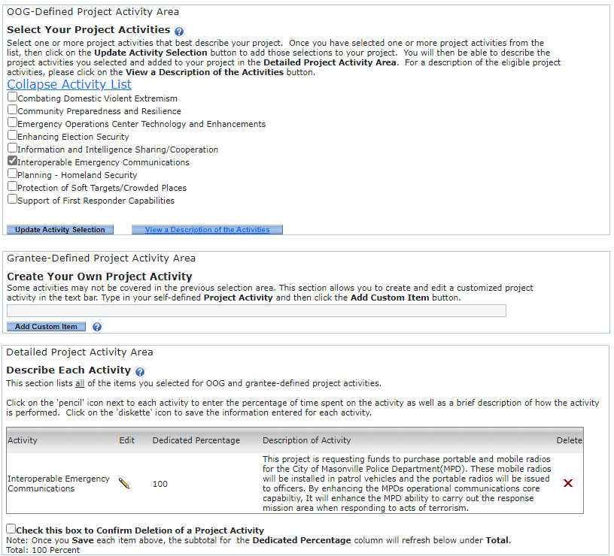
Activities Tab
Homeland Security Grant Program (HSGP) applicants must only select one project activity.
The eGrants system will allow multiple selections, but each HSGP subrecipient project must fit into one and only one of the Investment Categories that are listed as project activities under the "Activity List".
Do not create a custom measure!

Slide 135
Activities Tab
1
You will provide the following information about your organizations:
Project Activity Area- Please select from one of the preselected activity areas. Activity areas are also called investment areas. It is how the state tells FEMA the types of projects we are investing in.
Description of activities – You may find a definition for each of the activity areas listed to aid in aligning your project to the correct activity.
Describe Each Activity. - Provide a 2 to 4 sentence summary that identifies the following :
  By whom and How will these funds be utilized?
  What is the Nexus to terrorism?
2
3
Example Description of Activity
This project is requesting funds to purchase portable and mobile radios for the City of Masonville Police Department (MPD). These mobile radios will be installed in patrol vehicles and the portable radios will be issued to officers. By enhancing the MPD's operational communications core capability, the MPDs ability to carry out the response mission is improved when responding to acts of terrorism.

Slide 136
Measures Tab

Slide 137
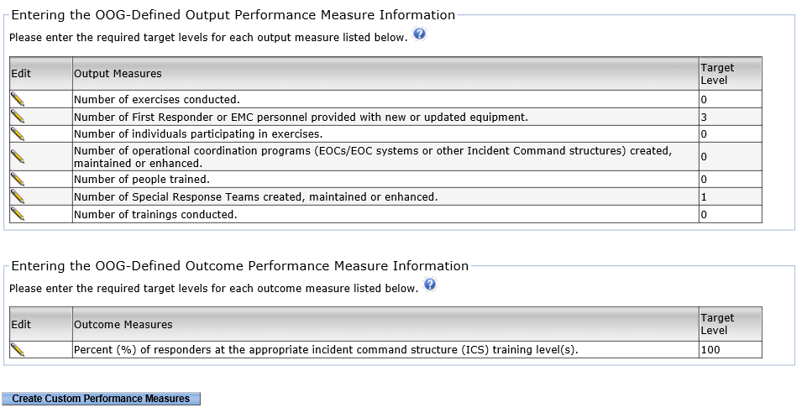
Measures Tab
The Measures Tab helps us understand how well a project improves safety and the skills of responders. It has two parts: Output Measures and Outcome Measures.
Output Measures: These metrics illustrate the project's achievements, including the number of workshops conducted or the quantity of equipment provided to first responders.
Outcome Measures: These indicators reflect the long-term impacts of the project, such as enhancements to systems or improved training for responders.
Both types of measures have "Target Levels" which are specific goals for what the project hopes to achieve.
Every Activity includes the following measures:
  Number of exercises conducted
  Number of individuals participating in exercises
  Number of people trained
  Number of trainings conducted

Slide 138
Measures Tab
When you choose an activity in the Activities tab, eGrants will automatically fill in some measures for you. Both the Output and Outcome measures have "Target Levels“ which are specific goals for what the project hopes to achieve.
Every Activity includes the following Output Measures:
Number of exercises conducted
Number of individuals participating in exercises
Number of people trained
Number of trainings conducted
Each project is unique, so the automatically populated measures might not always be relevant. For example, if the grant is funding activities that include exercises or trainings, then you will enter your target goals for those measures. If the grant isn’t funding these activities, you should enter zero (0) for those measures instead of providing target goals.
Every project should include at least one relevant measure. The applicant might need to consult with their Grant Manager during the application review to make sure the correct measures are set for the proposed project.

Slide 139
Measures Tab
The "Create Custom Performance Measures" button lets applicants develop their own performance measures, which must comply with the same rules as the OOG-Defined Performance Measures. In most cases, custom measures are not needed. Only include measures that are relevant to the grant-funded activities and avoid duplicating the OOG-Defined Performance Measures.

Slide 140
Budget Tab

Slide 141
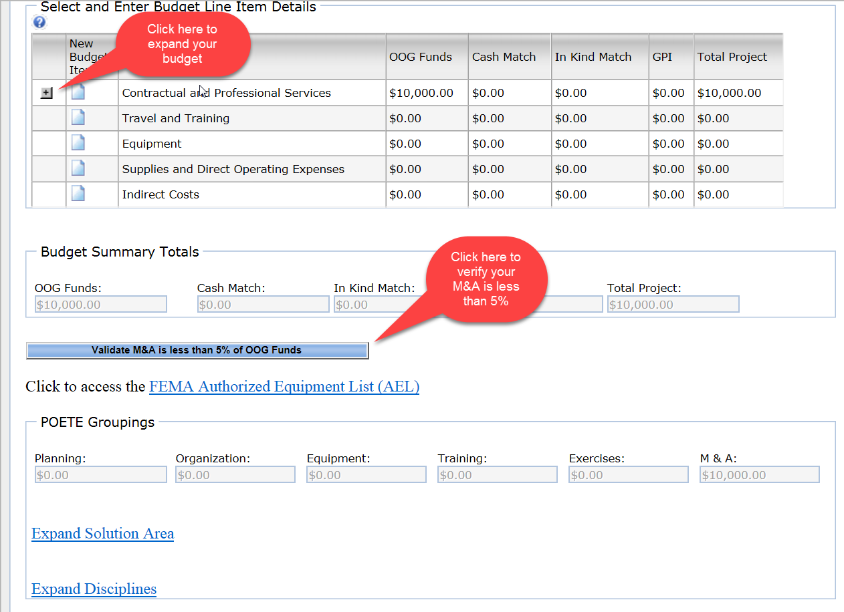
Budget / Details Tab
Creating Budget Line Items (BLI):
The budget tab is where you will tell the PSO what your specific budget costs will include.
Your budget will need to be broken down into different categories, depending upon planned costs.
Validate M&A expenses (If applicable)

Slide 142
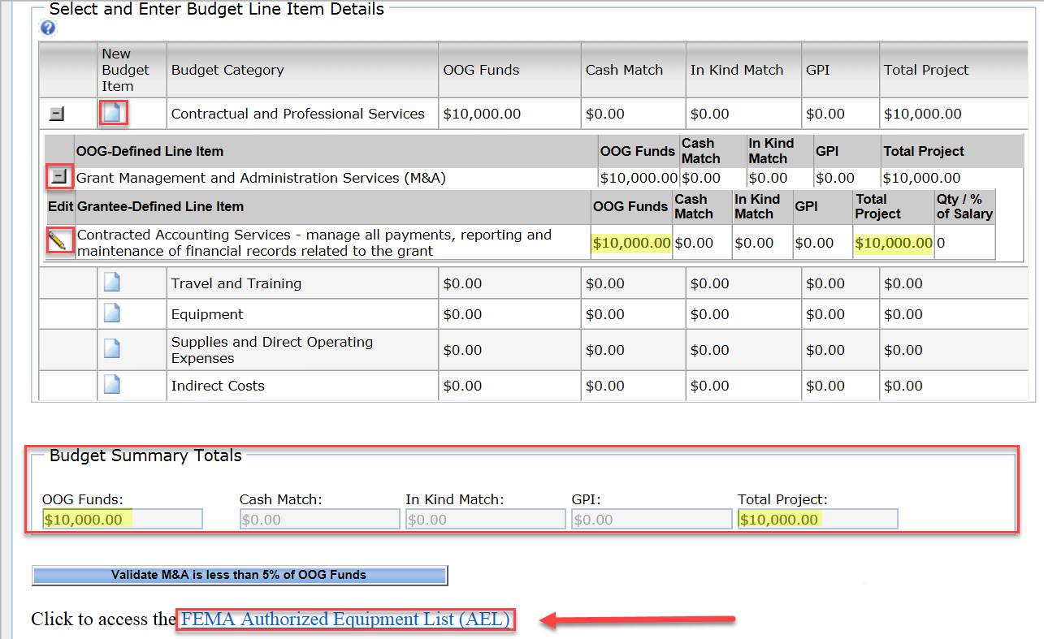
Budget / Details Tab
Creating Budget Line Items (BLI)
Please remember:
The “+” sign = Expand
The folded paper icon = Add
The pencil icon = Edit
The system calculates the “Budget Summary Totals”
There is a link to the FEMA AEL List under this tab

Slide 143
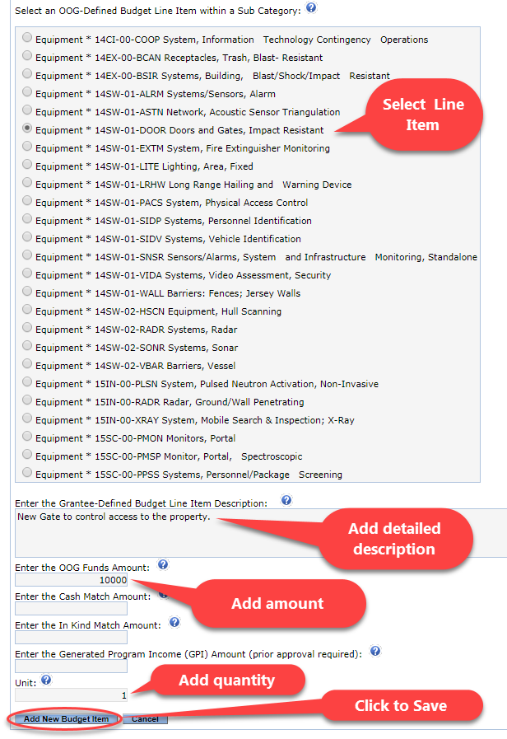
Budget / Details Tab
Creating Budget Line Items (BLI):
For each line item you are budgeting for, you will need to:
Select a radio button for the most appropriate OOG-defined line item
Provide a detailed description of the line item
Enter the Total amount to be spent on that Item(s)
List the units (a quantity is required for equipment)
Click “Add New Budget Item” to save your entry

Slide 144
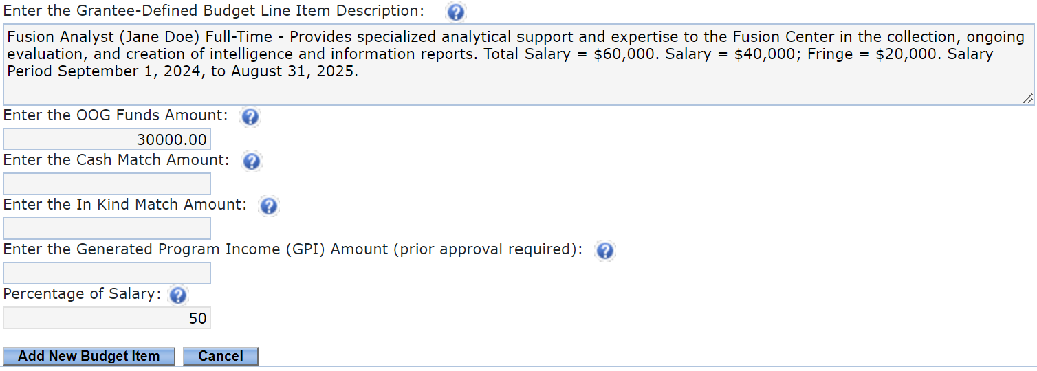
Budget / Details Tab: Personnel
Positions listed in Personnel must be employees (current/future) of the applicant agency, not contractors or positions within another organization.
Line-Item Descriptions must include:
Position Title
Name or Initials of Employee
Full-time/part-time status
Time period/date range
Description of duties or tasks related to the grant
Breakdown of Cost (Salary and Fringe)
(OOG Funds) / (Annual Salary + Fringe) = % of Salary
Overtime
Overtime costs for personnel, such as certified public safety officers and law enforcement direct support personnel (i.e., Communication Officers/Dispatchers, non-sworn law enforcement personnel), must be listed on a separate line item by type of work performed. All OT should use a standard description for the type of position and include the estimated hours, average OT rate for that position, and total budgeted. The “Qty/% of Salary” for overtime is always 100%. Note: although % of salary for OT personnel is always 100%, grant-funded personnel working overtime MUST maintain time and activity reports, periodic certifications would not be sufficient in place of activity reports.

Slide 145
Budget / Details Tab: Personnel – Overtime & Backfill
Overtime costs for personnel, such as certified public safety officers and law enforcement direct support personnel (i.e., Communication Officers/Dispatchers, non-sworn law enforcement personnel), must be listed on a separate line item by type of work performed. All OT should use a standard description for the type of position and include the estimated hours, average OT rate for that position, and total budgeted. The “Qty/% of Salary” for overtime is always 100%. Note: although % of salary for OT personnel is always 100%, grant-funded personnel working overtime MUST maintain time and activity reports, periodic certifications would not be sufficient.
Backfill VS Overtime
Backfill
A backfill employee is when the Applicant temporarily replaces an employee who is responding to an incident, training, or exercise. Overtime costs for the backfill employee may be eligible even if the backfill employee is not performing eligible work as long as the employee that he/she is replacing is performing eligible Emergency Work.
Overtime
Overtime Employee refers to a current employee who works extra hours beyond their regular work schedule.
Allowable Overtime & Backfill Purposes:
Overtime for information, investigative, and intelligence sharing activities (up to 50% of the allocation).
Overtime and backfill for emergency preparedness and response personnel attending DHS/FEMA-sponsored and approved training classes.
Overtime and backfill expenses for part-time and volunteer emergency response.
Overtime and backfill costs, including expenses for part-time and volunteer emergency response personnel participating in DHS/FEMA exercises.

Slide 146
Budget / Details Tab: Personnel Budget Line-Item Examples
Fusion Analyst
Budget Code: Analyst (Organization)
Fusion Center Analyst (Jane Doe) Full-Time - Provides specialized analytical support and expertise to the Fusion Center in the collection, ongoing evaluation, and creation of intelligence and information reports. Total Salary = $60,000. Salary = $40,000 plus Fringe = $20,000. Salary period September 1, 2024, to August 31, 2025.
Planner
Budget Code: Planner (Planning)
Planner (Bill Billson) Full-Time -- Assists in the creation of plans including THIRA, SPR, Implementation Plans; coordinates annual regional emergency alerting network exercise; assists local jurisdictions with Emergency Operations Plans annex updates upon requests; coordinates other emergency regional planning needs as they arise; assists and coordinates events and meetings that align with homeland security initiatives. Total Salary is $115,092.56 ($73,121.07 Salary + $41,971.49 Fringe). Salary period is 09.01.2024 - 08.31.2025.
Training Coordinator
Budget Code: Specialist (Training)
Training Specialist (Kathy Smith) FULL TIME: Performs entry-level Training Assistance work. Work involves assisting with the preparation of educational and training programs. Complies reports on training programs and maintains training records,. Organizes and prepares materials and supplies for training such as notebooks, handouts, flip-charts, projectors, laptops, and other resources. Enters data into the Training Database (www.preparingLonestar.org), generates students transcripts, class roster, and reports Salary: $34,127.25 & Benefits: $10,538.49 = $44,665.7 Salary Period 09/01/2025- 08/31/2026
Overtime
Budget Code: Overtime and Backfill for Employees Attending Training (Training)
Overtime for 20 Masonville Fire Department personnel to attend the Vehicle Rescue Operations course held at the Texas County College training facility. BLI will be updated with training dates once known. Overtime according to local OT policy - estimate of 2,535 hours at an average OT rate, including fringe benefits, of $53.27/hr - up to the amount of $135,000.

Slide 147
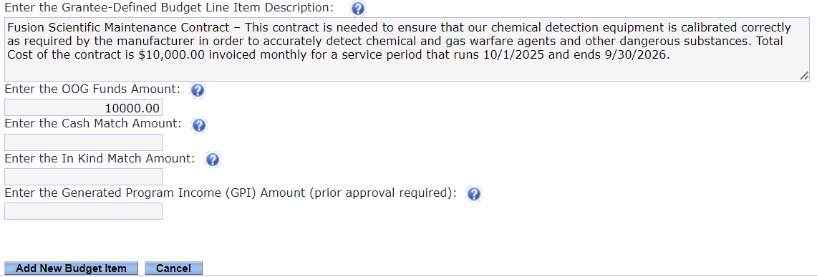
Budget / Details Tab: Contractual & Professional Services
Contractual and Professional Services include services and assistance obtained from other organizations to support the project scope of work.
Line-Item Descriptions must include:
A detailed description of services to link the service being provided to the grant activity.
How the payment for services is calculated (NOTE: contract costs should be pro-rated to fit within the grant period).
Line items must be separated by vendor or contract/service
Common Issues
Not enough information on the purpose of the contract Direct Operating Expenses placed in this area Personnel/employees of the Grantee placed in this budget category

Slide 148
Budget / Details Tab: Contractual & Professional Services
Personnel Contracts (Training Consultant)
Budget Code: Consultant (Training)
Training Consultant - Support for Training. Lone Star COG to provide support and training to stakeholders throughout the region. USFA Type 3 All-Hazard Incident Management Team Training Introduction course; In-person training for 25 participants in Masonville TX, March 27 to March 31, 2023. Rate of service $65 an hour x 100 hours = $6500.00
Communications Tower Leases
Budget Code: 06CP-03-TOWR Systems, Antenna and Tower (leased)
Tower space leased through Mega Towers Corp , to hold Texas County’s interoperable communications equipment. The annual cost to be $11,290.24 invoiced monthly ($11,290.24 / 12 months = $940.85) for the period of 10/1/17 - 9/30/18.
Emergency Alert Service
Budget Code: 04AP-09-ALRT - Systems, Public Notification and Warning
CodeRED Mass notification Service - CodeRed is a mass notification service that allows organizations to send emergency alerts, warnings, and important updates to residents and employees via phone calls, text messages, and emails. Annual cost for the Lone Star COG seven county region is $60,000.00. The contract service period will run from 10/1/2025 through 9/30/2026.
Fusion
Radios installation and Programing
Budget Code: Equipment * 21GN-00-INST Installation
Installation and programing costs for the Mobile and Portable Radios. Mobile Installation and Programing $500.00 per unit X 4 = $2,000.00. Programing of portable radios at $150 per unit X 20 units = $3,000.00

Slide 149
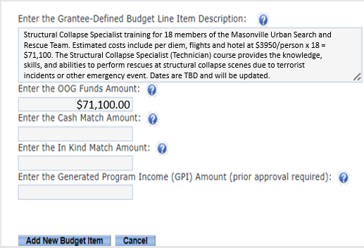
Budget / Details Tab: Travel & Training
This category is for travel/training costs for Grantee Agency Personnel only. Costs for non-agency personnel should be placed under operating expenses or contractual, as applicable.
Line-Item Descriptions must include:
A Conference name, dates, and/or location of travel (if known)
Number of personnel traveling
Additional details to demonstrate that the budgeted costs are reasonable and necessary (i.e., the number of days and nights for lodging, per diem rates, estimated trip costs per person, etc.)
Applicants should use two separate line items for training registration/course fees and mileage/incidental costs
When a line item includes any training, a GM will place a special Training Review Condition hold on the item. This hold requires the Applicant to submit a Training Review form and receive approval prior to attending training. (NOTE: Applicants should use two separate line items for registration/course fees and mileage/incidental costs.)
Structural Collapse Specialist training for 18 members of the Masonville Urban Search and Rescue Team. Estimated costs include per diem, flights and hotel at $3950/person x 18 = $71,100. The Structural Collapse Specialist (Technician) course provides the knowledge, skills, and abilities to perform rescues at structural collapse scenes due to terrorist incidents or other emergency event. Dates are TBD and will be updated.
$71,100.00
Common Issues
Line-item descriptions do not contain enough information to determine the reasonableness or benefit of the travel/training.

Slide 150
Budget / Details Tab: Travel & Training
In-State Incidentals and/or Mileage (Planning)
Budget Code: In-State Incidentals and/or Mileage (Planning)
Incidentals, per diem, transportation, and hotel for up to 3 Homeland Security Team members to attend the National Homeland Security Conference in June 2024. Location and dates to be determined. Estimated Costs of Per Diem, Flights and hotel at $2000.00 per staff member
Mileage to an in-State meeting
Budget Code: In-State Incidentals and/or Mileage (Planning)
Mileage for vehicles for travel within the LSCOG Region, travel from COG to COG, or to TARC. Estimated at 53 cents per mile for 755 miles.
Travel to Out-of-State Conferences
Budget Code: Out-of-State Incidentals and/or Mileage (Planning)
Travel expenses for the UASI/National Homeland Security Conference, and the International Association of Emergency Management Conference. Sending 2 Masonville Police Department Planners estimated at $3,880 per staff member which includes Per Diem, Flights and hotel. Location and dates to be determined.
Out-of-State Conference Registration
Budget Code: Out-of-State Registration Fees (Planning)
Registration fees for up to 3 Emergency Management staff to attend the June 2024 National Homeland Security Conference. The conference brings key stakeholders together from all states and all Urban Areas so they can collaborate on Homeland Security events, trends, response capabilities, planning, and grant management. The location will be in Miami Beach on 5/23/2024 – 5/28/2024. Registration is $500 / person
Responder Training Registration Fees
Budget Code: In-State Registration Fees (Training)
Recertification and evaluation for Explosives detection K9 handlers to maintain canine certification for both handler and animal. The training is scheduled to occur in Masonville Tx on March 17th, 2025. Registration fees are for (2) two Texas County Sheriff's Office K9 handlers and their K9s at $500/ person X 2 people = $1000.00

Slide 151
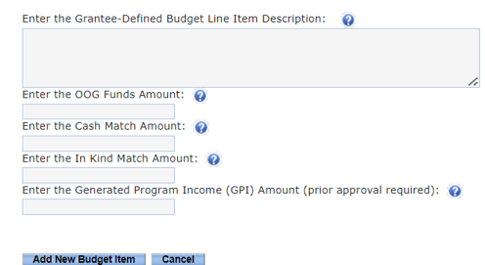
Budget / Details Tab: Equipment
Equipment is tangible personal property having a useful life of more than one year and a per-unit acquisition cost that equals or exceeds the lesser of the capitalization level established by the applicant agency, or $5,000. Items that are considered Controlled Assets (as identified by the Comptroller’s Office) and radios, must also be listed under Equipment.
Radio Solutions XLT 4500 P25 Portable radios. These radios will be used by the Masonville Fire Department to enhance interoperability when responding to acts of terrorism and other emergencies. 25 radio Kits (radio, holster, blet clip and charger) @ $2,500.00 per kit.
$62,500.00
Line-Item Descriptions must include:
Detailed equipment description to easily understand what the item is and its purpose
Who the equipment is intended to support
Make and Model of the Equipment
Per Unit Cost
Unit:
The quantity (number of units to be purchased with OOG and Matching Funds) must go in the Unit field of the line item.
Common Issues
Line-item descriptions do not contain the per unit costs. The equipment cannot be tied back to the purpose of the project.

Slide 152
Budget / Details Tab: Equipment
Explosive Ordinance Disposal Team X-Ray System
Budget Code: 02EX-01-XRAP X-Ray Equipment, Portable or Transportable
Clearview 7500 x-ray unit for the City of Masonville's EOD team. This equipment will allow the team x-ray items of interest during screening, searches, and responses in the Entertainment District and across the city and region in order to quickly identify and mitigate terrorist threats. Two units at $25,000.00 per unit.
SWAT Team Night Vision Goggles
Budget Code: 03OE-02-TILA Optics, Thermal Imaging and/or Light Amplification
9 pairs Nighthawk 8000 helmet mounted night vision goggles to be utilized by the Texas County SWAT team members. 9 @ $3550.00 Each
Repeaters
Emergency Operations Center Computers
Budget Code: 04HW-01-INHW Hardware, Computer, Integrated
Laptop computer with docking station, keyboard and mouse for use in the Texas County Emergency Operations center to enhance operational coordination during terror events. 25 Zell 8200 Laptop computer bundle which includes Laptop computer with docking station, keyboard and mouse @ $2,500 per unit.
Surveillance System for Critical Infrastructure
Budget Code: 14SW-01-VIDA Systems, Video Assessment, Security
Video Camera Surveillance system for the City of Masonville drinking water facility. This system will be purchased as a package which includes 25 IP cameras, one network video recorder and associated cables and connectors. One complete Surveillance Direct model 3250 packaged system at $25,000.00

Slide 153
Budget / Details Tab: Supplies & Direct Operating Expenses (DOE)
Supplies are tangible personal property valued less than $5,000.*
Direct Operating Expenses include direct costs such as leases for space, rental costs, software, project supplies, advertising costs for staff vacancies, etc.
*NOTE: The State of Texas recognizes computing devices that exceed $499 as equipment, NOT supplies. The Comptroller considers these state-controlled assets; they are not capitalized and may still be listed as supplies but would need to be maintained on an inventory list.
Purchase of 3 ballistic blankets for use by the Masonville SWAT teams to protect responders and civilians from terrorist attack. 4x6 Level IIIA Ballistic Blanket with carry straps. 3 @ $1,000
$3,000.00
Line-Item Descriptions must include:
Detailed description of the supply or direct operating expenses to easily understand what the item is and how it benefits the overall project
Quantities for items in this budget area should be included in the line-item description if applicable or known
Costs for rent shall include the cost per square foot and the number of square feet used for the project
Common Issues
Line-item descriptions do not contain the per unit costs. The supply item cannot be tied back to the purpose of the project.

Slide 154
Budget / Details Tab: Supplies & Direct Operating Expenses (DOE)
CERT Supplies
Budget Code: 21GN-00-CCEQ Equipment, Citizen Corps
CERT team backpacks with standard supply loadout for the Masonville CERT Team. These backpacks provide necessary supplies to allow CERT members to accomplish the skills learned in training when an event such as a terrorist attack occurs. 100 Level 2 CERT Land brand backpacks at $32.50 per unit.
Body Armor for Tactical Medic Team
Budget Code: 01LE-01-ARMR Armor, Body
Bullet Stopper 800 Active Shooter Armor Kit includes 2 Max Pro Level IV Ballistic plates, Ballistic plate carrier, and gear bag. (4 Kits @ $1041.84). This protective equipment will be used by the Masonville Fire department tactical medic team in support of Law Enforcement during terrorist incidents.
Emergency Operation Center Software
Budget Code: Software License and User Fees (Organization)
WebEOC software Licenses - WebEOC is a web-based emergency management software platform that facilitates real-time coordination, communication, and information sharing during incidents and crises. 40 Licenses at $100.00 per license and service dates 10/1/2025 – 9/30/2026.
Telecommunications Costs for a Homeland Security planner
Budget Code: Telecommunications Costs (Planning)
Cell Phone Service Costs for the Regional Emergency Planner at a rate of $32.50 per month totaling $390.00 from 09.01.2022 - 08.31.2023. This allows the planner to communicate with regional partners when out of the office.
Telecommunications Costs for a Homeland Security planner
Budget Code: Telecommunications Costs (Planning)
Office space cost for the Homeland Security Planner (Bill Billson) in order to support program planning activities. This cost is based on 203.12 SQFT @ $.06 a SQFT for a monthly cost of $13.83 for a yearly term of Sept. 2025-Aug. 2026.

Slide 155
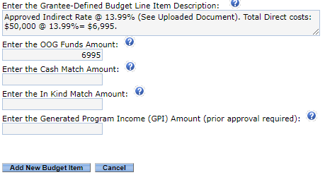
Budget / Details Tab: Indirect Costs
Indirect costs are costs without a direct link to a single project or activity. These are frequently aggregated into an overhead cost pool and allocated to various activities.
Rate Information:
Indirect costs must reflect the applicant’s indirect rate as determined by their cognizant agency.
Applicants who have negotiated an Indirect Cost Rate must upload a copy of the approval letter from their cognizant agency to the grant record.
De Minimis
The applicant may elect to charge a De Minimis rate of 10% of modified total direct costs (MTDC). Applicants using the De Minimis rate must confirm that they do not have an approved indirect cost rate AND they are NOT a state, local government, or Native American tribe receiving over $35 million in direct federal funding. More information on how to calculate the De Minimis rate can be found in the PSO’s Guide to Grants.
Common Issues
The approved Indirect Cost Rate letter is not uploaded to eGrants. The approved indirect rate is not listed in the line-item description. The De Mimimis rate is not calculated from the correct MTDC.

Slide 156
Budget / Details Tab: Indirect Costs
Approved Indirect Rate
The U.S. Department of Commerce/EDA approves our indirect cost plan based on direct salaries and fringe benefits at 9.47%, through September 30, 2017.
De-Minimis indirect Rate
The indirect costs requested for reimbursement is $26,768.10 for 24-month period. This calculation is derived from a total modified direct costs of $267,681 (personnel: $223,981 + contractual $25,000 + travel $2,700 + supplies $16,000) x 10%

Slide 157
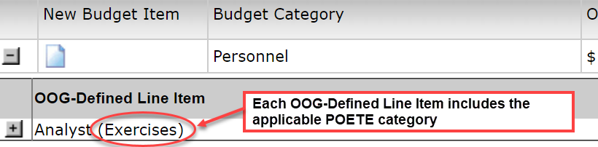
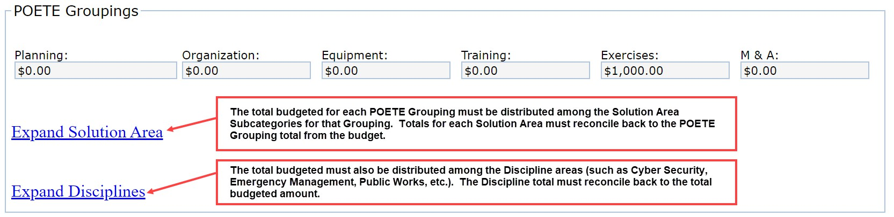

Budget / Details Tab: POETE Groupings
FEMA requires states to track expenditures at a detailed level, including within the following categories referred to as “POETE”:
Planning costs
Organization costs
Equipment costs
Training costs
Exercise costs
Applicants must also classify budgeted costs within each POETE category to a Solution Area and identify the Disciplines associated with those costs. If an Applicant needs assistance, they are encouraged to contact their Grant Manager.
Contact the assigned GM for assistance with the POETE Groupings.

Slide 158
Documents Tab

Slide 159
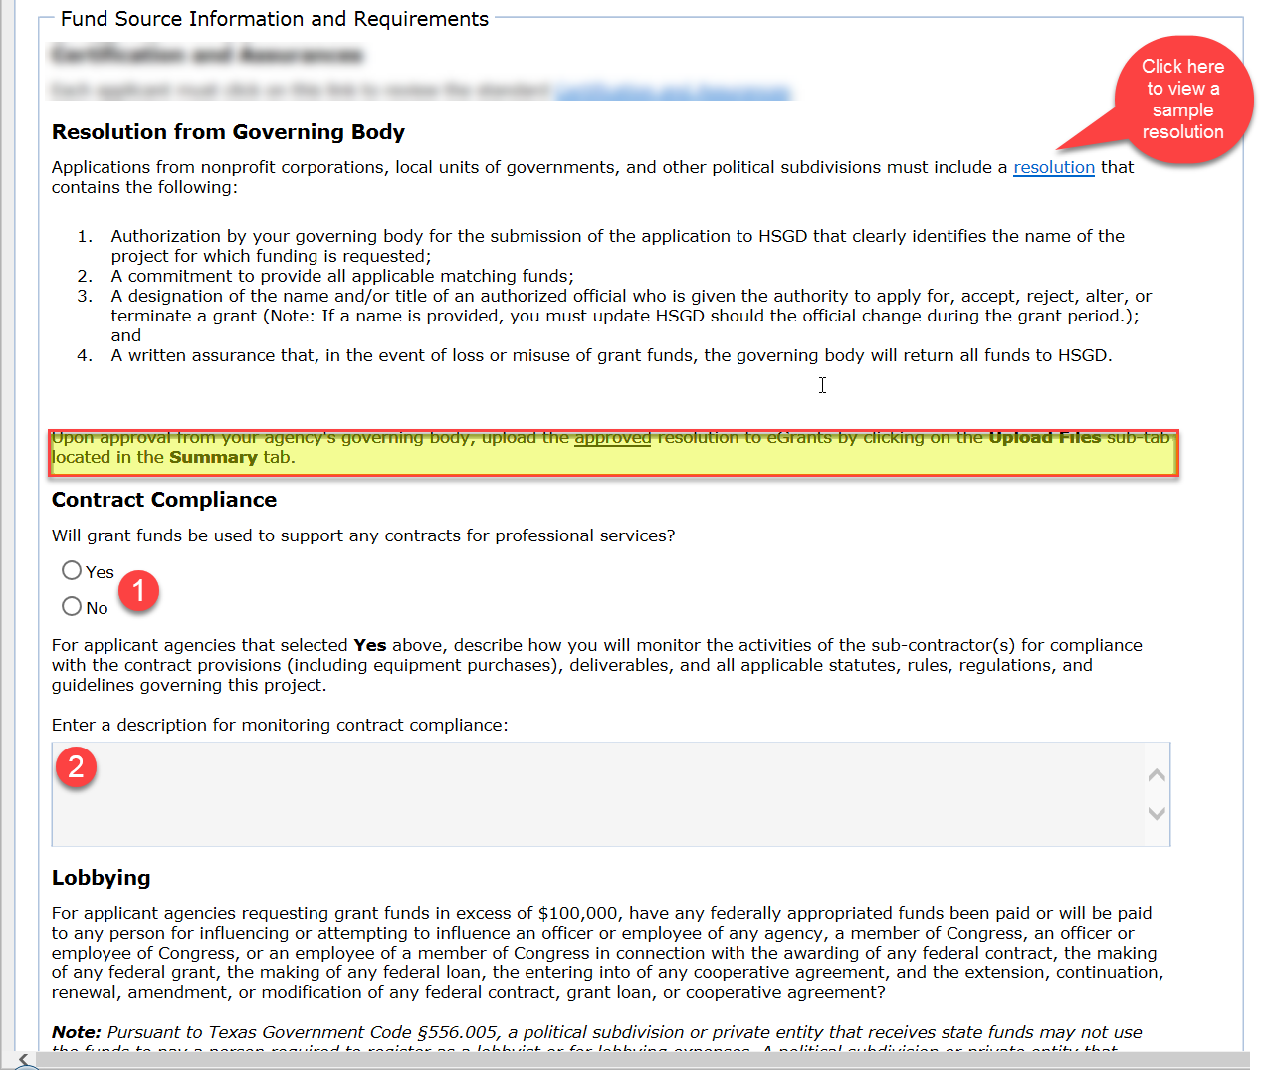
Documents Tab
The documents tab will request the following:
Resolution from Governing Body:
The OOG mandates that the Applicant’s governing body issue a resolution, following the example provided in eGrants. This resolution must designate the Authorized Official (AO), identify the relevant grant(s), and include all elements outlined in the example. Applicants should upload the signed resolution under the Upload Files tab in their application; failure to do so will result in a Condition of Funding hold until the resolution is provided with all necessary details.
Contract Compliance:
Applicants with budget line items in the Contractual and Professional Services category must select “Yes” and fill out this section.
The OOG requires a brief summary detailing how the Applicant will oversee sub-contractors' compliance with contract provisions, deliverables, and relevant regulations. A concise statement outlining the specific policies or procedures for monitoring the contractor and ensuring compliance is needed.
Contract Compliance Description Example:
The County Auditors office will monitor all contracts funded by this grant to ensure sub-contractors' compliance with contract provisions, deliverables, and relevant regulations as outlined in Texas County’s Procurement Policy.

Slide 160
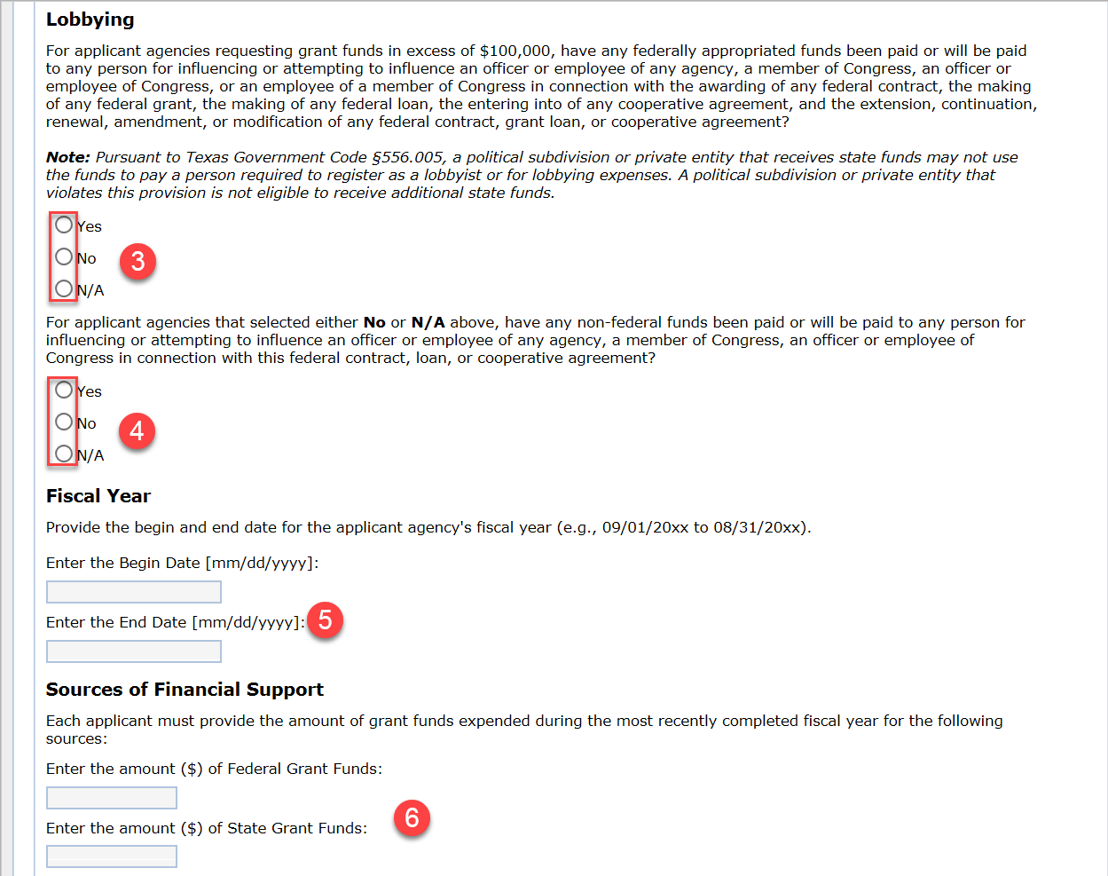
Documents Tab
The documents tab request the following:
Lobbying:
Grant funding cannot be used for lobbying, as stated in the Request for Applications (RFA), 2 CFR 200.450, and the Notice of Funding Opportunity (NOFO). If the correct answer to the first question regarding lobbying is “YES,” the project is ineligible.
If the response to the second question under Lobbying is “Yes” indicating the applicant agency has used non-federal funds for lobbying, the project will be required to complete and upload a Disclosure of Lobbying Activities form.
Fiscal Year
The OOG requests this information because agencies statewide have varying fiscal year dates. Providing these details helps the OOG determine the Applicant’s fiscal year and also aids in understanding the due date for a Single Audit, which is either 9 months after the fiscal year ends or 30 days following the release of the audit report, whichever comes first, if applicable.
Sources of Financial Support
Sources of financial support refer to the total grant funding an applying agency has received (and spent) from State and/or Federal sources. This amount encompasses all funding received by the agency, not just those from the OOG or PSO. If the total expended grant funding reaches the Single Audit threshold, the Applicant must also provide the date of their most recent single audit. A common error applicants make is reporting only the amount spent by the administering division rather than the total amount expended by the entire applicant agency from federal and state sources separately.

Slide 161
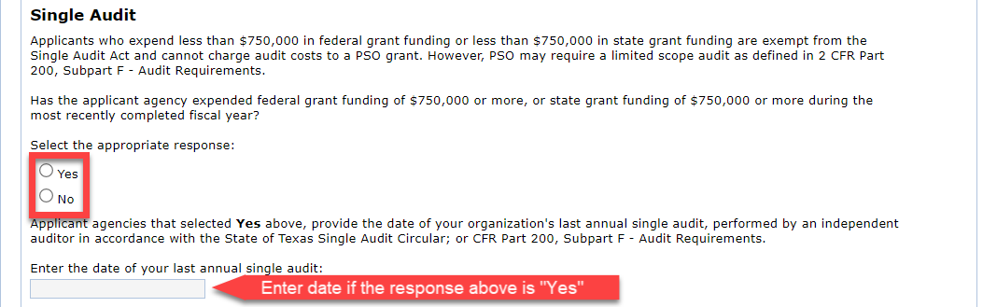
Documents Tab
The documents tab will request the following:
Single Audit:
Applicants who spend more than $750,000 in federal or state grant funding must complete a single audit. Those who spend less than $750,000 in either federal or state grant funding are exempt from the Single Audit Act and cannot use PSO grant funds to cover audit costs. However, PSO may still require a limited scope audit as specified in 2 CFR Part 200, Subpart F - Audit Requirements. Please answer the question by selecting yes or no and providing a single audit date if applicable.

Slide 162
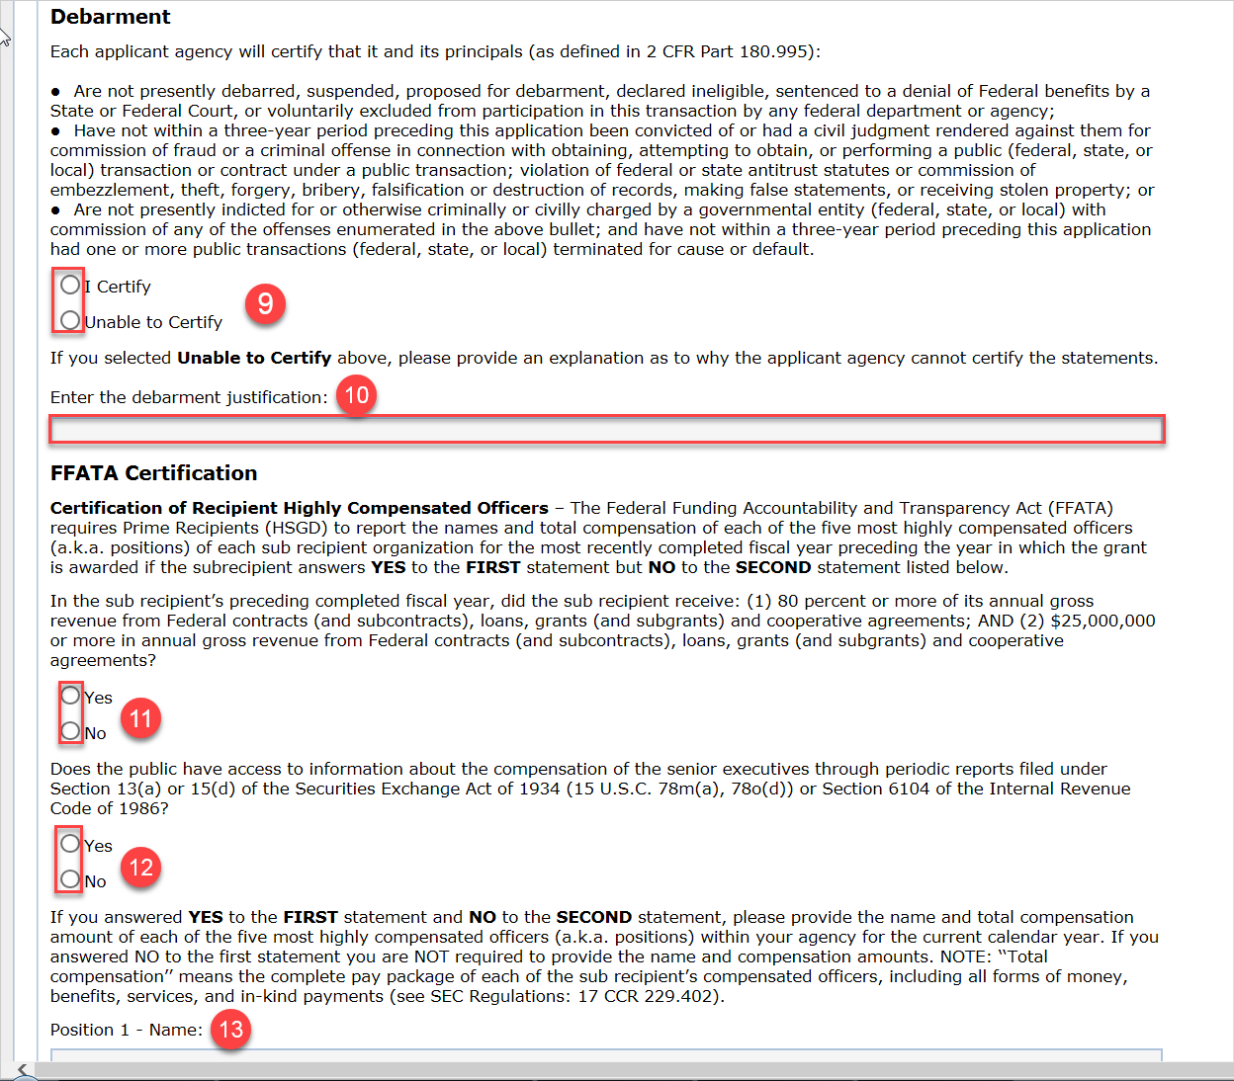
Documents Tab
The documents tab request the following:
Debarment:
Each applicant will certify that neither it nor its principals (as defined in 2 CFR Part 180.995) are currently debarred, suspended, proposed for debarment, declared ineligible, sentenced to denial of Federal benefits, or voluntarily excluded from participating in this transaction by any federal department or agency. Additionally, they must confirm that, within the three years preceding this application, they have not been convicted of or had a civil judgment for fraud or other criminal offenses related to public transactions, violated federal or state antitrust statutes, or had any public transactions terminated for cause or default.
If the applicant agency is unable to Certify, please provide an explanation in the field provided.
FFATA Certification:
Please identify if the applicant received 80% or more of its annual revenue from federal funds and at least $25,000,000 in federal revenue in the preceding fiscal year.
Please identify if the public has access to senior executive compensation information.
If the Applicant answers YES to receiving 80% or more in federal funds and NO to receiving $25,000,000 or more in federal revenue, information for the five most highly compensated officers must be provided.

Slide 163
Homeland Security Tab

Slide 164
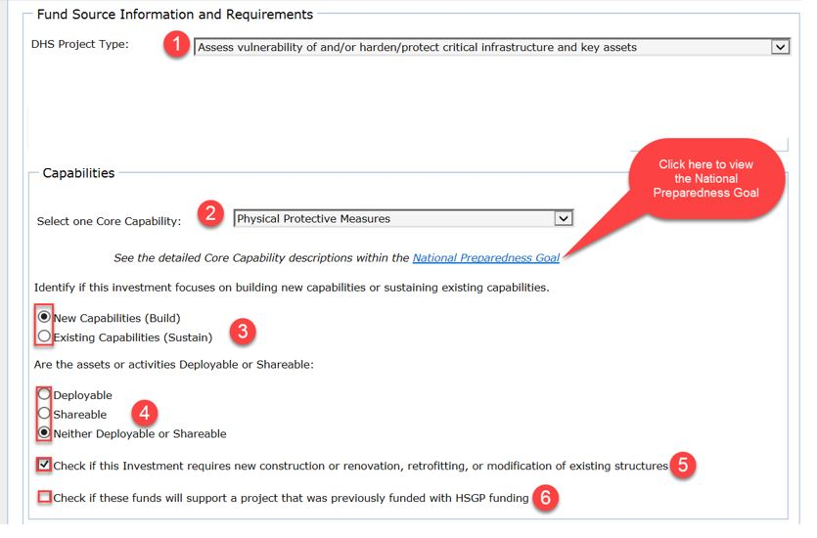
Homeland Security Tab
The Homeland Security tab will request the following:
Department of Homeland Security (DHS) Project type:
Applicants should select the most appropriate Project Type that applies to the project.
Capabilities:
Applicants should select the most applicable (primary) Core Capability for the project from the drop-down in the application. Applicants may view descriptions of Core Capabilities by clicking this link Mission Areas and Core Capabilities | FEMA.gov. Please ensure that it matches the core capability identified in the narrative.
Applicants must select if the investment will build or sustain capabilities.
Applicants must answer if the assets or activities funded with this grant are deployable, sharable, or neither.
Applicants must check the box If the project requires new construction or renovation, retrofitting, or modification of existing structures.
Applicants must check the box if the funding for the project supports another project previously funded with HSGP funding.

Slide 165
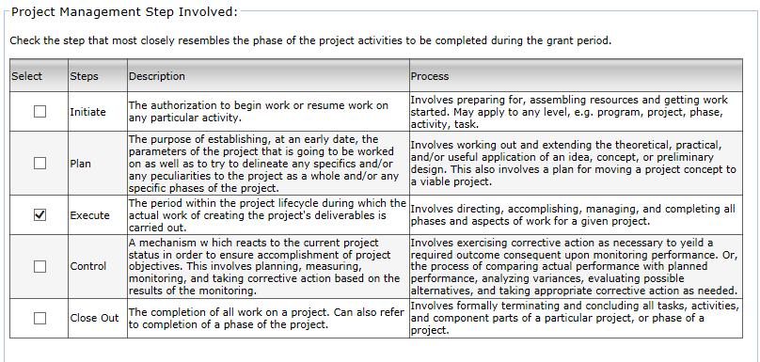
Homeland Security Tab
The Homeland Security tab will request the following:
Project Management Step:
Applicants should select the step that most closely resembles the phase of the project activities to be completed during the grant period.
The vast majority of SHSP applicants should select “Execute” as most grants will be completed from start to finish.

Slide 166
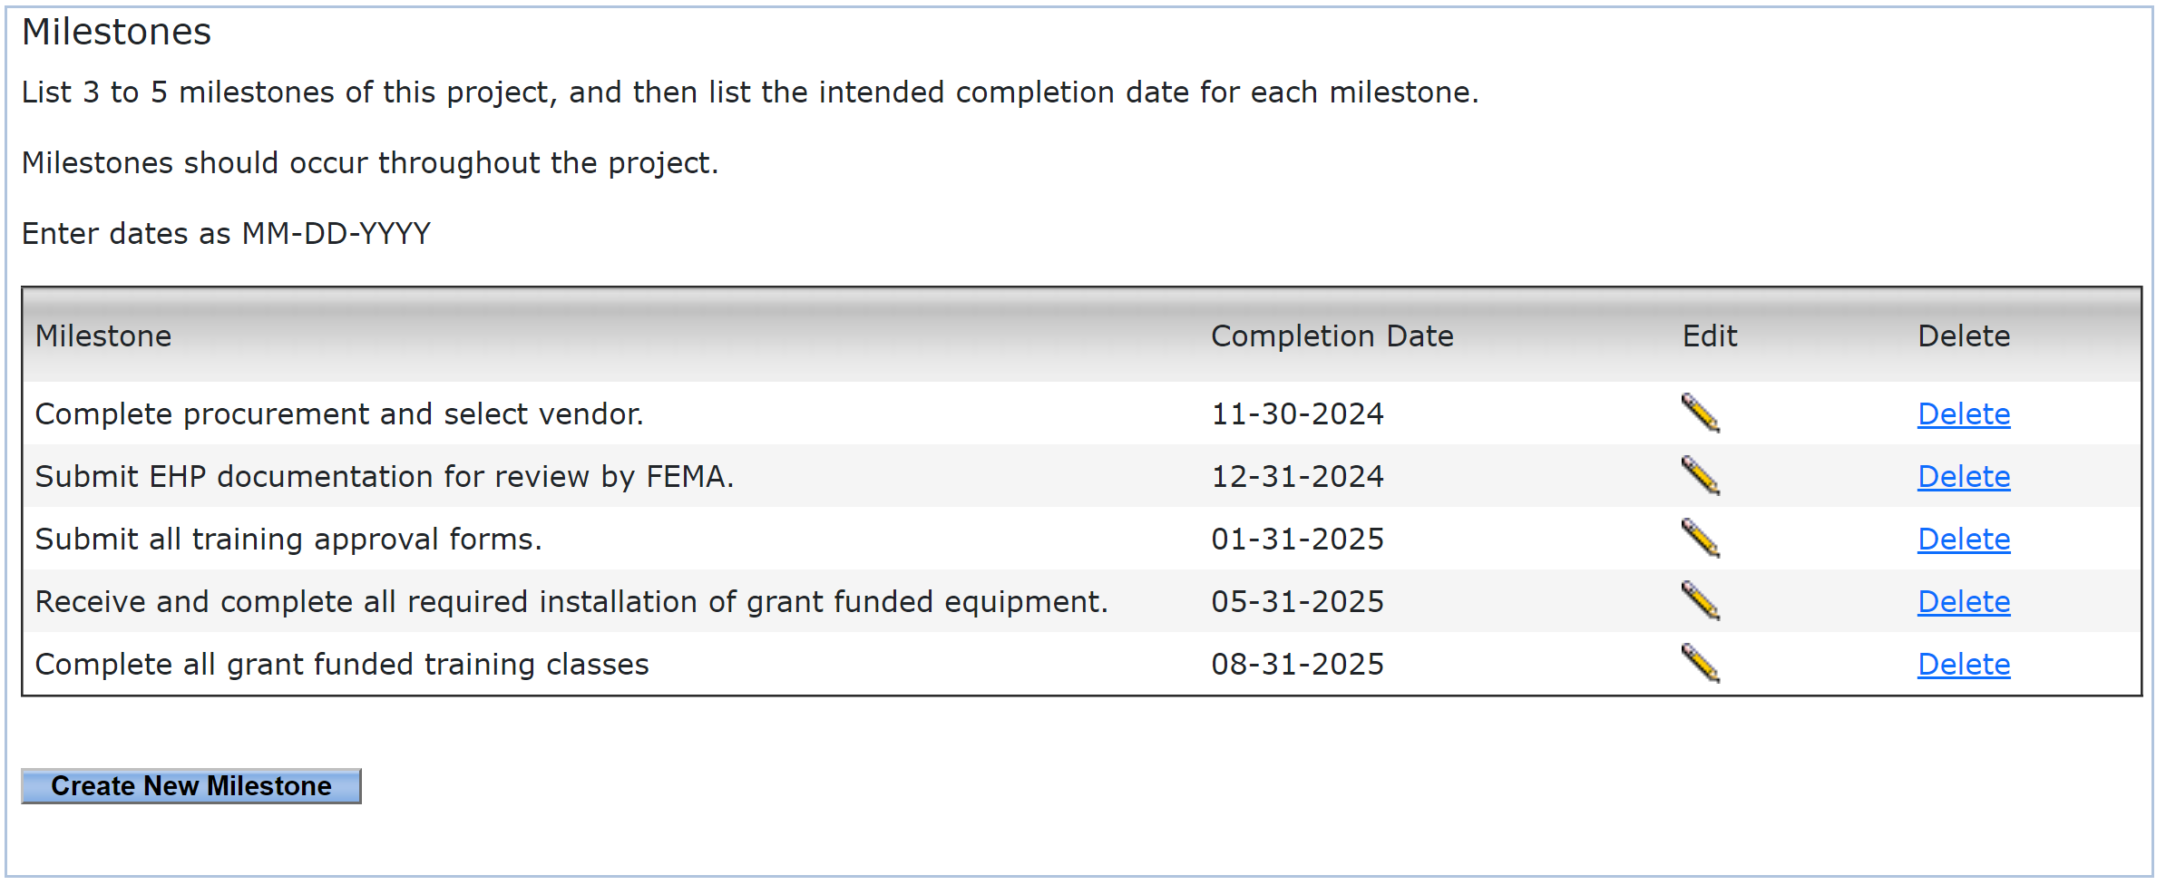
Homeland Security Tab
The Homeland Security tab will request the following:
Milestones
Milestones represent significant points of progress along a project's critical path. Starting from the project's initiation, milestones track major deliverables and goals that lead to the successful completion of the project by its end date.
Milestone Guidelines:
The first milestone should have a completion date do more than 90 days from the grant start date.
Milestones must be related to crucial activities such as equipment procurement, training events, or internal processes that impact grant performance and are necessary for project completion. Applicants must exclude events like the acceptance of the grant award or the closure of the project in eGrants.
Each milestone should be listed in chronological order.
Applicants must provide at least three and no more than five milestones for their project.
Milestones are vital for both the sub-grantee and the PSO, aiding in the assessment of project progress following the grant award. The PSO uses milestone status to report progress to FEMA.
Milestone Examples:
Complete procurement and select vendor.
Submit EHP documentation for review by FEMA.
Submit all training approval forms.
Receive and complete all required installation of grant funded equipment.
Complete all grant funded training classes.
Submit SWIC review forms for approval.
Issue purchase order and order equipment.
Submit Small Unmanned Aircraft System Waiver request to FEMA.
Identify all personnel requiring training and determine class availability and travel.

Slide 167
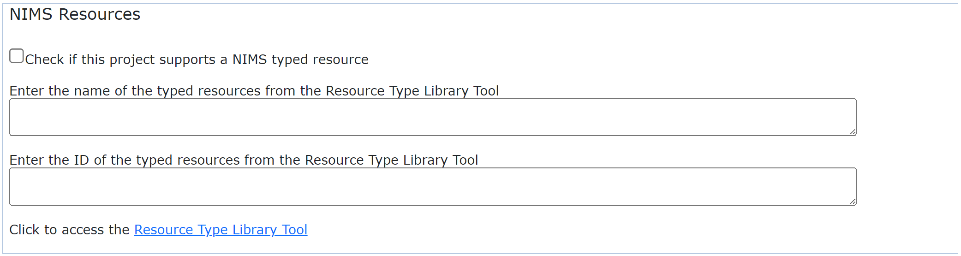
Homeland Security Tab
The Homeland Security tab will request the following:
NIMS Typed Resources:
If your project supports a NIMS typed resource, complete the NIMS Resources section using the Resources Typing Library Tool maintained by the Department of Homeland Security, which provides definitions and qualifications for national NIMS resource types. This tool enables users to consistently identify and inventory resources for capability assessment, planning, and mobilization during incidents. If your project does not support a NIMS typed resource, you do not need to fill out this section.
Most Common NIMS Typed Resources:
Hazardous Materials Response Team - ID# 4-508-1248
Bomb Response Team - ID# 6-508-1176
Special Weapons and Tactics Team – ID# 6-508-1245
Structural Collapse Rescue Team– ID# 8-508-1159
Intelligence Analyst – ID# 6-509-1281
Fusion Liaison Officer – ID# 6-509-1280.

Slide 168
Upload Files Tab

Slide 169
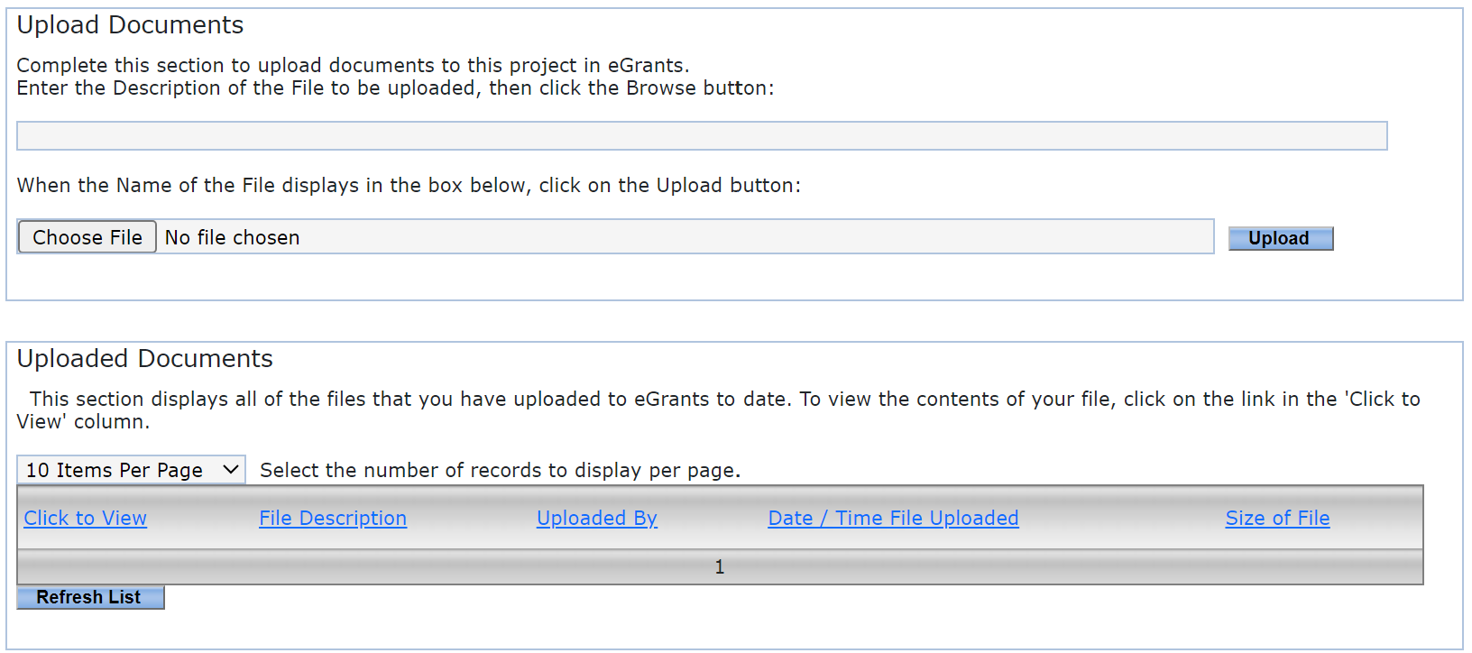
Upload.Files Tab
The Upload.Files tab allows you to do the following:
Applicants use this tab to upload most* required or requested documentation for the application. Documentation such as resolutions from the governing body, SWIC approval, Indirect Cost rate letters, etc. goes under this tab. Once the grant has been awarded, the Grant Manger or any of the grant officials may continue to upload other documentation for the grant record under this tab.
*NOTE: For more details on file types, size limitations, and instructions on uploading a document, please refer to the Uploading eGrants Files document found in the “General Information and Instructions” area of this tab.
NOTE
DO NOT upload any Vendor documentation including Direct Deposit, New Payee ID, and W9 forms on this tab. Each of those forms MUST be uploaded to the Grant.Vendor tab, not the Upload.Files tab. DO NOT upload any Environmental Historical Preservation (EHP) documentation until after the award is received and accepted. The best practice for EHP documentation is to email it directly to the Grant Manager and copy the Program Manager for processing. The Grant Manager will upload EHP documentation to the Grant Record. FEMA will not process any EHP until after acceptance of the award. Uploading an EHP during the application phase will not help speed up the process. If Applicants have questions, they should contact the COG or their Grant Manager.

Slide 170
Conditions of Funding Tab

Slide 171

Condition.of.Funding Tab
Conditions of funding represent outstanding items identified during the application review or a reminder of actions to be taken once the grant is awarded.
When the condition is met the "Date Met" field will show the date the condition was cleared.
When a hold is placed on a project, the project “Status” will be show:
[FUND HOLD] = A hold has been placed on the entire
grant.
[BLI HOLD] = Hold affects one or more Budget Line Items
[VENDOR HOLD] = Agency is on hold across the PSO
NOTE
A [VENDOR HOLD] indicates there is a compliance or other outstanding issue on an existing Active grant. While on Vendor Hold, all activity on active grants and pending applications with an agency are suspended in eGrants until the issue is resolved.

Slide 172
Submitting the Application

Slide 173

Submitting the Application
The Submit Application tab will request you take the following actions:
List of Application errors and Incomplete Information:
This section will display any issues that may keep the application from being submitted. The Error will be listed along with a link to the tab where the error is located. All errors must be cleared before the Authorized Official is able to certify the application.

Slide 174


Submitting the Application
The Submit Application tab will request you to take the following actions:
Submitting an application in eGrants involves a two-part process: (1) the grant writer first submits the initial application, which is then (2) forwarded to the Authorized Official to certify.
Submit Initial Application:
Once all errors and incomplete information issues have been resolved, the initial application can be submitted.
AO Certifies Application:
Once the initial application has been submitted, the Authorized Official will then be able to certify.
Withdrawing the Application
If the Authorized Official determines that they would no longer like to move forward with this application, then they may select the “Withdraw Application” button. Please note that once it is withdrawn, it will no longer be available to submit.
Click to “Submit”
Click to "Certify”

Slide 175


Submitting the Application
Submitting an application in eGrants is a TWO-STEP process. Both steps must be taken in eGrants prior to the deadline for your application to be considered for funding.
Step 1: Submit the Initial Application
NOTE
Once the application is Certified it will be in a “Pending OOG Review” status and will be locked for updates unless the GM reopens the application for edits.
Step 2: Certify the Official Application

Slide 176
Helpful Links and Contact Information

Slide 177
HELPFUL LINKS
AEL Codes and code descriptions
https://www.fema.gov/authorized-equipment-list
Title 2 Code of Federal Regulations (2CFR) Part 200
http://www.ecfr.gov/cgi-bin/textidx?tpl=/ecfrbrowse/Title02/2cfr200_main_02.tpl
eGrants User’s Guide to Creating an Application
https://egrants.gov.texas.gov/uploads/egrants_files/eGrants_Guide_to_Creating_an_Application_12.2020.pdf
OOG – General Frequently Asked Questions (FAQs)
https://egrants.gov.texas.gov/uploads/egrants_files/FAQs_eGrants.pdf
Public Safety Office – General Frequently Asked Questions (FAQs)
httpshttps://egrants.gov.texas.gov/uploads/egrants_files/PSO_General_FAQs_2022_Revised.pdfegrants.gov.texas.gov/updates.aspx
PSO Guide to Grants
https://egrants.gov.texas.gov/uploads/egrants_files/2024_Guide_to_Grants.pdf
FEMA Homeland Security Grant Program
https://www.fema.gov/grants/preparedness/homeland-security

Slide 178

How do I find which COG I’m located in?
If you have questions regarding which regional Council of Governments your Agency/Organization is in, you may utilize the Texas Association of Regional Councils (TARC) “Find Your COG” feature located on the TARC website.
This feature allows you to look up your COG by the county your agency/organization resides in.

Slide 179
CONTACT US
Will Ogletree | Administrator, Terrorism Preparedness Programs
(512) 463-8339 – Will.Ogletree@gov.texas.gov
----
Miranda Rodriguez | Associate Administrator, Terrorism Preparedness Programs
(512) 463-8361– Miranda.Rodriguez@gov.texas.gov
---
Jim Hershey | Grant Manager, Terrorism Preparedness Programs
(512) 475-2594 - Jim.Hershey@gov.texas.gov
Special Equipment Waivers & Environmental Historic Preservation Specialist
  Statewide Emergency Radio Infrastructure (SERI)
  State Agency Projects
---
eGrants Help Desk
(512) 463-1919 - eGrants@gov.texas.gov

Slide 180
CONTACT US
Efren Chavez | Grant Manager (UASI/SHSP), Terrorism Preparedness Programs
(512) 475-2594 - Efren.Chavez@gov.texas.gov
  Houston-Galveston Area Council
  Houston UASI
---
Chris Edwards | Grant Manager (UASI/SHSP), Terrorism Preparedness Programs
(512) 463-8400 - Chris.Edwards@gov.texas.gov
North Central Texas Council of Governments
  DFWA UASI
Mitchell Hachey | Grant Manager (UASI/SHSP), Terrorism Preparedness Programs
(512) 463-8406 - Mitchell.Hachey@gov.texas.gov
  San Antonio UASI
  Alamo Area Council of Governments
  Austin Area UASI
  Capital Area Council of Governments
  Concho Valley Council of Governments
  Golden Crescent Regional Planning Commission
  South Texas Development Council
  Coastal Bend Council of Governments
  Lower Rio Grande Valley Development Council

Slide 181
CONTACT US
Robert Gamez | Grant Manager (SHSP), Terrorism Preparedness Programs
  (512) 463-5726 - Robert.Gamez@gov.texas.gov
  Ark-Tex Area Council of Governments
  Brazos Valley Council of Governments
  Central Texas Council of Governments
  Deep East Texas Council of Governments
  East Texas Council of Governments
  Heart of Texas Council of Governments
  Middle Rio Grande Development Council
  Nortex Regional Planning Commission
  Panhandle Regional Planning Commission
  Permian Basin Regional Planning Commission
  Rio Grande Council of Governments
  South East Texas Regional Planning Commission
  South Plains Association of Governments
  Texoma Council of Governments
  West Central Texas Council of Governments

