Slide 1

2018 Application Development Workshop
State Homeland Security Program (SHSP)
Criminal Justice Division (CJD)
Office of the Governor – Homeland Security Grants Division
Preparedness Programs
Presented by: Jesse Hennage
P.O. BOX 729 • BELTON, TX 76513 • 254-770-2200 • FAX 254-770-2360 • www.ctcog.org

Slide 2
Housekeeping Items
Restrooms
Breaks
Schedule
Food & Beverage
Emergency Information
After Action Review
Notes:
Slide 2 – Housekeeping
Presenter Note:
Location of restrooms
Breaks
Quick overview of the schedule
Food and beverage, as appropriate to location and availability
Any emergency information
Exits
Fire evacuation
Severe Weather (if applicable)
Other items as appropriate
After Action Review.

Slide 3
Agenda
Introduction
2018 Request for Application (RFA) Highlights
Application Development
After Action Review
Closing Comments
Notes:
Slide 3 – Agenda
Presenter Note: Provide an overview of the workshop agenda
Note:
Introduction
2018 Request for Application (RFA) Highlights
The presenter will discuss key items in the RFA while encouraging the Participants to fully read the RFA before completing their application
Application Development
This will go Tab by Tab in eGrants with a focus on common issues identified in previous Grant Reviews.
After Action Review
To be completed by the presenter following the presentation of all material and the closing of all questions from the Participants.
Closing Comments

Slide 4
Introduction / Purpose
Highlight important items in the RFA
Homeland Security
Criminal Justice
Application development
  Provide guidance by tab for quality application elements
  Discuss common items for revision
  Clarify the intent of application elements
Notes:
Slide 4 – Introduction/Purpose
The purpose of this workshop is to highlight key elements of the Request for Applications (RFA) and provide tips for developing quality application elements.

Slide 5
2018 Request for Homeland Security Applications (RFA)
Purpose: The purpose of the SHSP is to support state, tribal and local preparedness activities that address high-priority preparedness gaps across all core capabilities where a nexus to terrorism exists. All investments must be consistent with capability targets set during the Threat and Hazard Identification and Risk Assessment (THIRA) process, and gaps identified in the State Preparedness Report (SPR).
Notes:
Slide 5 – 2018 Request for Applications (RFA)
Presenter Notes: Inform the participants that they are expected to fully read the RFA and that this presentation is only highlighting SOME of the important areas and changes to the RFA from the prior year. The RFA can be found at https://egrants.gov.texas.gov/fundopp.aspx once it has posted.
Purpose: The purpose of the SHSP is to support state, tribal and local preparedness activities that address high-priority preparedness gaps across all core capabilities where a nexus to terrorism exists. All investments must be consistent with capability targets set during the Threat and Hazard Identification and Risk Assessment (THIRA) process, and gaps identified in the State Preparedness Report (SPR).
The SHSP is intended to support investments that improve the ability of jurisdictions to:
Prevent a threatened or an actual act of terrorism;
Protect its citizens, residents, visitors, and assets against the greatest threats and hazards;
Mitigate the loss of life and property by lessening the impact of future catastrophic events;
Respond quickly to save lives, protect property and the environment, and meet basic human needs in the aftermath of a catastrophic incident; and/or
Recover through a focus on the timely restoration, strengthening, accessibility and revitalization of infrastructure, housing, and a sustainable economy, as well as the health, social, cultural, historic, and environmental fabric of communities affected by a catastrophic incident.
Many activities which support the achievement of target capabilities related to terrorism preparedness may simultaneously support enhanced preparedness for other hazards unrelated to acts of terrorism. However, all SHSP projects must assist grantees in achieving target capabilities related to preventing, preparing for, protecting against, or responding to acts of terrorism.
Law Enforcement Terrorism Prevention Activities (LETPA)
Per Congressional mandate (911 Act), twenty-five percent (25%) of the combined Homeland Security Grant Program funding must be spent on Law Enforcement Terrorism Prevention Activities (LETPA). Similar to regular SHSP projects, all LETPA investments must be consistent with capability targets set during the Threat and Hazard Identification and Risk Assessment (THIRA) process, and gaps identified in the State Preparedness Report (SPR).
The SHSP-LETPA is intended to support investments that improve the ability of jurisdictions to:
Prevent a threatened or an actual act of terrorism;
Protect its citizens, residents, visitors, and assets against the greatest threats and hazards;
Prevention is defined as the capabilities necessary to avoid, prevent, or stop a threatened or actual act of terrorism.
All capabilities being built or sustained must have a clear linkage to one or more of the following Core Capabilities in the National Preparedness Goal: Planning, Public Information and Warning, Operational Coordination, Intelligence and Information Sharing, Interdiction and Disruption, Screening, Search, and Detection, and Forensics and Attribution.

Slide 6
2018 Request for Homeland Security Applications (RFA)
Funding Levels:
Minimum: $2,500
Maximum for Local and Regional projects: None
Maximum for Urban Area Security Initiative (UASI) jurisdictions that did not receive a direct allocation from the Federal Emergency Management Agency (FEMA): $450,000 for Fusion Center projects.
Notes:
Slide 6 – 2018 Request for Applications (RFA)
Funding Levels:
Minimum: $2,500
Maximum for Local and Regional projects: None
Maximum for Urban Area Security Initiative (UASI) jurisdictions that did not receive a direct allocation from the Federal Emergency Management Agency (FEMA): $450,000 for Fusion Center projects.

Slide 7
2018 Request for Homeland Security Applications (RFA)
Prohibitions – Numerous items, please read the RFA
Eligible Activities
  Fusion Centers (LETPA only)
  Intelligence and Information Sharing
  Interoperable Communications
  Special Response Teams and First Responder Capabilities (including Border Security capabilities)
  State, Regional and Local Planning
  Operational Coordination
  Critical Infrastructure
Notes:
Slide 7 – 2018 Request for Applications (RFA)
Prohibitions
Presenter note: Please cover the following prohibitions during the presentation and stress the importance of reading the RFA completely.
Grant funds may not be used to support a number of services, activities, and costs. Applicants should read the RFA carefully to ensure their entire project is allowable. The RFAs for SHSP for Regular and LETPA contain a list of prohibitions. Notable prohibitions for 2018 include:
vehicles or equipment for government agencies that are for general agency use and/or do not have a clear nexus to terrorism prevention and protection (i.e. mobile data terminals, body cameras, in-car video systems, radios, or radar units, etc. for officers assigned to routine patrol; general firefighting equipment or uniforms);
weapons, ammunition, weaponized vehicles or explosives (exceptions may be granted when explosives are used for bomb squad training);
food, meals, beverages, or other refreshments, except for eligible per diem associated with grant-related travel or where pre-approved for working events;
any use of grant funds to replace (supplant) funds that have been budgeted for the same purpose through non-grant sources;
amateur radios and equipment, FMS radios, GMRS radios, or other radio equipment that is not P25 compliant;
regular and/or preventative maintenance of communications equipment or infrastructure (applicable to LETPA projects only, this activity will still be allowed under regular SHSP) and;
any other prohibition imposed by federal, state, or local law.
Eligible Activities:
Grant projects must be consistent with the program purpose stated above and must be submitted in support of one of the following approved activity areas:
Fusion Center (only eligible under the LETPA RFA)
Intelligence and Information Sharing (Non-Fusion Center requests)
Interoperable Communications
Special Response Teams and First Responder Capabilities (including Border Security capabilities)
State, Regional and Local Planning
Operational Coordination
Critical Infrastructure
All capabilities being built or sustained must have a clear link to one or more Core Capabilities in the National Preparedness Goal. For a project being proposed under LETPA, the project must be linked to one of the following seven (7) Core Capabilities: Planning; Public Information and Warning; Operational Coordination; Intelligence and Information Sharing; Interdiction and Disruption; Screening, Search, and Detection; or Forensics and Attribution.
Many capabilities which support terrorism preparedness simultaneously support preparedness for other hazards. Grantees must demonstrate this dual-use quality for any activities implemented under this program that are not explicitly focused on terrorism preparedness. Activities implemented under SHSP must support terrorism preparedness by building or sustaining capabilities that relate to the prevention of, protection from, mitigation of, response to, and recovery from terrorism.

Slide 8
2018 Request for Homeland Security Applications (RFA)
Eligibility Requirements
Adoption and Implementation of NIMS
Current Emergency Management Plan or member of an inter-jurisdictional emergency management program with a plan
90% criminal history disposition reporting by August 1, 2018
Current on reporting Part I violent crime data to DPS
Must have a DUNS number
Must be registered in System for Award Management (SAM)
Notes:
Slide 8 – 2018 Request for Applications (RFA)
Eligibility Requirements:
Grantees are required to maintain adoption and implementation of the National Incident Management System (NIMS). The NIMS uses a systematic approach to integrate the best existing processes and methods into a unified national framework for incident management across all homeland security activities including prevention, protection, response, mitigation, and recovery. Grantees must use standardized resource management concepts for resource typing, credentialing, and an inventory to facilitate the effective identification, dispatch, deployment, tracking and recovery of resources.
Cities and counties must have a current emergency management plan or be a legally established member of an inter-jurisdictional emergency management program with a plan on file with the Texas Department of Public Safety, Texas Division of Emergency Management (TDEM). Plans must be maintained throughout the entire grant performance period and must be at least at the Intermediate Level. If you have questions concerning your Emergency Management Plan (preparedness) level, contact your Emergency Management Coordinator (EMC) or your regional Council of Governments (COG). For questions concerning plan deficiencies, contact TDEM at tdem.plans@dps.texas.gov.
In order for an applicant to be eligible, the county (or counties) in which the applicant is located must have a 90% average on both adult and juvenile criminal history dispositions reported to the Texas Department of Public Safety for calendar years 2012 through 2016. This requirement must be met by August 1, 2018.
Eligible applicants operating a law enforcement agency must be current on reporting Part I violent crime data to the Texas Department of Public Safety (DPS) for inclusion in the annual Uniform Crime Report (UCR). To be considered eligible for funding applicants must have submitted a full twelve months of accurate data to DPS for the most recent calendar year.
Eligible applicants must have a DUNS (Data Universal Numbering System) number assigned to its agency (to request a DUNS number, go to http://fedgov.dnb.com/webform/displayHomePage.do).
Eligible applicants must be registered in the federal System for Award Management (SAM) database located at https://www.sam.gov/ and maintain an active registration throughout the grant period.
Failure to comply with program eligibility requirements may cause funds to be withheld and/or suspension or termination of grant funds.

Slide 9
2018 Request for Homeland Security Applications (RFA)
Project Period: Grant-funded projects must begin between September 1, 2018 and March 1, 2019, and expire on or before August 31, 2020. Additional guidelines are noted below:
Project periods should be structured so that projects that include grant-funded salaries and/or annual recurring costs do not overlap with the project periods of previous or future grant awards with the same costs.
Project periods should be structured so that grants with grant-funded salaries or annual recurring costs are on a 12 or 24-month grant cycle/performance period.
Project periods for equipment only projects are generally awarded for a 6 to 12 month grant period.
HSGD will consider proposed start or end dates falling outside of these guidelines on a case-by-case basis.
Notes:
Slide 9 – 2018 Request for Applications (RFA)
Project Period: Grant-funded projects must begin between September 1, 2018 and March 1, 2019, and expire on or before August 31, 2020. Additional guidelines are noted below:
Project periods should be structured so that projects that include grant-funded salaries and/or annual recurring costs do not overlap with the project periods of previous or future grant awards with the same costs.
Project periods should be structured so that grants with grant-funded salaries or annual recurring costs are on a 12 or 24-month grant cycle/performance period.
Project periods for equipment only projects are generally awarded for a 6 to 12 month grant period.
HSGD will consider proposed start or end dates falling outside of these guidelines on a case-by-case basis.
Presenter Notes: HSGD believes that most projects can fit within the stated parameters. However, as the above indicates, HSGD will consider other performance periods as may be necessary for complex projects.

Slide 10
2018 Request for Homeland Security Applications (RFA)
Application Process
For eligible local and regional projects:
  Applicants must contact their applicable regional council of governments (COG) regarding their application.
  Each of Texas’ 24 COGs holds its own application planning workshops, workgroups, and/or subcommittees and facilitates application prioritization for certain programs within its region. Failure to comply with regional requirements imposed by the COG may render an application ineligible.
UASI jurisdictions that do not receive a direct allocation from the Federal Emergency Management Agency may submit an application directly to HSGD for a Fusion Center project.
All applicants must access HSGD’s grant management website at https://eGrants.gov.texas.gov to register and apply for funding.
Notes:
Slide 10 – 2018 Request for Applications (RFA)
Application Process:
For eligible local and regional projects:
Applicants must contact their applicable regional council of governments (COG) regarding their application.
Each of Texas’ 24 COGs holds its own application planning workshops, workgroups, and/or subcommittees and facilitates application prioritization for certain programs within its region. Failure to comply with regional requirements imposed by the COG may render an application ineligible.
UASI jurisdictions that do not receive a direct allocation from the Federal Emergency Management Agency may submit an application directly to HSGD for a Fusion Center project.
All applicants must access HSGD’s grant management website at https://eGrants.gov.texas.gov to register and apply for funding.
eGrants:
Presenter Note: There is a separate guide on eGrants that explains the initial steps in eGrants when an agency decides to apply for grant funding through the Office of the Governor. The link to the resource titled “eGrants User’s Guide to Creating an Application” is displayed at the end of this presentation. Please ensure applicants are aware of a few basic steps in the process as listed below. Link to eGrants User’s Guide to Creating an Application: https://egrants.gov.texas.gov/FileDirectory/eGrants_Users_Guide_Appsv3.pdf
Starting an eGrants Application:
User must have or establish an eGrants User Account
Applicant must logon to eGrants and go to the “Apply” tab
The applicant will enter some basic information about their Desired Funding Agency, Organization Type, and Project to search for funding opportunities
After the applicant selects their funding opportunity, they will need to enter their accurate 9-digit Federal Employer Identification (FEI) Number or Vendor ID (i.e. 17512345670002) Note: A leading digit and mail code are added to the beginning and end of the FEI to create the Texas Payee ID Number. eGrants requests just the nine digit FEI as shown in this example.
IMPORTANT: If the applicant is applying for funds to continue a project from a prior year, the applicant will need to enter their existing grant number into eGrants at this point. (If the proposed project is to support the same general purpose as a prior year grant that was funded by the OOG, the application would generally be classified as a continuation project.)
The applicant will click the “Start Application” button to begin filling-out the required application fields tab by tab.

Slide 11
2018 Request for Homeland Security Applications (RFA)
Application Process
Task | SHSP
Apps Available in eGrants | 12/15/2017
Application due to HSGD | 2/28/2018
NOTE: Applicants must upload the required Direct Deposit forms, New Payee Identification Form, and W9 Form for each application prior to submission. The eGrants system will not allow an application submission until these forms are attached to the application.
Notes:
Slide 11 – 2018 Request for Applications (RFA)
Presenter: Review the dates in the chart on the slide
NOTE: Applicants must upload the required Direct Deposit forms, New Payee Identification Form, and W9 Form into the Grant.Vendor tab for each application prior to submission. The eGrants system will not allow an application submission until these forms are attached to the application. These forms are available at https://egrants.gov.texas.gov/updates.aspx under the Financial Management section of "Forms and Guides" or by clicking on the hyperlinks above.
Presenter Note: Instructions on how to upload and attached these forms will be covered later in the presentation
Closing Date for Receipt of Applications: All applications must be certified via HSGD’s grant management website on or before 5:00 PM CST on the dates displayed in this slide.

Slide 12
Criminal Justice Division (CJD)
Justice Programs

Slide 13
Justice Assistance Grant (JAG) Opportunity Snapshot
Purpose
The purpose of this announcement is to solicit applications for projects that promote public safety, reduce crime, and improve the criminal justice system.
Eligible Funding Areas
Projects must fall under one of four categories: Prevention or Intervention, General Criminal Justice System Support, Targeted Criminal Justice Response, and Recidivism Reduction.
Funds Available
It is anticipated that up to $12M may be funded under this announcement.
Budget
The minimum allowed under this program is $10,000 and there is no limit on the amount of funding an applicant can request.
Match
There is no match requirement under this program.
Project Periods
Continuation projects may not exceed a 12-month period.
Organizational Eligibility
Applications may be submitted by state agencies, public and private institutions of higher education, independent school districts, Native American tribes, councils of government, non-profit corporations (including hospitals and faith-based organizations), and units of local government, which are defined as a non-statewide governmental body with the authority to establish a budget and impose taxes.
Source of Funding
Federal funding is authorized under the Omnibus Crime Control and Safe Streets Act of 1968.

Slide 14
Juvenile Justice Opportunity Snapshot
Purpose
The purpose of this announcement is to support projects that prevent violence in and around schools; and to improve the juvenile justice system and develop effective education, training, prevention, diversion, treatment, and rehabilitation programs in the arena of juvenile delinquency.
Eligible Purpose Areas
Projects must fall under one of two categories: Prevention or Intervention, or Recidivism Reduction.
Funds Available
It is anticipated that up to $6.5 million for local juvenile justice programs and up to $1 million for statewide juvenile justice programs may be funded under this announcement.
Budget
The minimum allowed under this program is $10,000 and there is no limit on the amount of funding an applicant can request.
Match
There is no match requirement under this program.
Project Periods
Continuation projects may not exceed a 12-month period.
Organizational Eligibility
Applications may be submitted by state agencies, public and private institutions of higher education, independent school districts, Native American tribal governments, councils of government, non-profit corporations (including hospitals and faith-based organizations) and units of local government, which are defined as a non-statewide governmental body with the authority to establish a budget and impose taxes. Juvenile specialty courts authorized under Ch. 121 of the Texas Government Code are not eligible to apply under this announcement.

Slide 15
Juvenile Justice and Delinquency Prevention (JJDP)
Eligibility Changes
Purpose. Supports programs that prevent violence in school areas and improve the juvenile justice system through developing effective education, training, prevention, diversion, treatment, and rehabilitation programs in the area of juvenile delinquency.
Note: Juvenile Case Managers and Juvenile drug court programs are not eligible under this funding opportunity.
Note: Non-profits are eligible to apply under local solicitation now.
Eligible Funding Areas:
Aptitude Testing
Diversion in a Rural Setting
Evaluation Projects
Diversion
Mental Health Services
Aftercare/Reentry
After-School Programs
Alternatives to Detention
Community-Based Programs and Services
Delinquency Prevention
Girl-Focused Services
School Programs
Substance and Alcohol Abuse
Disproportionate Minority Contact
Mentoring, Counseling and Training Programs
Job Training
Local and state wide organizations no longer have separate RFAs.

Slide 16
Body Worn Camera Program Opportunity Snapshot
Purpose
The purpose of this announcement is to provide financial assistance to counties for essential public services including law enforcement services, jail services, court services, or reimbursement of extraordinary costs incurred for the investigation or prosecution of a capital murder or crimes committed because of bias or prejudice.
Organizational Eligibility
Applications may be submitted by municipal governments or counties who operate municipal police departments or county sheriff’s departments that employ officers who are engaged in traffic or highway patrol, otherwise regularly detain or stop motor vehicles, or are primary responders to calls for assistance from the public. Governments that received prior CJD body-worn camera grants are eligible to apply under this funding announcement, but will be given lower priority than first-time applicants.
Project Periods
Projects may not exceed a 12-month period.
Budget
There is no minimum or maximum budget under this program.
Match
Grantees must provide matching funds equal to 20% of the total project cost. The match requirement can be met through cash or in-kind contributions. Match funds may not be in the form of discounts or contributions from camera or storage vendors.
Funds Available
It is anticipated that up to $2 million.

Slide 17
County Essential Services Program Opportunity Snapshot
Purpose
The purpose of this announcement is to provide financial assistance to counties for essential public services including law enforcement services, jail services, court services, or reimbursement of extraordinary costs incurred for the investigation or prosecution of a capital murder or crimes committed because of bias or prejudice.
Organizational Eligibility
Applications may be submitted by Texas counties.
Project Periods
Projects may not exceed a 12-month period.
Budget
There is no minimum or maximum budget under this program.
Match
There is no match requirement under this program.
Contact Information
If additional information is needed, contact Margie Fernandez-Prew at Margie.Fernandez-Prew@gov.texas.gov or ask to speak with a Justice Programs staff member at (512) 463-1919.

Slide 18
Residential Substance Abuse Treatment Program Opportunity Snapshot
Purpose
The purpose of this program is to provide residential substance abuse treatment within state and local correctional facilities and jails during the federal fiscal year 2018 grant cycle.
Organizational Eligibility
Applications may be submitted by state agencies or counties operating secure correctional facilities. Community supervision and corrections departments should apply under an affiliated county government, but the authorizing resolution may name CSCD officials as the project officials.
Project Periods
Projects may not exceed a 12-month period.
Budget
The minimum allowed under this program is $10,000 and there is no maximum funding request.
Match
Grantees must provide matching funds equal to 25% of the total project cost. The match requirement can be met through cash or in-kind contributions.
Funds Available
It is anticipated that up to $2 million.

Slide 19
Specialty Courts Program Opportunity Snapshot
Purpose
The purpose of this program is to support specialty problem-solving courts as defined in Chapter 121 of the Texas Government Code. Courts allowed under this announcement include family drug court programs, adult drug court programs, juvenile drug court programs, veterans court programs, mental health court programs, commercially sexually exploited persons court programs, and problem-solving court programs that combine two or more types of court programs above into a multi-purpose program designed to bring multiple types of treatment for co-occurring disorders or issues.
Organizational Eligibility
Applications may be submitted by county governments affiliated with a specialty court authorized under Ch. 121, Texas Government Code. Only projects that received an award under this program in either FY 2017 or FY 2018 – or new Public Safety Employees Treatment Court Program courts operating under Ch. 129, Texas Government Code – are eligible to apply. (See Eligibility section for more details.)
Project Periods
Continuation projects may not exceed a 12-month period.
Budget
The minimum allowed under this program is $10,000 and the maximum can be no more than the most recent year’s award under this program.
Match
There is no match requirement under this program.
Funds Available
It is anticipated that up to $8.5 million.

Slide 20
Truancy Prevention and Intervention Program Opportunity Snapshot
Purpose
The purpose of this program is to improve truancy prevention and intervention services by local governmental entities.
Organizational Eligibility
Applications may be submitted by units of local government, independent school districts, justice courts, municipal courts, constitutional county courts, or other local governmental entities authorized to employ juvenile case managers for truancy prevention and intervention purposes under Texas statutes Art. 45.056, Code of Criminal Procedure and Sec. 65.004, Family Code, or Sec. 25.0915, Education Code. Priority for grant awards shall be given to justice, municipal, and constitutional county courts that are authorized under Sec. 65.004, Texas Family Code, to exercise jurisdiction over cases involving allegations of truant conduct, that are requesting funds to establish a new juvenile case manager in a jurisdiction that does not already have a juvenile case manager.
Project Periods
Projects may not exceed a 12-month period.
Budget
The minimum allowed under this program is $10,000 and there is no maximum funding request.
Match
There is no match requirement under this program.
Funds Available
It is anticipated that up to $8 million.

Slide 21
Victim Services Section

Slide 22
Victims of Crime Act (VOCA) Opportunity Snapshot
Purpose
The purpose of this program is to provide services and assistance directly to victims of crime to speed their recovery and aid them through the criminal justice process.
Eligible Purpose Areas
Projects must fall under one of five purpose areas: General Victim Services, Transitional Housing and Support Services, College Campus Victim Assistance, Sexual Assault Forensic Services, or Victim Assistance System Improvement.
Funds Available
It is anticipated that up to $130 million.
Budget
The minimum allowed under this program is $10,000 and there is no limit on the amount of funding an applicant can request.
Match
Grantees must provide matching funds equal to 20% of the total project cost. The match requirement can be met through cash or in-kind contributions.
Project Periods
First-year projects may not exceed a 12-month period, except Transitional Housing projects must have a 24-month project period. Continuation projects may not exceed a 24-month period. Projects receiving a 24-month award in 2017 may not apply for continuation funding.
Organizational Eligibility
Applications may be submitted by state agencies, public and private non-profit institutions of higher education, independent school districts, Native American tribes, councils of governments, non-profit corporations (including hospitals and faith-based organizations) and units of local government, which are defined as a non-statewide governmental body with the authority to establish a budget and impose taxes (includes hospital districts). Other local governmental agencies should apply through an associated unit of local government. See the Eligible Organizations section for more information.

Slide 23
Victims of Crime Act (VOCA)
Overview
Purpose of Fund
Awards
Established in 1984 by the
Office for Victims of Crime
Provide direct services that respond to:
  emotional & physical needs of victims
  assist victims in stabilizing their lives after a victimization
  assist victims to understand and participate in the criminal justice system
Provide victims with a measure of safety
2015 Award: $161,830,424
2016 Award: $185,614,610
2017 Award:
+/- $155 – $200k

Slide 24
Victims of Crime Act (VOCA)
Eligible Activities
Match Requirements
Additional Information
  Licensed counseling & therapy
  Peer support groups
  Crisis services
  Personal advocacy and emotional support
  Prevention
  Legal advocacy & assistance
  Forensic interviews
  Shelter/TH
  Multi-disciplinary teams and case coordination
  Victim-offender meetings
  Equipment, technology, vehicles
  Program evaluation
  Recipients are required to provide 20% matching funds for each project
  In Aug of 2016, OVC published the “Final Rule” (81 FR 44528).
  This document changed several of the allowable costs under VOCA and expanded the eligible services.

Slide 25
VOCA
Eligible costs and activities
Direct Services
Indirect Services
Mental health assistance
Immediate health and safety
Legal advocacy
Forensic examinations and interviews
Costs necessary and essential to proving direct services
Skills training for staff
Salary and benefits for direct service providers
Supervision of direct service providers
Training materials and conferences
Training related travel
Project site and associated costs
*Prevention includes…

Slide 26
VOCA – Eligible costs and activities cont.
Direct Services
Indirect Services
  Rent & telephone service
  Transportation
    costs for victims to receive services
    emergency transportation costs
    local travel expenses for service providers
Relocation
Special services
Personnel costs that are directly related to proving direct services
Prevention* related activities
Equipment and furniture
Purchasing or leasing vehicles
Contracts for professional services
Operating costs; e.g. office and project supplies
Repair and/or replacement of essential Items (minor)
Printing, publications, and public presentations
Computers and software

Slide 27
VOCA - Ineligible costs and activities
Lobbying and administrative advocacy
Perpetrator rehabilitation and counseling
Prosecution activities
Fundraising
Liability insurance on buildings
Construction and capital improvements
Property loss and replacement
Real estate purchases or mortgage payments
Medical costs/ Inpatient treatment
Development of protocols
Cost of sending individual crime victims to conferences
Activities exclusively related to crime prevention
State or local sales taxes
Entertainment
Fines, penalties, or credit card fees
Tips and alcoholic beverages
Land acquisition
Administrative staff
Staff bonuses or commissions

Slide 28
VOCA – Match Calculation
Match under VOCA is 20% of total project cost
    Example:
    Total project cost of $100,000 per year.
  $80,000 would come from VOCA
  $20,000 will have to be covered by the agency as match.
  Match can come from cash or in-kind donations or services but still must be grant eligible.

Slide 29
Violence Against Women Justice and Training Program Opportunity Snapshot
Purpose
The purpose of this funding is to solicit applications for projects that promote a coordinated, multi-disciplinary approach to improve the justice system’s response to violent crimes against women, including domestic violence, commercial sex trafficking, sexual assault, dating violence, and stalking.
Eligible Purpose Areas
Projects must fall under one of the eligible purpose area categories: General Victim Services, Targeted Criminal Justice Response, Recidivism Reduction, or Prevention or Intervention.
Related Opportunity for Victims Services Projects:
Only a limited amount of funds is available for direct victim services projects statewide. Applicants for such projects may instead wish to apply under the General Victim Assistance Program, which has up to $120 million reserved specifically for victim services. Applicants may not submit the same or substantially similar applications under both programs.
Funds Available
It is anticipated that up to $9 million.
Budget
The minimum allowed under this program is $10,000 and there is no limit on the amount of funding an applicant can request.
Match
Grantees must provide matching (cash or in-kind) funds equal to 29% of the total project cost.
Project Periods
First-year projects may not exceed a 12-month period, except Transitional Housing projects must have a 24-month project period. Continuation projects may not exceed a 24-month period. Projects receiving a 24-month award in 2017 may not apply for continuation funding.
Organizational Eligibility
Applications may be submitted by state agencies, public and private non-profit institutions of higher education, Native American tribal governments, non-profit corporations (including faith-based) and units of local government, defined as a non-statewide governmental body with authority to establish a budget and impose taxes (includes hospital districts). Other local governmental agencies must apply through an associated unit of local government. See the Eligible Organizations section for details.

Slide 30
Sexual Assault Services Program (SASP)
Overview
Purpose of Fund
Awards
Established in 2005
Office on Violence Against Women
Provide intervention, advocacy, accompaniment, support services, & related assistance for adult, youth, and child victims of sexual assault, family and household members of victims, and those collaterally affected by the sexual assault.
SASP is the first federal funding stream solely dedicated to direct intervention and assistance for victims of sexual assault
2015 Award: $644,275
2016 Award: $1,161,068
2017 Award: $760,148*

Slide 31
Sexual Assault Services Program (SASP)
Eligible Activities
Match Requirements
Additional Information
  Direct Services only:
  Crisis Services
  Support Groups
  Professional Therapy and Counseling
  No match requirements for this fund
  Designed to supplement other funding sources
  Usually awarded to support rape crisis centers and other non-profit organizations
  Non-competitive

Slide 32
Violence Against Women Act (VAWA)
Overview
Purpose of Fund
Awards
Established in 1994 by the Office for Violence Against Women
Also known as the S.T.O.P. Program – Services, Training, Officers, Prosecutors
Develop & implement coordinated, multidisciplinary approaches to address domestic violence, sexual assault, and stalking crimes
2015 Award: $9,245,711
2016 Award: $10,698,475
2017 Award: $10,525,055

Slide 33
Violence Against Women Act (VAWA)
Eligible Activities
Match Requirements
Additional Information
  Court services/improvements;
  Crisis services;
  Investigation;
  Legal advocacy;
  Multi-disciplinary teams and case coordination;
  Prosecution;
  Protective order assistance;
  Training;
  Victim-offender meetings;
  Technology;
  Domestic violence high risk teams; and
  Forensic interviews
  Recipients are required to provide 29% matching funds for each project
  VAWA has mandatory set-asides for services:
  30% - victim services
  25% - prosecution
  25% - law enforcement
  5% - court programs
  15% - discretionary

Slide 34
VAWA
Violence Against Women Act
 | CHILDREN (under 11) | WOMEN | MEN
VAWA
SASP
VOCA
✗
✓
✓
✓
✓
✓
✓
✓
✓
✓
✗
Allowable
Not-Allowable

Slide 35
VAWA
Violence Against Women Act
 | SART TEAM | SUPPLIES/ FURNITURE | VEHICLES
VAWA
SASP
VOCA
✓
✗
✓
✗
✓
✗
✓
✓
✓
✓
✗
Allowable
Not-Allowable

Slide 36
Additional CJD Programs

Slide 37
Emergency and Long-Term Residential Services for Child Sex Trafficking Victims Program Opportunity Snapshot
Purpose
The purpose of this program is to build emergency and long-term residential care capacity in the State of Texas for victims of commercial sexual exploitation of children (CSEC).
Organizational Eligibility
Applications may be submitted by state agencies, non-profit organizations (including faith-based organizations) or local governments operating relevant agencies. The grantee agency must 1) be currently licensed by the State of Texas to care for youth victims; or 2) have substantial positive operational experience providing residential services for trafficked youth and successful outcomes outside of Texas; or 3) have a written working agreement or contract to develop this program with an agency that is licensed in Texas which includes an agreement to operate under the oversight of a currently licensed agency.
Project Periods
First-year projects may not exceed a 24-month period.
Budget
The minimum budget under this program is $10,000 and there is no maximum funding request.
Match
Grantees must provide matching funds equal to 20% of the total project cost. The match requirement can be met through cash or in-kind contributions.
Funds Available
It is anticipated that up to $12 million.

Slide 38
Crime Stoppers Program Opportunity Snapshot
Opportunity Snapshot
The State of Texas wants to encourage and fund local Crime Stoppers organizations. This is an overview of elements of the opportunity. Complete information is in the funding announcement.
Purpose
This announcement supports certified Texas Crime Stoppers organizations during the state fiscal year 2019 grant cycle.
Organizational Eligibility
Applications may be submitted by organizations defined in Section 414.001(2) of the Texas Government Code as certified by the Texas Crime Stoppers Council. These organizations are certified to receive repayments under Articles 37.073 and 42.152 of the Texas Code of Criminal Procedure, or payments from a defendant under Article 42.12 of the Texas Code of Criminal Procedure.
Project Periods
Projects may not exceed a 12-month period.
Budget
There is no minimum or maximum budget under this program.
Match
No match is required for this grant program.
Funds Available
It is anticipated that up to $300,000 will be funded in this announcement.

Slide 39
Targeted VOCA Programs
College Campus, Transitional Housing, Sexual Assault Forensic Services

Slide 40
Targeted VOCA Programs
In 2017, CJD issued three new targeted VOCA funding announcements in order to improve services to underserved populations.
In the next funding cycle, these three initiatives will be rolled into VOCA general applications.
  College Campus Initiative
  Transitional Housing Initiative (TH)
  Sexual Assault Forensic Services Initiative (SAFS)

Slide 41
Road to Homeland Security/Criminal Justice Grants
August 31, 2018 – Tentative – HSGD award notices ready for release
August 1, 2018 – Tentative – OOG/HSGD Review complete
June/??? 2018 – Tentative – CJD notifies applicants of project status
June 1, 2018 – Tentative - Preliminary Review Report (PRR) Issues Resolved
Late May 2018 – CTCOG sends funding recommendation email to CJD applicants
May 2018 – Tentative – HSGD Schedule and conduct individual conference calls with each COG
Early May 2018 – CJ priority listings due to CJD
May 1, 2018 – Tentative – HSGD initial grant review complete
Mid April 2018 – Tentative - CJAC scores applications
March 31, 2018 – SHSP Priority Listings due to HSGD
March/April 2018/TBD – HSAC scores applications
March 15, 2018 – FY18 SHSP Applications batched to COGs
February 28, 2018 – FY 18 SHSP Applications due in eGrants
February 22, 2018 – FY 18 CJD applications batched to COGs
February 20, 2018 – FY 18 CJD Applications due in eGrants
February 15, 2018 - CTCOG holds grant workshop 4/4 located in Bell County
February 1, 2018 - CTCOG holds grant workshop 3/4 located in Mills County
January 24, 2018 - CTCOG holds grant workshop 2/4 located in Coryell County
January 4, 2018 – CTCOG holds grant workshop 1/4 located in Bell County
December 20, 2017 – CTCOG notifies regional partners of funding availability
December 19, 2017 – CJD releases funding availability
December 15, 2017 –HSGD releases funding availability

Slide 42
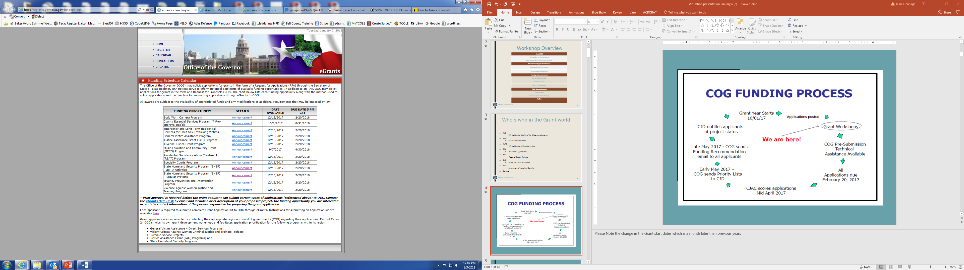
Request for Applications (RFA)

Slide 43
Questions?
eGrants questions? Contact the eGrants Help Desk
  eGrants@gov.texas.gov, or via telephone at: (512) 463-8382 or dial 7-1-1 for relay services
Programmatic questions? Contact your Grant Manager or the HSGD/CJD Preparedness Programs Manager
Notes:
Slide 36 – Questions
Presenter:
Field questions, record those that need to be referred to the OOG-HSGD/CJD.

Slide 44
Application Development:
Objectives
Increase familiarity with the information requirements
Be able to identify common errors to avoid
Clarify understanding of information requirements
Reduce the number of application revisions
Notes:
Slide 37 – Application Development: Objectives
Presenter Notes: Review the objectives for the Application Development module of the presentation.
Our first objective in this module is to become familiar with important areas in each tab
Second, identify common errors to avoid
Third, gain a clearer idea of the information the OOG-HSGD needs in each tab and why it is important
Last, become better prepared to complete an application

Slide 45
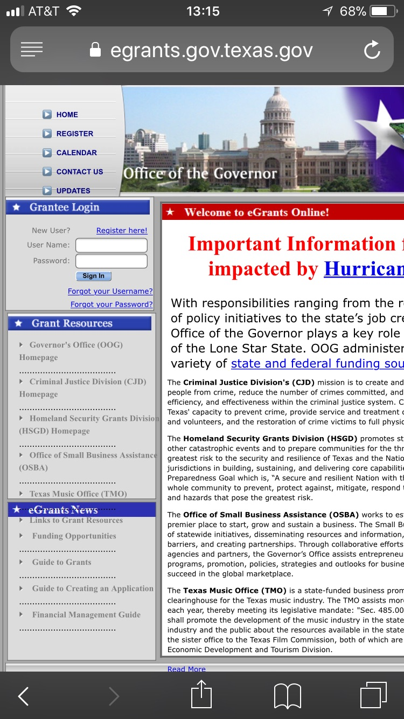
https://egrants.gov.texas.gov/Default.aspx

Slide 46
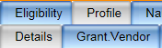
Application Development:
Profile Tab
Sub-tabs
  Details
  Grant Vendor
Notes:
Slide 39 – Application Development: Profile Tab
The Profile tab consists of two (2) sub-tabs: Details and Grant Vendor

Slide 47
Application Development:
Profile/Details Tab
Identifying Information
Project Title
Project dates
Target Area Information
Grant Officials and contact information
Notes:
Slide 40 – Application Development: Profile Tab: Details
Identifying Information - This information tells the OOG who the Applicant is, identifies the project, and provides the project’s planned start/end dates.
Presenter Notes: briefly cover the areas on the slide then transition to next slide for a screen shot of the tab and more detail.

Slide 48
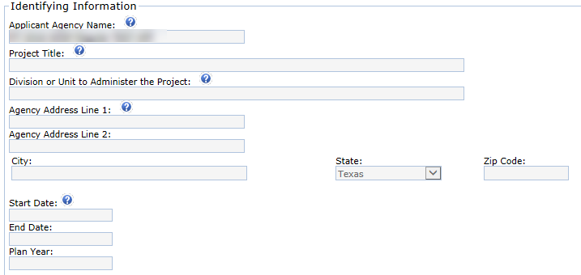
Application Development:
Profile/Details Tab
Project start dates must be the 1st of the month.
Project end dates must be the last day of the month.
eGrants will not allow any other dates between the first and last day of a month for project dates.
Notes:
Slide 41 – Application Development: Profile Tab: Details
Applicant Agency Name
Applicants enter the legal name of the agency requesting funding. Local governments should enter the legal name of a city (“Sample, City of”) or county government (“Sample County”). Applicants should use this standard format so all records within the system can be located by Agency Name in a consistent manner.
Project Title
The project title should provide an indication of what the project is. (Examples: Interoperable Communications, Planning, Fusion Center Sustainment, Special Team Sustainment, etc.)
Division or Unit to Administer the Project
This information tells the OOG who will be administering the grant.
Agency Address
This is the physical address for the applying agency and must include the zip code plus four. (Applicants can get this information from the local post office if it is unknown).
Agency Address Line 1: Enter the physical address for this project. If your organization is required to keep this information confidential, please enter a mailing address instead for this project.
Common Error: Entering 0000 in the zip plus four
Start/End Dates
Project Period: Grant-funded projects must begin between September 1, 2018 and March 1, 2019, and expire on or before August 31, 2020. Additional guidelines are noted below:
Project periods should be structured so that projects that include grant-funded salaries and/or annual recurring costs do not overlap with the project periods of previous or future grant awards with the same costs
Project periods should be structured so that grants with annual recurring grant-funded expenses are on a 12 or 24-month grant cycle/performance period.
Project periods for equipment only projects are generally awarded for a 6 to 12 month grant period.
HSGD will consider proposed start or end dates following outside of these guidelines on a case-by-case basis.
Presenter Notes: Remind the applicants that the start date must be the first day of the month and the end date must be the last day of the month. The Plan Year is an HSGD field that will autofill based on project start date entered.

Slide 49
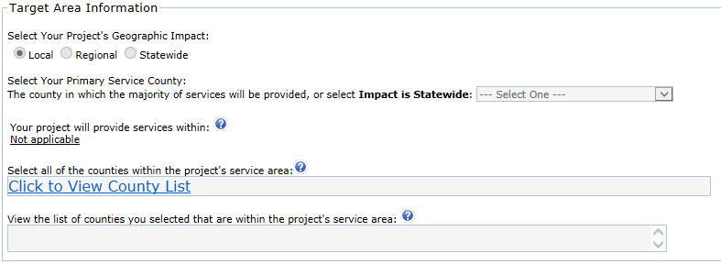
Application Development:
Profile/Details Tab
Notes:
Slide 42 – Application Development: Profile Tab: Details
Target Area Information
This area refers to the geographical area the project is targeting to impact. Follow the directions for each field.
Note: If the Impact is Local, only one County should be listed under the Service Area. If the Impact is Regional, more than one County should be listed under the Service Area.

Slide 50
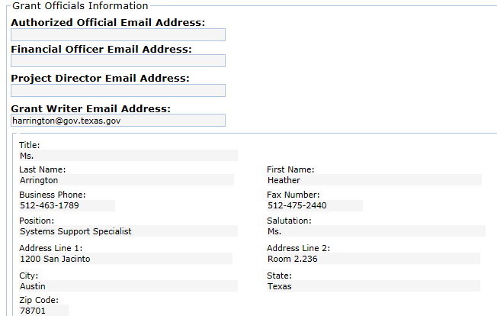
Application Development:
Profile/Details Tab
Insert the email address linked to the designated official’s eGrants account. If the designated official does not have an account, one will need to be established for them.
Ensure the contact information in the official’s profile is correct. This is the information the OOG will use to contact them.
Notes:
Slide 43 – Application Development: Profile Tab: Details
Grant Officials and contact information
Grant Officials – The Authorized Official (AO), Financial Officer (FO) and Project Director (PD) must be three different individuals. Applicants must take care in designating and/or delegating their Grant Officials. 1 TAC §3.2501, Grant Officials
The Authorized Official (AO) should be the chief elected official or officer of the applying agency, e.g. County Judge, Mayor, COG Executive Director, etc. This is the person that is responsible for designating the other grant officials. If the Authorized Official is delegated to anyone other than the chief official, the position shall be included in a resolution from the governing body designating the individual OR position title as the AO.
NOTE: The OOG recommends using position titles in the resolutions. If the official is named, then leaves office for any reason, the OOG will require a new resolution whereas if the position title is used, the incoming official is covered by the existing resolution. Any requirement to include the name of the official is strictly that of the applying agency.
The Financial Officer (FO) should be the Chief Financial Officer for the applying agency, e.g. County Auditor, Finance Director, etc. Applicants are responsible for ensuring that only responsible and capable individuals are designated as the FO. The applying agency should not delegate this responsibility to junior level personnel and it cannot be a general agency clerk. The FO should have adequate experience and knowledge of grants accounting. The applying agency may be asked to certify the designated FO has the appropriate skills and knowledge to perform the assigned duties.
The Project Director (PD) is the official that will be the most familiar with the project. The PD should be involved in the day-to-day performance of the grant and must be an employee of the applying agency.
The Grant Writer may be the same individual that fills the role of one of the Grant Officials. The Grant Writer has no authority or ability to modify the application after it has been certified by the Authorized Official. The Grant Writer also has no permissions to request adjustments once an application has been awarded.
Contact Information
This information comes from the profile information entered into each eGrant user’s account when it was created/updated. The contact information will display after the email address for the official is entered and linked to the application record.
The information provided must be correct. The Grant Manager or Program Manager may need to contact Grant Officials during the life of a grant. Applicants should use official organizational email addresses only.

Slide 51
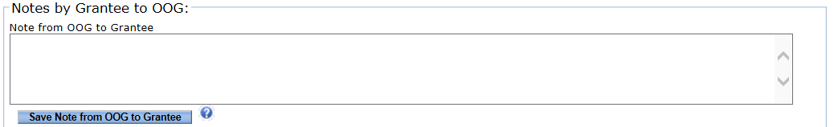
Application Development:
Profile/Details Tab
Notes by Grantee to OOG
  Use to add important information as needed in the grant record
  Subject to public records regulations
  Grant business only, notes cannot be deleted
  Should only pertain to items on the respective tab
Notes:
Slide 44 – Application Development: Profile Tab: Details
Notes by Grantee to OOG
This area is available on several tabs throughout the application. Applicants can type notes or comments that are visible to the OOG. This opens a way for the Applicant to communicate with the OOG for a number of reasons. This may include responding to a question asked by the OOG in this area, clarifying any statements made under a particular tab in the application, or adding further detail on any changes.
NOTE: Notes added to this section cannot be deleted and are subject to public records regulations. Entries into this area should only pertain to items on the respective tab and pertinent to the grant itself.

Slide 52
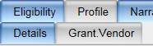
Application Development:
Profile/Grant Vendor Tab
Vendor Identifying Information
  Organization Type
  Federal Employee Identification (FEI) Number
  DUNS Number
System for Award Management (SAM) Expiration
Notes:
Slide 45 – Application Development: Profile Tab: Grant Vendor
Applicants use the drop down menus to select the appropriate Organization type. Additionally, the applicant needs to select the matching payment information (pick the radio button that matches the uploaded documents or select “No Match”, and then enter their applicable DUNS number and SAM Expiration Date on this tab.
Presenter: The next slide displays an example of the tab for clarity.

Slide 53
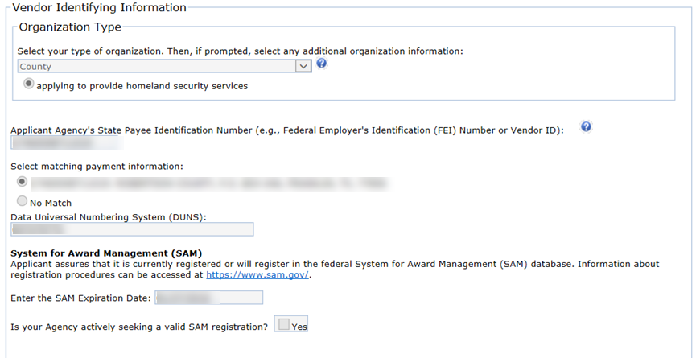
Application Development:
Profile/Grant Vendor Tab
The applicant needs to select the matching payment information
Notes:
Slide 46 – Application Development: Profile Tab: Grant Vendor
Presenter: Use this slide to point out the location of each area discussed on the previous slide.

Slide 54
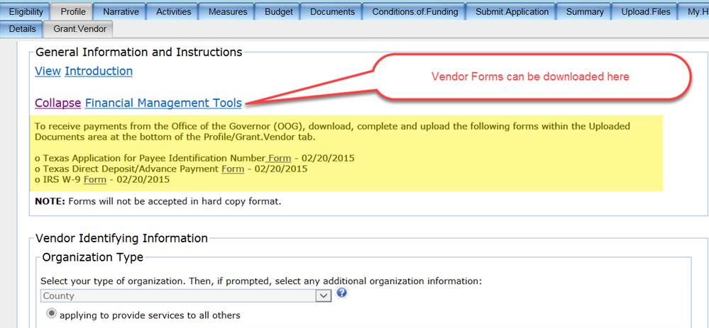
Application Development:
Profile/Grant Vendor Tab
Notes:
Slide 47 – Application Development: Profile Tab: Grant Vendor
Upload Vendor Information Documents: In order to streamline the OOG review process, Applicants/Grantees are required to submit the Direct Deposit Form, New Payee ID Form, and W9 Form with each application. These documents are required because they are necessary for the grantee to receive grant payments.
Applicants submitting more than one application may use the new Global Upload Feature in eGrants. This feature can be found on the My.Home tab. More information and steps to use this feature are covered later in the presentation. (Slides 47 – 49)
The applicant must ensure that blank documents are not uploaded to the application. This will delay the application review process.
The forms are available within the General Information and Instructions section at the top of the Grant Vendor subtab under the Link labeled “Financial Management Tools”.

Slide 55
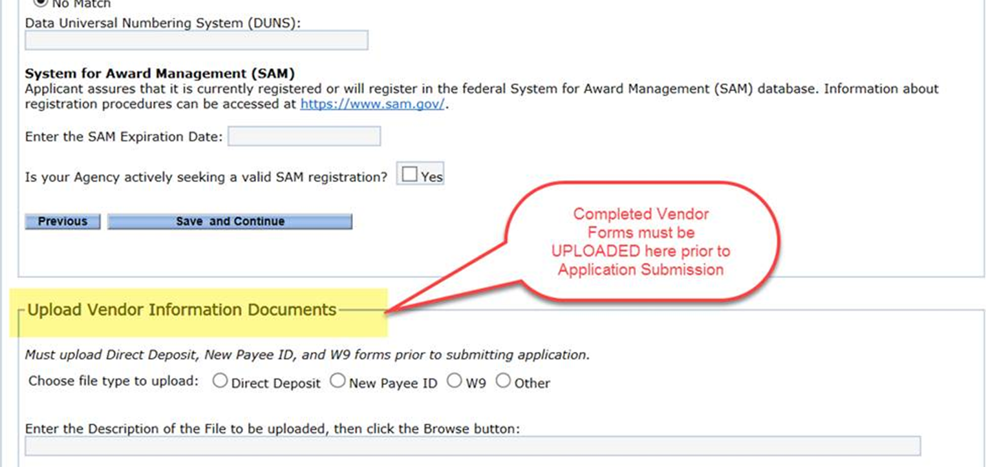
Application Development:
Profile/Grant Vendor Tab
Notes:
Slide 48 – Application Development: Profile Tab: Grant Vendor
Upload: The Applicants/Grantees may upload these documents directly onto the Grant Vendor tab. The uploaded documents will be validated prior to submission in eGrants. This means that the application cannot be submitted without the required documentation. The documentation will only be visible to the Applicant’s Financial Officer and the OOG Financial Services Division due to the sensitive information contained therein.

Slide 56
Application Development:
Narrative Tab
Project Summary
Problem Statement
Existing Capabilities
Existing Capability Gaps
Impact Statement
Homeland Security Priority Actions
Target Group
Long-term Approach
Notes:
Slide 49 – Application Development: Narrative Tab
Presenter Notes: Note that these areas contain information from sources belonging to the Applicant, this is information the OOG uses to make determinations on the eligibility and/or effectiveness of a project. Further, OOG uses the information to prepare the State’s application to FEMA and prepare project summaries for general information requests.
The Project Summary:
The Project Summary is the area for the Applicants to tell the OOG-HSGD what they want to do with the funds they are requesting. The summary should focus on how the project will affect prevention, protection, mitigation, response and/or recovery from terrorism events. The purpose of projects funded through HSGP grants must specifically connect to terrorism, not natural disasters. While the project may serve both purposes, the primary purpose for the grant must be terrorism related. This is the applicant’s one and only chance to make a solid case for funding.
Terrorism related focus
Should support the selected activity (Activities tab) and core capability (Homeland.Security tab)
Must be clear and concise; a reader with no knowledge of the project, the applying agency, or the region must be able to understand what it is the Applicant wants to do
Recommended length: 3-4 sentences/150 words or less
Common Issues:
The project summary focuses on natural hazards/disasters and/or there is no connection to terrorism.
Does not support the selected core capability or activity
Discusses threats and capability gaps without stating anything about what will be done
Discusses the need for the project without discussing the actual project.
The project summary is too long and includes too much information that belongs elsewhere in the narrative (e.g. includes long descriptions of all of the threats facing the jurisdiction).
Problem Statement:
The Problem Statement is a general statement regarding the problem the project addresses. This statement should cover existing threats and hazards that correspond with the threats related to terrorism in the Applicant’s regional THIRA. This statement should focus on the terrorism threats the project will address.
The Problem Statement should:
Be specific, cite threats and scenarios in the regional THIRA if possible
Be brief, focus on the terrorism threats and hazards the project will target as opposed to all of threats and hazards in the region
Remain focused on the threats and hazards. Information on capability gaps, project impact, etc. can be detailed in the appropriate section
COMMON ISSUES:
Long problem statements with little information regarding threats or hazards
Restating information from the project summary
Focusing on natural disasters rather than terrorism related events
Duplicative information found in other areas of the narrative
Existing Capability Levels:
This area should consist of a concise summary of existing capabilities or resources currently available to the Applicant that support the proposed project activities.
This area should answer two questions:
What capability will the project enhance/replace/or build upon?
What is currently in place that will support this project?
Keep the focus of the description limited to the existing capabilities. The next section will be the focus for the capability gaps.
Common Issues:
Information provided describes the need for funded activities rather than what is in place already
Problem Statement included. This occurs when the applicant copies other narrative information into multiple fields
Detailing the capability gaps. Touching on the gaps may provide some clarity however, the details should be provide in the capability gaps area (next section).
Simply stating N/A. (If the applicant is using the funding to build a new capability, a brief explanation of this can be provided in this section.)
Capability Gaps:
An Applicant should use this section to provide a description of specific gaps the project will address and their connection with gaps discussed in the State Preparedness Report (SPR).
Be clear on the gap the project is going to address
Keep the focus on the gap being filled
Reference the gap as identified in the Regional SPR (State SPR for State agencies)
The gap should be consistent with the core capability and activity identified elsewhere in application
Common Issues:
The Applicant entered “N/A” or “none”. (If the applicant is proposing funding to sustain a capability, this section should describe how the project will prevent a gap.)
The Applicant restates the need for equipment as the gap rather than tying the need to a gap in the SPR.
Including information about capability gaps that are not addressed by the project
Limiting the information to a page number in the SPR
Not including a page number in the SPR where the capability gap is referenced
Impact Statement:
This is a statement of the primary objective(s) of the project. This is not a re-statement of project activities. This answers the question; what will the completed project accomplish?
Tells the reviewer what the project will accomplish
Builds on the intended impact the applicant provided in the Project Summary
Common Issues:
Applicant re-states the project activities
Applicant does not describe what the project will accomplish
Homeland Security Priority Actions:
The Homeland Security Priority Actions are found in the Texas Homeland Security Strategic Plan 2015-2020. Applicants/Grantees shall select only ONE action that most accurately ties to the project. Applicants should follow the specific format example provided within the instructional text on the narrative page.
Select the most appropriate action
Some projects may not have a perfect fit. Get as close as possible.
Only need to enter the action. The goal and objective can be deduced with just the priority action number noted. (see next Slide for examples)
Common Issues:
Referencing Homeland Security Objectives (The Priority Actions nest within the Objectives)
Selecting more than one action
Selecting an action unrelated to the project activities
Cutting then pasting the formatting example given on the tab or by a Grant Manager rather than the applicable action
Target Group:
This area is a description of who is benefitting from the project. For example: City of XXX SWAT; Regional First Responders, etc. The intent is to capture who is the recipient of the activities funded by the grant. For example, if a grant is purchasing equipment for a specialized team, the specialized team is the target group. The population would be the number of responders on the team.
Common Issues:
Using the population of the city, county, region, or state as the target group without covering the actual group that will be receiving equipment, training, or salaries funded by the project.
In some cases, the general population in an area may be the target group.
Long-term Approach:
The long-term approach is a description of how the Applicant will maintain the capability if funding becomes unavailable. If the capability cannot be maintained without funding, state this. If the Applicant will maintain the capability with other funding sources, state this and provide the funding source.
Should include:
If the applying agency will seek future local funds to maintain/sustain the project’s capabilities
What actions the applicant is taking to secure other resources to support the project's capabilities, if applicable
If the capability cannot be maintained without federal grant funding
Common Issues:
Area left blank
Entry does not offer a description of how the applying agency will maintain the capability
Focus on repairs and up keep versus how the applying agency will retain the capability.

Slide 57
Application Development:
Narrative Tab
Homeland Security Priority Action Examples
1.2.3 - Expand and enhance the network of human sources that can provide detailed and relevant information on known or suspected terrorist and criminal enterprises.
OR
4.7.1 - Ensure adequate homeland security training is available to and completed by leaders with homeland security responsibilities, first responders, and key stakeholders throughout the state.
Notes:
Slide 50 – Application Development: Narrative Tab
Presenter: Use this slide to show two different examples of Homeland Security Priority Actions

Slide 58
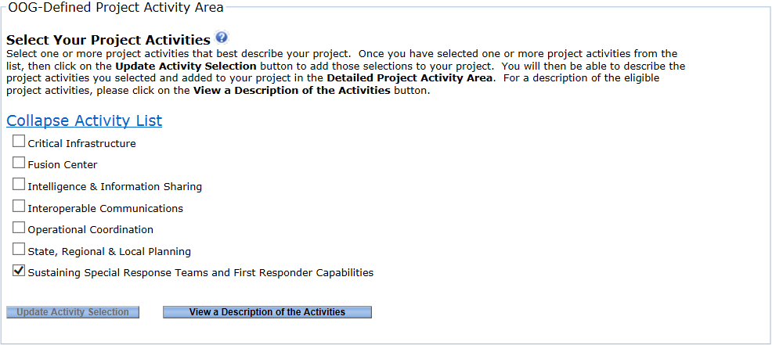
Application Development:
Activities Tab
Select only one (1) activity per application
Activities align with the OOG Investment Justification (IJ)
Click here to view a description of activities
Notes:
Slide 51 – Application Development: Activities Tab
HSGP Instructions for Project Activity Selection
Homeland Security Grant Program (HSGP) applicants should only select ONE (1) project activity. The eGrants system will allow multiple selections, but each HSGP subrecipient project must fit into one and only one of the Investment Categories that are listed as project activities under the "Activity List".
Applicants may review the activity descriptions included within the RFAs under the “Eligible Activities” section or by clicking the “View a Description of the Activities” button on this page in eGrants. Applicants should pick the one activity that that most closely matches the planned project activities and then click the button to "Update Activity Selection".
Presenter Notes: Please note that the HSGD is not the only division of the OOG using eGrants. Because of this, there is language in the tab that refers to “one or more” activities.

Slide 59
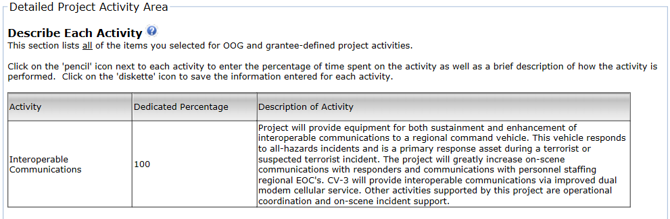
Application Development:
Activities Tab
Notes:
Slide 52 – Application Development: Activities Tab
Detailed Project Activity Area: This area should be a short summary description of what the project will do based on the selected activity.
Dedicated Percentage: The applicant will enter 100% as the dedicated percentage since all SHSP projects must be tied to only one Activity.
Presenter Notes: The detailed project activity information is entered into a table. The applicant will click on the “pencil” icon to enter/edit the information and the “disk” icon to save the information they have entered.

Slide 60
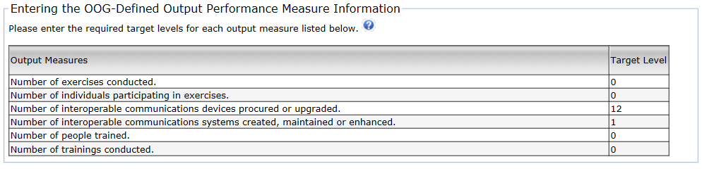
Application Development:
Measures Tab
Entering the OOG-Defined Output Performance Measure Information
Creating Custom Measures
Notes:
Slide 53 – Application Development: Measures Tab
Entering the OOG-Defined Output Performance Measure Information
When the Applicant selects an activity on the Activities tab, eGrants auto-populates a set of measures in the Measures tab. The Applicant provides the “Target Level” for the measures specifically related to the proposed activities funded by the grant.
Every Activity includes the following measures:
Number of exercises conducted
Number of individuals participating in exercises
Number of people trained
Number of trainings conducted
Provide the Target Level data for these areas only IF the grant will fund Exercises or Trainings. Otherwise, the Applicant should enter a zero (0). This rule is applicable to other measures that may also not be relevant to the grant-funded activities.
Each project is different and the auto-populated measures may or may not apply. All projects should have at least one applicable measure. It may be necessary for the Applicant to work with their Grant Manager during the review process to ensure the appropriate measures are established for the proposed project.
Creating Custom Measures
This area allows the option for an Applicant to create Custom Performance Measures. These measures must follow the same rules as the OOG-Defined Performance Measures. Custom Measures are not necessary in most cases. Enter only those measures that relate to grant-funded activities. Custom measures should not be duplicative of the OOG-Defined Performance Measures.

Slide 61
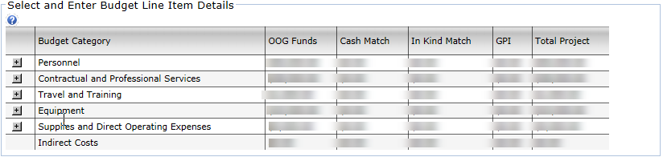
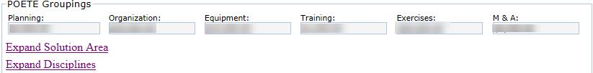
Application Development:
Budget Tab
Notes:
Slide 54 – Application Development: Budget Tab
Many of the issues identified during previous grant application reviews came from items in the budget. Common issues include but are not limited to:
Poor line item descriptions - Descriptions that lack enough detail for the OOG to determine what the item is, if the item is allowable and whether the amount listed is a "reasonable and necessary" cost for the grant project.
The use of an inappropriate AEL code – It is important to read the ENTIRE AEL code description before selection. The code itself may exclude the item an Applicant intends to purchase. Note: A link to the FEMA AEL descriptions is provided on the budget tab. Once a budget category is opened in eGrants, applicants may use "Control+F" to bring up a search field to find items in the eGrants list by keyword or number.
Equipment quantities omitted, we need to know quantities to determine if the costs are reasonable. There will be more information on quantities later in the presentation.
Budgeting rent vs. depreciation when budgeting for office space. A grantee cannot charge rent if the space is within a building owned by the applying agency. In this case, the applicant can use depreciation and must provide specific information covered later in the presentation.
Multiple items rolled into one line item(s) that are not broken out appropriately. An example would be multiple radio accessories purchased separately from the radios that were not already included in accessories that come with the radios (including pouches, spare antennas, spare batteries, chargers, earpieces, and speaker microphones.)
Line items mistakenly placed in the wrong budget category, such as items that are direct operating expenses placed under Contractual and Professional Services. The OOG-HSGD also noted trends in placing equipment items under supplies or vice-versa.
The OOG-HSGD is available to help applicants determine where to place items in their budget if needed. Please do not hesitate to contact your Grant Manager during the application process or following the grant review when making corrections. Additionally, the expectation is that the applicants will seek assistance if there are questions. The Grant Managers at the OOG are available to assist applicants that have questions about what budget category, AEL, or POETE category is most appropriate for an anticipated expenditure line item.

Slide 62

Application Development: Budget/Details:
POETE Groupings
Planning, Organization, Equipment, Training, Exercises (POETE)
M&A
Solution Area
Disciplines
Notes:
Slide 55 – POETE Groupings
FEMA requires states to track expenditures at a detailed level, including within the following categories referred to as “POETE”:
Planning costs
Organization costs
Equipment costs
Training costs
Exercise costs
M&A: Each SHSP grant within eGrants is allowed to use up to 5% of the subgrant award amount for Management and Administration costs; these are activities related to administering the grant funds received.
eGrants ties each line item to a POETE category and calculates the overall sum. Within the POETE Groupings area, located at the bottom of the Budget tab, applicants must also classify budgeted costs within each POETE category to Solution Area and identify the Disciplines associated with those costs. If an Applicant needs assistance, they are encouraged to contact the COG or their Grant Manager.

Slide 63
Application Development: Budget/Details
Personnel
Line Item Descriptions
Salary percentages
Salary periods (12-24 months)
Notes:
Slide 56 – Personnel
This budget category is for grantee staff positions with clear, defined duties and responsibilities connected with the grant. Positions listed here must be employees (current/future) of the applicant agency, not contractors or positions within another organization. Applicants/Grantees must be able to articulate what duties each of the personnel perform in supporting the outcome of the grant. Federal grant funding cannot supplant existing salaries.
Line Item Descriptions:
The description for each position must include the employee’s duty title, whether the employee is full-time or part-time status, the time period/date range the salary will cover, and a description of duties or tasks related to the grant.
Presenter Note: Personnel Line Items examples will be displayed in the next slide.
Grantees should be aware that they must maintain and might be required to provide detailed timesheets and additional documentation during a monitoring review.
Qty/% of Salary
The salary percentage must be included in the appropriate column. This percentage represents the portion of each employee’s salary expected to be charged against the grant. When a grantee is monitored, the percent of time this position works on grant-funded activities must be equal to or greater than the percent of salary listed within the grant budget.
Salary Periods
The OOG-HSGD requires all grant-funded salaries to be on a 12 or 24-month period that aligns with the grant cycle/performance period. This move is a control to counter the potential for double charging a salary across two separate grants. Grantees that elect to use a 24-month period will only be considered for grants to support those salaries every other grant year, versus every year for those that elect a 12-month period. Grant awards containing 12 months of budgeted salaries should only have a performance period of 12 months in order to prevent overlapping performance periods with prior and future grant awards supporting the same salaries.
Common Issues: The description(s) lack detail and/or information that would help the OOG determine if the cost is reasonable or necessary to achieve the proposed project activities.

Slide 64
Application Development: Budget/Details
Personnel
Example Personnel Line Item Descriptions:
HS Planner, Full-Time, 1/1/18 – 12/31/18, Coordinates all homeland security planning activities for 10-county COG region.
Exercise Coordinator, Part-Time 20 HRS, 1/1/18 – 12/31/18, Coordinates all homeland security exercises for the 10-county COG region.
Senior Accountant, Part-Time 10 HRS, 1/1/18 – 12/31/18, Tracks all grant-related expenses, prepares financial status reports, and maintains supporting documentation for expenditures.
Notes:
Slide 57 – Personnel
Examples:
HS Planner, Full-Time, 1/1/18 – 12/31/18, Coordinates all homeland security planning activities for 10-county COG region.
Exercise Coordinator, Part-Time 20 HRS, 1/1/18 – 12/31/18, Coordinates all homeland security exercises for the 10-county COG region.
Senior Accountant, Part-Time 10 HRS, 1/1/18 – 12/31/18, Tracks all grant-related expenses, prepares financial status reports, and maintains supporting documentation for expenditures.
While not required, it is helpful to add an employee’s initials to the description, especially if the employee’s salary is funded through multiple grants. This aids a reviewer in determining the reasonableness of the costs.

Slide 65
Application Development: Budget/Details:
Contractual and Professional Services
Definitions:
  Contract
  Professional Services
Authorized Equipment List (AEL) codes
  https://www.fema.gov/authorized-equipment-list
Line Item Descriptions
Notes:
Slide 58 – Contractual and Professional Services
Contractual and Professional Services include services and assistance obtained from other organizations to support the project scope of work.
Presenter Notes: Use the information below to clarify or explain how Contractual and Professional Services are defined for any participants that may need it.
Contract: A written agreement where a contractor provides goods or services in accordance with the established price, terms and conditions (Texas Comptroller of Public Accounts, 2016).
Professional Services: Professional services are typically those that are provided by someone who is required to be licensed or registered with the state. In the context of Homeland Security this may include, but is not limited to, accounting, engineering or medical services. Services provided by professionals outside the scope of their profession, e.g. management consulting services provided by registered nurse, are not considered professional services.
Authorized Equipment List codes:
Be sure to read the description of each AEL code used to ensure that it is the most appropriate code for the line item. The codes and their descriptions may be found at: https://www.fema.gov/authorized-equipment-list
Line Item Descriptions:
Line Items Descriptions for this area shall include:
A description of services, detailed enough for the Grant Manager (GM) and OOG to understand what services are being provided and how they support the grant activities.
Contract Period; this period should align with the same 12 or 24 months cycle as personnel. Note: contract costs may be pro-rated to fit within a specified grant period.
Contract Rate, how the payment for services in calculated.
The Line Item description should also include:
Vendor Name if available – Applicants, DO NOT forget to check vendors in SAM and on Texas CPA. Some vendors may have been debarred since last checked. It is the responsibility of the sub-grantee to verify a vendor’s status in SAM prior to procurement.
Maintenance Agreements
Applicants should use caution when entering into maintenance agreements. The OOG will need to have a clear understanding of what type of maintenance is included in the planned project and if any of the work will require an EHP screening.
Common Errors:
Not enough information on the purpose of the contract
Direct Operating Expenses placed in this area
Personnel/employees of the Grantee placed in this budget category

Slide 66
Application Development: Budget/Details:
Contractual and Professional Services
21GN-00-INST Installation
  Helicopter Installation to include- Installation of Meeker Aviation for nose mount kit (nose mount kit and lower/upper dovetails), landing light kit (nose mount light kit, landing light, and taxi light), and search light kit (searchlight mount kit and lower/upper dovetails). Installation of FM Radio (FM connector box and tri-band antenna), Camera system, search light slaved to camera,. Removal of excess wiring, equipment, weighted plates, etc. and manufacture cover plates. Perform re-weighs, FAR 91.411 transponder (2yrs), and FAR 91.413 pitot static (2yrs). Shipping and labor included in installation/performance costs.
Notes:
Slide 59: Contractual and Professional Services
Contractual and Professional Services Line Item Description Example
21GN-00-INST Installation
Helicopter Installation to include- Installation of Meeker Aviation for nose mount kit (nose mount kit and lower/upper dovetails), landing light kit (nose mount light kit, landing light, and taxi light), and search light kit (searchlight mount kit and lower/upper dovetails). Installation of FM Radio (FM connector box and tri-band antenna), Camera system, search light slaved to camera,. Removal of excess wiring, equipment, weighted plates, etc. and manufacture cover plates. Perform re-weighs, FAR 91.411 transponder (2yrs), and FAR 91.413 pitot static (2yrs). Shipping and labor included in installation/performance costs.

Slide 67
Application Development: Budget/Details:
Travel and Training
Line Item Descriptions
Training Review Worksheets
In-State considerations
Out-of-State considerations
Overseas considerations
Notes:
Slide 60 – Travel and Training
This category is for travel and training costs for Grantee Agency Personnel only. Cost for non-agency personnel should be placed under operating expenses.
Line Item Descriptions:
Line item descriptions in this category shall include:
The names of conferences and/or location of travel (if known)
The dates of planned travel (if known)
Number of personnel traveling to each event
Other detail to help convey the cost budgeted is reasonable and necessary (i.e. number of days/nights for lodging, per diem, estimated trip cost per person, etc…)
When a line item includes any training, a Grant Manager will place a special Training Review Condition hold on the item. This hold requires the Applicant to submit a Training Review form and receive approval prior to attending training.
Training Review Worksheets
If required, after award but before participating in the training, the Applicant must complete the Training Review Form. Any hold placed on the grant will not allow reimbursement of funds until the Grantee has met the condition. IF training is not approved the Grantee will not receive reimbursement for expenditures resulting from non-compliance.
In-State considerations
Applicants should use two separate line items for training registration/course fees and mileage/incidental costs. The training line item descriptions need to include information to support how the cost(s) in the budget were estimated, such as: the training name/course title, dates for training, location of training, estimated travel cost per trip per person, number of participants for each trip/event, and a brief description of the travel/training. Additionally, Applicants should include the venue for the training. This detail will help the OOG-HSGD determine if an EHP is required for the training or exercises.
Out-of-State considerations
Similar considerations should be made for out-of-state travel or training. Training out-of-state requires approval through the OOG to ensure that comparable training is not available within the State. Similar to In-State training, the line items should be broken out to two separate line items for training registration/course fees and mileage/incidental costs. Additionally, the training line item descriptions need to include the training name/course title, dates for training, location of training, number of participants for each event, and a brief description of the training.
International Considerations
The Department of Homeland Security (DHS) must approve any international travel in advance. All international training requires additional documentation be submitted through HSGD to DHS/FEMA for approval. If an Applicant has identified potential international travel and training opportunities, they should contact the OOG-HSGD for more information on the DHS training approval process and the required documentation as soon as possible following the acceptance of the award, if funded. This process can take up to 60 days to review and approve.

Slide 68
Application Development: Budget/Details:
Travel and Training
Example Line Item Descriptions
In-State Incidentals and/or Mileage (Planning)
  Attendance to the following trainings: The Texas Emergency Management Conference in San Antonio in May 2018 (1 staff member @ $1,500), Terrorism Risk Management workshop in Austin in June 2018 (1 staff member @ $700), and Regional Preparedness Conference in Sample, Texas, in November 2018 (2 staff members @ $500/person).
In-State Registration Fees (Training)
  Defense Against Methods of Entry in Sample County Sheriff's Academy, Sample, TX (09/12/18 - 09/16/18). Training for one (1) technician @ $1,500: breaching, booby traps, advanced electronic, wire defeat/hand entry, -sustain and provide the bomb technician with the skills to identify and neutralize explosive devices used in terror events.
Notes:
Slide 61– Travel and Training
The first example is suitable in cases where the travel and training to be funded has not yet been determined.
In-State Incidentals and/or Mileage (Planning)
Attendance to the following trainings: The Texas Emergency Management Conference in San Antonio in May 2018 (1 staff member @ $1,500), Terrorism Risk Management workshop in Austin in June 2018 (1 staff member @ $700), and Regional Preparedness Conference in Sample, Texas, in November 2018 (2 staff members @ $500/person)
The next example shows a specific training event.
In-State Registration Fees (Training)
Defense Against Methods of Entry in Sample County Sheriff's Academy, Sample, TX (09/12/18 - 09/16/18). Training for one (1) technician @ $1,500: breaching, booby traps, advanced electronic, wire defeat/hand entry, -sustain and provide the bomb technician with the skills to identify and neutralize explosive devices used in terror events.

Slide 69
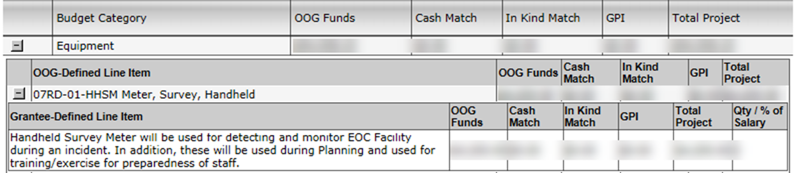
Application Development: Budget/Details:
Equipment
2 CFR § 200.33 – Equipment
State Controlled Assets
Authorized Equipment List (AEL) codes
Line Item Descriptions
Quantity
Notes:
Slide 62 – Equipment
2 CFR §200.33 Defines Equipment as –
“Equipment means tangible personal property (including information technology systems) having a useful life of more than one year and a per-unit acquisition cost which equals or exceeds the lesser of the capitalization level established by the non-Federal entity for financial statement purposes, or $5,000. See also §§200.12 Capital assets, 200.20 Computing devices, 200.48 General purpose equipment, 200.58 Information technology systems, 200.89 Special purpose equipment, and 200.94 Supplies.”
State Controlled Assets
The following items valued between $500.00 and $4,999.99 are designated by HSGD or the Texas Comptroller as controlled assets within the State Property Accounting guidance and are also considered equipment items that must be maintained within the grantee’s inventory records:
Sound systems and other audio equipment
Cameras
TVs
Video players/recorders
Desktop or laptop computers
Data projectors
Smartphones, tablets and other hand held devices
Mobile/Portable radios*
*Note: HSGD has designated mobile and portable radios as a controlled asset.
When adding items into this area of the budget, Applicants should take the time to discern if what they are planning to purchase is actually equipment. The Uniform Guidance (2 CFR 200) definition of Equipment and state controlled asset list can be used to help applicants in making that determination. Moreover, the 2 CFR 200 definition of equipment includes references to other areas of the Uniform Guidance. Applicants should familiarize themselves with these as well. Keep in mind; the items in this area of the budget (equipment) will need to be listed on your local inventory of equipment.
AEL Codes
Just as in other areas of the budget, applicants must select the most appropriate AEL codes. Again, applicants must read the description of each AEL code used to ensure that it is the most appropriate code for the line item. Equipment codes may require equipment to meet special requirements or specifications. This may include recognized industry safety standards, protection levels, or engineering specifications.
(Example: Equipment under AEL code 02EX-01-XRAP - X-Ray Equipment, Portable or Transportable must meet the requirements of the National Institute of Justice (NIJ) Standard 0603. - Portable X-Ray Systems for Use in Bomb Identification, or IEEE/ANSI N42.55-2013, American National Standard for the Performance of Portable Transmission X-Ray Systems for Use in Improvised Explosive Device and Hazardous Device Identification, as applicable.) Not all codes have such requirements; Applicants must ensure they are reading the AEL code descriptions completely.
Line Item Descriptions
The line item descriptions are not a reiteration of the AEL code description.
The line item descriptions for equipment shall include at a minimum:
A description of the equipment containing enough detail for a reader with no familiarity with the Applicant or the equipment to understand what the item is and how it benefits the overall project i.e. what is it, who is the end user, and why do they need it?
Per Unit Cost
Presenter Notes: Please explain to the Participants that the reviews at the OOG include divisions outside of the HSGD. These reviews have an influence on the determination to fund a project. A clear, concise, and detailed description can help these reviews move more quickly without requiring the OOG to place a hold on the review to request more information.
Like items may be included in a single line item (e.g. Radio Accessories). Non-like items should be broken out to separate line items (e.g. Computer Hardware (04HW-01-INHW) and Video Camera (04MD-01-VCAM)).
Qty/% of Salary
For equipment line items, the quantity (number of units to be purchased) must go in the Quantity/% of Salary column in the budget.

Slide 70
Application Development: Budget/Details:
Equipment
Example Equipment Line Item Descriptions
07CD-01-DPGC Analyzer, Gas Chromatograph…
  Portable gas chromatograph ACEM 9350/CDS or equivalent for quantitation of organic contaminants in air, water and soil; to be used by FFD response unit
01LE-01-ARMR Armor, Body
  Ballistic Body Armor - The Body Armor is the ballistic type used by HROU and will be worn by the Bomb Technician when accompanying HROU during searches and entries as required by FEMA Typing standards.
02EX-02-RBTL Attachments/Tools, Robot
  NANO with Integrated Display- Small portable x-ray device used with the Small Robot Platform, and other platforms, which will allow for on-scene picture development and viewing of suspect packages eliminating the need to return to a command vehicle for plate development thus saving valuable time (i.e.: scene in in Reliant Center and vehicle is in parking lot).
Notes:
Slide 63 – Equipment
Equipment Line Item Examples
Equipment Line Item Descriptions
07CD-01-DPGC Analyzer, Gas Chromatograph…
Portable gas chromatograph ACEM 9350/CDS or equivalent for quantitation of organic contaminants in air, water and soil; to be used by FFD response unit
01LE-01-ARMR Armor, Body
Ballistic Body Armor - The Body Armor is the ballistic type used by HROU and will be worn by the Bomb Technician when accompanying HROU during searches and entries as required by FEMA Typing standards.
02EX-02-RBTL Attachments/Tools, Robot
NANO with Integrated Display- Small portable x-ray device used with the Small Robot Platform, and other platforms, which will allow for on-scene picture development and viewing of suspect packages eliminating the need to return to a command vehicle for plate development thus saving valuable time (i.e.: scene in in Reliant Center and vehicle is in parking lot).

Slide 71
Application Development: Budget/Details:
Supplies and Direct Operating Expenses
Definitions
  2 CFR §200.94 – Supplies
  OOG Guide to Grants – Direct Operating Expenses
Authorized Equipment List (AEL) codes
Line Item Descriptions
Rent vs. Depreciation
Quantities
Notes:
Slide 64 – Supplies and Direct Operating Expenses
§200.94 Supplies
”Supplies means all tangible personal property other than those described in §200.33 Equipment. A computing device is a supply if the acquisition cost is less than the lesser of the capitalization level established by the non-Federal entity for financial statement purposes or $5,000, regardless of the length of its useful life. See also §§200.20 Computing devices and 200.33 Equipment”
Note: Even though the federal definition of Supplies categorizes computing devices valued at less than $5,000 as supplies, the State of Texas recognizes these devices as well as several other items as Equipment when their value exceeds $499.
Direct Operating Expenses
Direct Operating Expenses include other direct costs such as leases for space, rental costs, tangible items that have a per unit value of less than $5,000, project supplies, office supplies, advertising costs for staff vacancies, etc. Other costs may include but are not limited to communications costs, service subscriptions (WebEOC), or wireless services. Items must be necessary for the purposes of the grant project.
AEL Codes
Again, applicants must select the most appropriate AEL codes. Applicants should read the description of each AEL code used to ensure that it is the most appropriate code for the line item. Equipment codes may require equipment to meet special requirements or specifications. This may include recognized industry safety standards, protection levels, or engineering specifications.
It is the responsibility of the Applicant to determine if the equipment that they plan to purchase meets any requirements outlined in the Grant Notes of the AEL. Additionally, the Applicant is responsible for providing a copy of any documentation (upon request) that verifies the equipment meets these requirements for the grant record. This allows the Grantee and the OOG to validate that the purchased equipment is an allowable cost in the event of programmatic or financial monitoring of the project.
Line Item Descriptions
The line item description should not be a reiteration of the AEL code description.
The line item descriptions for supplies shall include at a minimum:
A description of the Supplies or Direct Operating Expense containing enough detail for a reader with no familiarity with the Applicant or the supply item to understand what the item is and how it benefits the overall project (What is it? Who is the end user? Why do they need it?)
Quantities for items in this budget area should be included in the line item description if applicable or known. Approximate quantities are okay when listing "less" expensive items (e.g. 2-3 video projector bulbs for use in EOC video displays).
Costs for rent shall include the cost per square foot and the number of square feet used for the project. Line items for depreciation of owned real property shall include the same level of detail.
Rent vs. Depreciation
Rent is not an allowable expense IF the applicant owns, or otherwise holds title of, the real property in which the “rented” space is located. Applicants may not charge themselves rent however, they may charge depreciation of the space as an allowable expense.
“Rent is subject to the limitations described in paragraphs (b) through (d) of this section, rental costs are allowable to the extent that the rates are reasonable in light of such factors as: rental costs of comparable property, if any; market conditions in the area; alternatives available; and the type, life expectancy, condition, and value of the property leased” (2 CFR §200.465).
Depreciation is the method for allocating the cost of fixed assets to periods benefitting from asset use. Applicants should refer to 2 CFR §200.436 for more information about depreciation and the requirements.
Presenter Notes: Please reiterate to the Participants that the reviews at the OOG include reviews by divisions outside of the HSGD. These reviews have an influence on the determination to fund a project. A clear, concise, and detailed description can help these reviews move more quickly without requiring the OOG to place a hold on the review to request more information.
Similar to Equipment, like items may be included in a single line item. Non-like items should be broken out to separate line items.
Quantity
Quantities in this category are not required however, it is strongly preferred and usually helpful (in demonstrating the "reasonableness" of the amount budgeted) if the Applicant includes the planned quantity and per unit cost used to estimate the total in the grantee-defined line item description box.

Slide 72
Application Development: Budget/Details:
Supplies and Direct Operating Expenses
21GN-00-SHIP Shipping (Grantee split out the $380 total cost by type of item)
  Shipping costs for Tactical Equipment and Medical Supplies
  (estimated at $125)
  Shipping Costs for Night Vision and Thermal Imager Equipment
  (estimated at $255)
10BC-00-BATT Batteries, All Types, Sizes (Grantee split out the $1,200 total cost by battery type)
  Thermal Imagers: 7.4Volt batteries (20 batteries @ $38 each = $760)
  NVG: 3Volt lithium batteries (12pk @ $22 each x 20 pks = $440)
Notes:
Slide 65 – Supplies and Direct Operating Expenses
Supplies and Direct Operating Expenses Line Item Examples
These examples show where the Grantee split out the costs by expenditure. For Shipping BLIs, a simple “Shipping for Grant Funded Equipment” is sufficient. It will be the responsibility of the Grantee to maintain records for all costs charged against the grant for monitoring purposes.
21GN-00-SHIP Shipping (Grantee split out the $380 total cost by type of item)
Shipping costs for Tactical Equipment and Medical Supplies (estimated at $125)
Shipping Costs for Night Vision and Thermal Imager Equipment (estimated at $255)
10BC-00-BATT Batteries, All Types, Sizes (Grantee split out the $1,200 total cost by battery type)
Thermal Imagers: 7.4Volt batteries (20 batteries @ $38 each = $760)
NVG: 3Volt lithium batteries (12pk @ $22 each x 20 pks = $440)

Slide 73
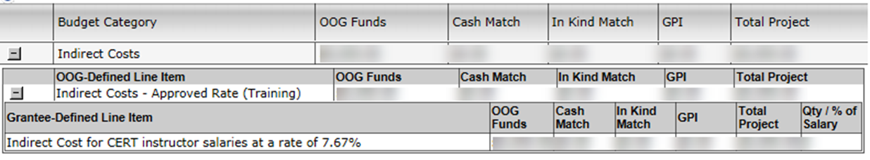
Application Development: Budget/Details:
Indirect Costs
Rate Information
Indirect Cost Rate Letters
Gaps between rate letters
De Minimus Rate
Notes:
Slide 66 – Indirect Costs
Indirect costs are costs without a direct link to a single project or activity. These are frequently aggregated into an overhead cost pool and allocated to various activities.
Rate Information
Indirect costs must include the Applicant’s indirect rate as established by their cognizant agency for indirect costs. Applicants must ensure that the organization’s current indirect rate is in the line item descriptions for indirect costs.
Indirect Cost Rate Letter
Applicants that have negotiated an Indirect Cost Rate should have a letter from the cognizant agency that states the rate. Applicants shall upload a copy of the letter to the grant record.
Gaps between rate letters
The OOG recognizes there is potential for gaps in an Applicant’s indirect Cost Rate letters. In these cases, the Applicant is responsible for ensuring that all indirect cost expenditures remain within their designated rate. A Grant Manager will place an informational condition on the application if the current letter expires before an updated letter can be uploaded in eGrants. This condition does not prohibit the Applicant from receiving reimbursement; it is simply to inform the Applicant that they: a) must ensure they keep all expenditures within their authorized rate, and b.) are required to upload an updated letter when it becomes available. In the event of a change in the indirect rate, applicants should request a grant adjustment in eGrants to update the grant record.
De Minimis
In some cases, an Applicant may not have an approved indirect cost rate. In this case, the applicant may elect to charge a De Minimis rate of 10% of modified total direct costs (MTDC). More information on the De Minimis rate may be found in 2 CFR 200.414. Applicants using the De Minimis rate must confirm that they have NEVER had an approved indirect cost rate AND they are NOT a state, local government, or Native American tribe receiving over $35 million in direct federal funding. Both of these criteria must be met in order to qualify for the De Minimis rate.

Slide 74
Application Development:
Documents Tab
Resolution from Governing Body
Contract Compliance
Lobbying
Fiscal Year
Sources of Financial Support
Notes:
Slide 67 – Application Development: Documents Tab
The information in this slide is related to areas in the Documents tab where Applicants should pay special attention.
Resolution from Governing Body:
The OOG requires a resolution from the Applicant’s governing body. This resolution should follow the example provided by the OOG in eGrants. At a minimum, the resolution should designate the Authorized Official (AO), Identify the applicable grant(s), and contain all of the applicable elements in the example resolution. Applicants must upload the signed resolution into the Application under the Upload Files tab. If an Applicant cannot provide a resolution, the reviewing Grant Manager will place a Condition of Funding hold on the entire project. This condition is met when the applicant uploads the resolution with all required clauses/details etc. described in the example resolution.
Contract Compliance:
If the Applicant has any budget line items under the Contractual and Professional Services category, they must complete this section. The OOG is looking for a brief summary of how the Applicant will monitor the activities of the sub-contractor(s) for compliance with the contract provisions (including equipment purchases), deliverables, and all applicable statutes, rules, regulations, and guidelines governing this project. The OOG is looking for a concise statement outlining specific policies or procedures the Applicant will follow to oversee the contractor and monitor compliance.
Lobbying:
The use of grant funding for lobbying is prohibited per the Request for Applications (RFA), 2 CFR 200.450, and the Notice of Funding Opportunity (NOFO). If the accurate response to the first question under Lobbying is “YES”, the project is not eligible.
If the accurate response to the second question under Lobbying is “Yes” indicating the applicant agency has used non-federal funds for lobbying, the project will be required to complete and upload a Disclosure of Lobbying Activities form.
Applicants must be sure to read the questions closely before responding.
Presenter Note: This is a very common error caused by an Applicant not taking care when completing the application.
Fiscal Year
The OOG asks for this because applying agencies across the state have different dates for their respective fiscal years. These fields inform the OOG of the Applicant’s fiscal year and also allow us to understand when a Single Audit is due (9 months following close of fiscal year or 30 days after the audit report is released, whichever is earlier), if required.
Make note that this is not the period of performance date
Sources of Financial Support
The sources of financial support are the total amount of grant funding an applying agency has received (expended) from the State and/or Federal sources. This amount includes agency funding from all sources and is not exclusive to funds received through the OOG or HSGP. If the total amount of grant funding expended meets the A-133 Single Audit threshold ($750,000), the Applicant must also include the information regarding the date its last single audit was completed.
COMMON ERROR: Listing only the amount the administering division expended instead of the amount the entire applicant agency expended in federal and state (separately) funds.

Slide 75
Application Development:
Homeland Security Tab
Department of Homeland Security (DHS) Project type
Capabilities (National Preparedness Goal)
Project Management Step Involved
Milestones
National Incident Management System (NIMS) Resources
Notes:
Slide 68 – Application Development: Homeland Security Tab
Department of Homeland Security (DHS) Project type
Applicants should select the most appropriate Project Type that applies to the project.
Capabilities
Applicants should select the most applicable (primary) Core Capability for the project from the drop-down in the application. (Applicants may view descriptions of Core Capabilities within the National Preparedness Goal document.)
Additionally, the Applicants must select if the investment will build or sustain capabilities and answer if the assets or activities are deployable, sharable, or neither.
If the project requires new construction or renovation, retrofitting, or modification of existing structures, the Applicants must check the box next this statement.
If the funding for the project supports another project previously funded with HSGP funding, the Applicants must check the box next to this statement.
Project Management Step Involved
Applicants should select the step that most closely resembles the phase of the project activities to be completed during the grant period.
Milestones
Milestones are the most common issue in the Homeland Security tab. A milestone identifies a key point of progress along the critical path of a project. Beginning with the project start date, milestones mark the major deliverables and/or goals leading to the successful completion of a project by the project end date. These events should not include the acceptance of the grant award or closing the project in eGrants, but rather key steps in between these two points. The applicant may want to consider milestones that outline the items relevant to events such as the procurement of equipment, any training related events, or internal organization processes that drive the performance of the grant and are required to complete the project. Milestones should be specific and in chronological order.
The project milestones serve an important purpose for the sub-grantee and the HSGD. Good milestones help a grant project director and the HSGD evaluate the progress of a project after the grant is awarded. HSGD is also required to report to FEMA on project progress using milestone status.
Applicants must enter at least three (3) but no more than five (5) milestones for the project. These milestones should only include those key activities for the project. Ancillary activities, or those not funded by the project, should not be included. Milestones should be relevant to the project’s performance.
National Incident Management System (NIMS) Resources
If the project supports a NIMS typed resource, complete the NIMS Resources section of the tab. The Department of Homeland Security maintains the Resources Typing Library Tool. The tool is an online catalogue of national NIMS resource typing definitions and job titles/position qualifications. National NIMS resource types support a common language for the mobilization of resources (equipment, teams, units, and personnel) prior to, during, and after major incidents. Resource users at all levels use these definitions as a consistent basis when identifying and inventorying their resources for capability estimation, planning, and for mobilization during mutual aid efforts. National NIMS resource types represent the minimum criteria for the associated component and capability (Department of Homeland Security, 2016). This tool may be helpful in completing this section of the application. If the project does not support a NIMS typed resource, no action in this section is required.

Slide 76

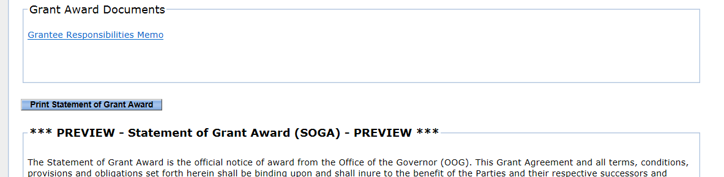
Application Development:
Summary Tab
Grant Issues
Award Statement
Notes:
Slide 69 – Summary Tab
Grant Issues
Once the Application has been through Intake and Grant Review, the Grant Manager may return the application, referred to as the Preliminary Review Report (PRR), to the Applicant if updates are required. The Applicant may review all notes made during the review under the Summary/Grant Issues tab.
This summary gives the Applicant visibility and notes from the OOG on the corrections or revisions needed in order to forward the Application to Program Review. Applicants should pay special attention to all of the notes and take action accordingly.
COMMON ERRORS:
Failing to review and/or not addressing all issues
Waiting to address issues with the application - This has required the OOG to place holds on the application and may delay the award and/or release of grant funds if the project is funded.
Applicants should understand that this is not the end of the review process and, when needed, the OOG may request more information to clarify portions of the application. For this reason, it is important to resolve any issues quickly in order for the application to move through the process more quickly.
Award Statement
This sub-tab displays the Statement of Grant Award (SOGA) and any special conditions for the grant. Grant Officials may also find a link to the Grantee Responsibilities Memo. Applicants/Grantees should read all grant award documents, the SOGA, and review all of the special conditions thoroughly.

Slide 77
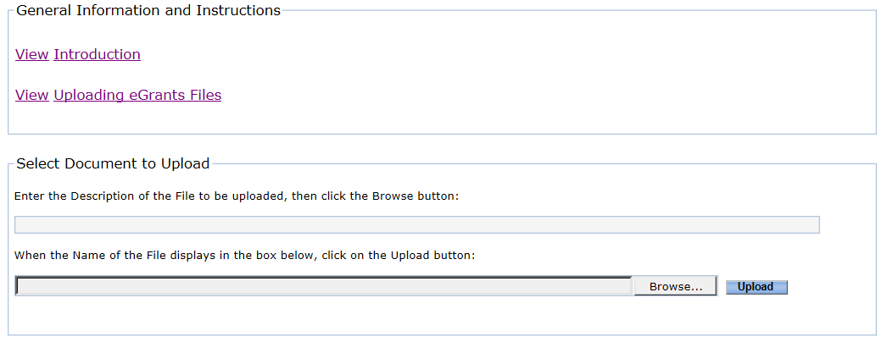
Application Development:
Upload Files Tab
Notes:
Slide 70 – Upload Files Tab
Applicants use this tab to upload most* required or requested documentation for the application. Documentation such as resolutions from the governing body, P25 interoperability letters, Indirect Cost rate letters, etc. goes under this tab. Once the grant has been awarded, the Grant Manger or any of the grant officials may continue to upload other documentation for the grant record under this tab.
For more details on file types, size limitations, and instructions on uploading a document, please refer to the Uploading eGrants Files document found in the “General Information and Instructions” area of this tab.
Presenter Note: A hyperlink is provided above.
DO NOT upload any Environmental Historical Preservation (EHP) documentation until after the award is received and accepted. The best practice for EHP documentation is to email it directly to the Grant Manager and copy the Program Manager for processing. The Grant Manager will upload EHP documentation to the Grant Record. FEMA will not process any EHP until after acceptance of the award. Uploading an EHP during the application phase will not help speed up the process. If Applicants have questions, they should contact the COG or their Grant Manager.
*Note: DO NOT upload any Vendor documentation including Direct Deposit, New Payee ID, and W9 forms on this tab. Each of those forms MUST be uploaded to the Grant.Vendor tab, not the Upload.Files tab.

Slide 78
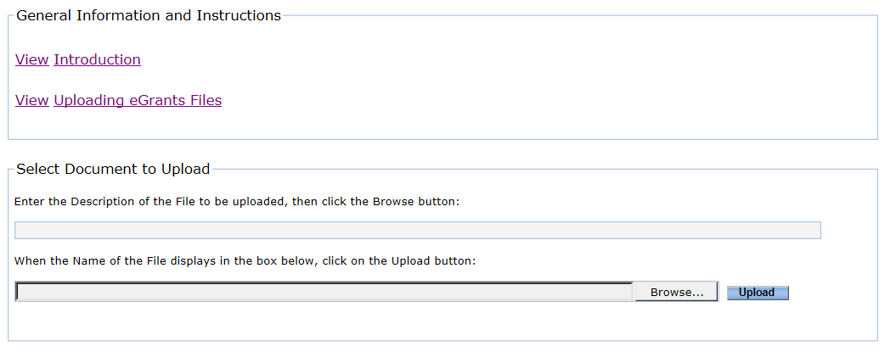
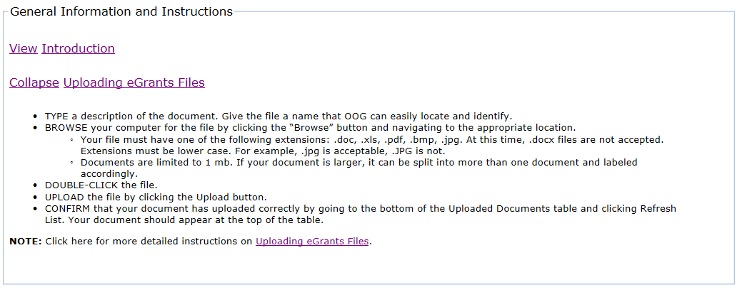
Application Development:
Upload Files Tab
Click here
Notes:
Slide 71 – Upload Files Tab
Presenter Note: Use the animations in this slide to show participants where they may find the Uploading eGrants Files document

Slide 79
Global Upload
New Global Upload Feature in eGrants
Located on a user’s My.Home tab
Allows for the simultaneous upload of a document to multiple applications/grants at one time
Limited to one file at a time
Users can select to upload files to the Upload Files tab or financial documentation that uploads to the Grant Vendor tab
Notes:
Slide 72 – Global Upload Feature
Applicants also have a new feature in eGrants that allows them to upload documents to multiple applications at once. This Global Upload Feature can be found at the bottom of the “My.Home” tab.

Slide 80
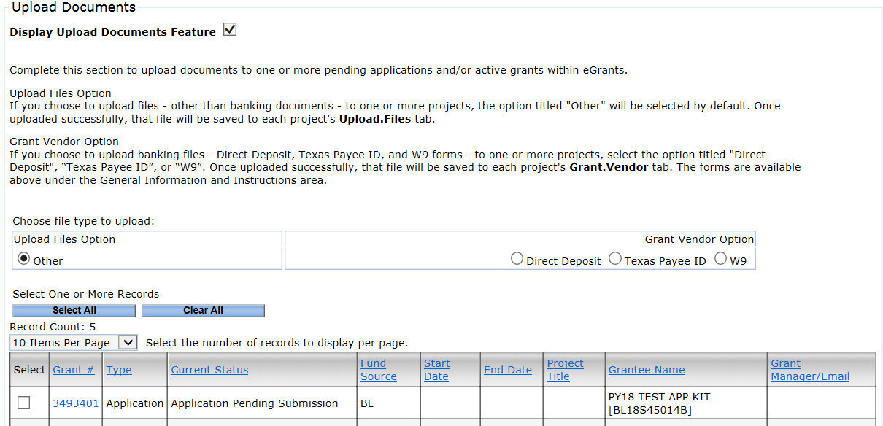
Global Upload
Notes:
Slide 73 – Global Upload Feature
Steps for using the Global Upload Feature:
Scroll to the bottom of the My.Home tab and locate the Upload Documents area.
Click the box next to “Display Upload Documents Feature”
Once the Upload Documents feature is displayed, choose the types of files you will upload, by selecting the appropriate radio button.
Select the applications you wish to upload the files to in the table displayed on the screen.

Slide 81
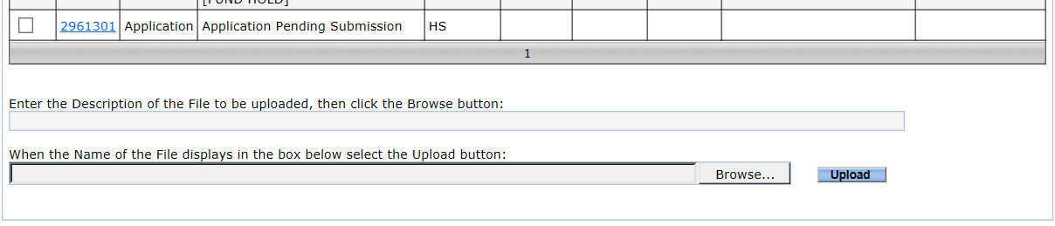
Global Upload
Notes:
Slide 74 – Global Upload Feature
Steps for using the Global Upload Feature (continued):
Below the table, enter a short, clear description of the file to be uploaded
Click the Browse button and locate the file to be uploaded
Once you have selected the file to be uploaded, click the Upload button. The file will then be uploaded to all of the selected applications.
NOTE: This feature is available for all applications and grants in eGrants.

Slide 82
Office of the Governor
HSGD - Preparedness Programs
Robert Cottle – Program Manager
  (512) 463-8317 - Robert.Cottle@gov.texas.gov
Will Ogletree – Associate Program Manager
  (512) 463-8339 - Will.Ogletree@gov.texas.gov
eGrants Help Desk –
  (512) 463-1919 - eGrants@gov.texas.gov
Notes:
Presenter Notes: The information on these slides is the contact information for the HSGD Preparedness team. The Grant Managers are assigned COG regions and handle all SHSP, UASI, and Non-Profit grants for their assigned regions. Regions may want to present only slide 47 and the slide for their grant manager.

Slide 83
Office of the Governor
Homeland Security Grants Division
Noah Gilliam
  (512) 463-8457 - Noah.Gilliam@gov.texas.gov
  Houston-Galveston Area Council
  Houston UASI
Daisy Saenz-Rodriguez
  (512) 463-8398 - Daisy.Saenz-Rodriguez@gov.texas.gov
  North Central Texas Council of Governments
  DFWA UASI
Notes:
Noah Gilliam is the Grant Manager and Point of Contact for all projects in the following region and urban area:
Houston-Galveston Area Council
Houston UASI
Daisy Saenz-Rodriguez is the Grant Manager and Point of Contact for all projects in the following region and urban area:
North Central Texas Council of Governments
DFWA UASI

Slide 84
Office of the Governor
Homeland Security Grants Division
Jaclyn Coles
  (512) 463-8318 - Jaclyn.Coles@gov.texas.gov
  Capital Area Council of Governments
  Central Texas Council of Governments
  Golden Crescent Regional Planning Commission
  Heart of Texas Council of Governments
  Nortex Regional Planning Commission
  South East Texas Regional Planning Commission
  South Plains Association of Governments
Notes:
Jaclyn Coles is the Grant Manager and Point of Contact for all projects in the following regions:
Capital Area Council of Governments
Central Texas Council of Governments
Golden Crescent Regional Planning Commission
Heart of Texas Council of Governments
Nortex Regional Planning Commission
South East Texas Regional Planning Commission
South Plains Association of Governments

Slide 85
Victim Services Staff Members
CJD Victim Services Team
Director of Victim Services – Dr. Zena Hooper
Associate Director – Scott Kelly
Grant Coordinators
Alyssa Smith
Lester Brown
Donald Stout – VAWA/SASP
Program Coordinators
Jake Lira
Cecilia Acuff

Slide 86
Helpful Links
AEL Codes and code descriptions
  https://www.fema.gov/authorized-equipment-list
Title 2 Code of Federal Regulations (2CFR) Part 200
  http://www.ecfr.gov/cgi-bin/text-idx?tpl=/ecfrbrowse/Title02/2cfr200_main_02.tpl
eGrants User’s Guide to Creating an Application
  https://egrants.gov.texas.gov/FileDirectory/eGrants_Users_Guide_Appsv3.pdf

Slide 87
Helpful Links
Uploading eGrants Files
  https://egrants.gov.texas.gov/FileDirectory/eGrants_Upload_Files_Instructions_v3.pdf
Preliminary Review Report video
  https://egrants.gov.texas.gov/Videos/8_Submit_PRR/8_Submit_PRR.html
Budget Line Item Edits
  https://egrants.gov.texas.gov/Videos/5_Budget_Edit/5_Budget_Edit.html

Slide 88
Helpful Links
Find and Resolve a Special Condition
  https://egrants.gov.texas.gov/Videos/11_Special_Conditions/11_Special_Conditions.html
Grant Adjustment Tutorial
  https://egrants.gov.texas.gov/Videos/09_Grant_Adjustments/09_Grant_Adjustments.htmlBudget Line Item Edits
Prepare and Submit an FSR
  https://egrants.gov.texas.gov/Videos/10_Financial_Status_Reports/10_Financial_Status_Reports.html

Slide 89
Helpful Links
OOG-Homeland Security Grants Division (HSGD)
  http://gov.texas.gov/hsgd/
HSGD Guidance – Frequently Asked Questions (FAQs)
  https://egrants.gov.texas.gov/updates.aspx
HSGD Guide to Grants
  https://egrants.gov.texas.gov/FileDirectory/Guide_to_Grants_v8.pdf
FEMA Preparedness (Non-Disaster) Grants
  https://www.fema.gov/preparedness-non-disaster-grants

Slide 90
Helpful Links CJD
eGrants - the online grant application and management system
Guide to Grants - information on applying for and managing grants
eGrants support page - forms, resources, and helpful support documents, including the User’s Guide to Creating an Application.
Developing a Good Project Narrative - Guidance on how to formulate an effective project, and how to communicate it clearly in the application’s narrative prompts.
Grantee Conditions and Responsibilities - A compendium of CJD and Homeland Security Grants Division policies for all grantees.
Standard Certifications and Requirements - CJD’s standard requirements that the Authorized Official must certify upon applying for a grant.
CJD Grant Activities and Measures - A reference for applicants on the activities allowed for different project types and the measures associated with each.

Slide 91
Helpful Links CJD Continued
Texas Administrative Code - the regulations specific to CJD grants
Uniform Grant Management Standards - the regulation for grants management in Texas
Uniform Administrative Requirements, Cost Principles, and Audit Requirements for Federal Awards - Otherwise known as “2 CFR 200,” or the OmniCircular, the regulations related to grants management for federal funding sources
eGrants Financial Management Guide - a guide to understanding how to manage your grant within eGrants
DOJ Grants Financial Guide - a guide that translates many of the federal grant rules into easier-to-understand terms
Texas State Library and Archives Commission’s Resources for Grantees - Helpful links and official state guidance for grants
Immigration and Customs Enforcement Detainer Certification - Information for local governments on how to comply with CJD’s requirement regarding compliance with requests from ICE for information or to detain illegal aliens in custody.

Slide 92
Helpful Links CJD Continued
CJD encourages all applicants and grantees to rely on evidence when designing grant projects. We have a growing focus on ensuring that the projects we fund are working and delivering the promised results. One way to increase the chances that a grant will be successful is to rely on information that uses the successes and failures of the field and learns from both. There are a variety of resources that may be helpful:
BJS Data Analysis Tools - The Bureau of Justice Statistics (BJS) offers a variety of analysis tools online including tools for census data, corrections, juvenile justice, case processing, victimization, and other topics.
COPS Office Resource Center - This site provides a variety of best practices and approaches for policing.
CrimeSolutions.gov - The National Institute of Justice’s CrimeSolutions.gov uses research to rate the effectiveness of programs and practices in achieving criminal justice related outcomes in order to inform practitioners and policy makers about what works, what doesn’t and what’s promising in criminal justice, juvenile justice, and crime victim services.
National Association of Drug Court Professionals - This site provides best practices for drug courts and guidance for other types of specialty courts.
National Criminal Justice Reference Service (NCJRS) - Established in 1972, the National Criminal Justice Reference Service is a federally funded resource offering justice and drug-related information to support research, policy, and program development worldwide.
OJJDP Model Programs Guide - The Office of Juvenile Justice and Delinquency Prevention’s (OJJDP’s) Model Programs Guide (MPG) contains information about evidence-based juvenile justice and youth prevention, intervention, and reentry programs. It is a resource for practitioners and communities about what works, what is promising, and what does not work in juvenile justice, delinquency prevention, and child protection and safety.
Youth.gov - This site provides interactive tools and other resources to help youth-serving organizations and community partnerships plan, implement, and participate in effective programs for youth.

Slide 93
QUESTIONS
CTCOG Resources
jesse.hennage@ctcog.org
(254) 770-2365 Office
(254) 410-9424 Cell
Homeland Security https://ctcog.org/emergency-services/homeland-security/
Criminal Justice https://ctcog.org/emergency-services/criminal-justice/

