Slide 1
Impacts of nonattainment (an mpo perspective)
Central Texas Council of Governments
Jenny Narvaez
North Central Texas Council of Governments
May 26, 2016

Slide 2
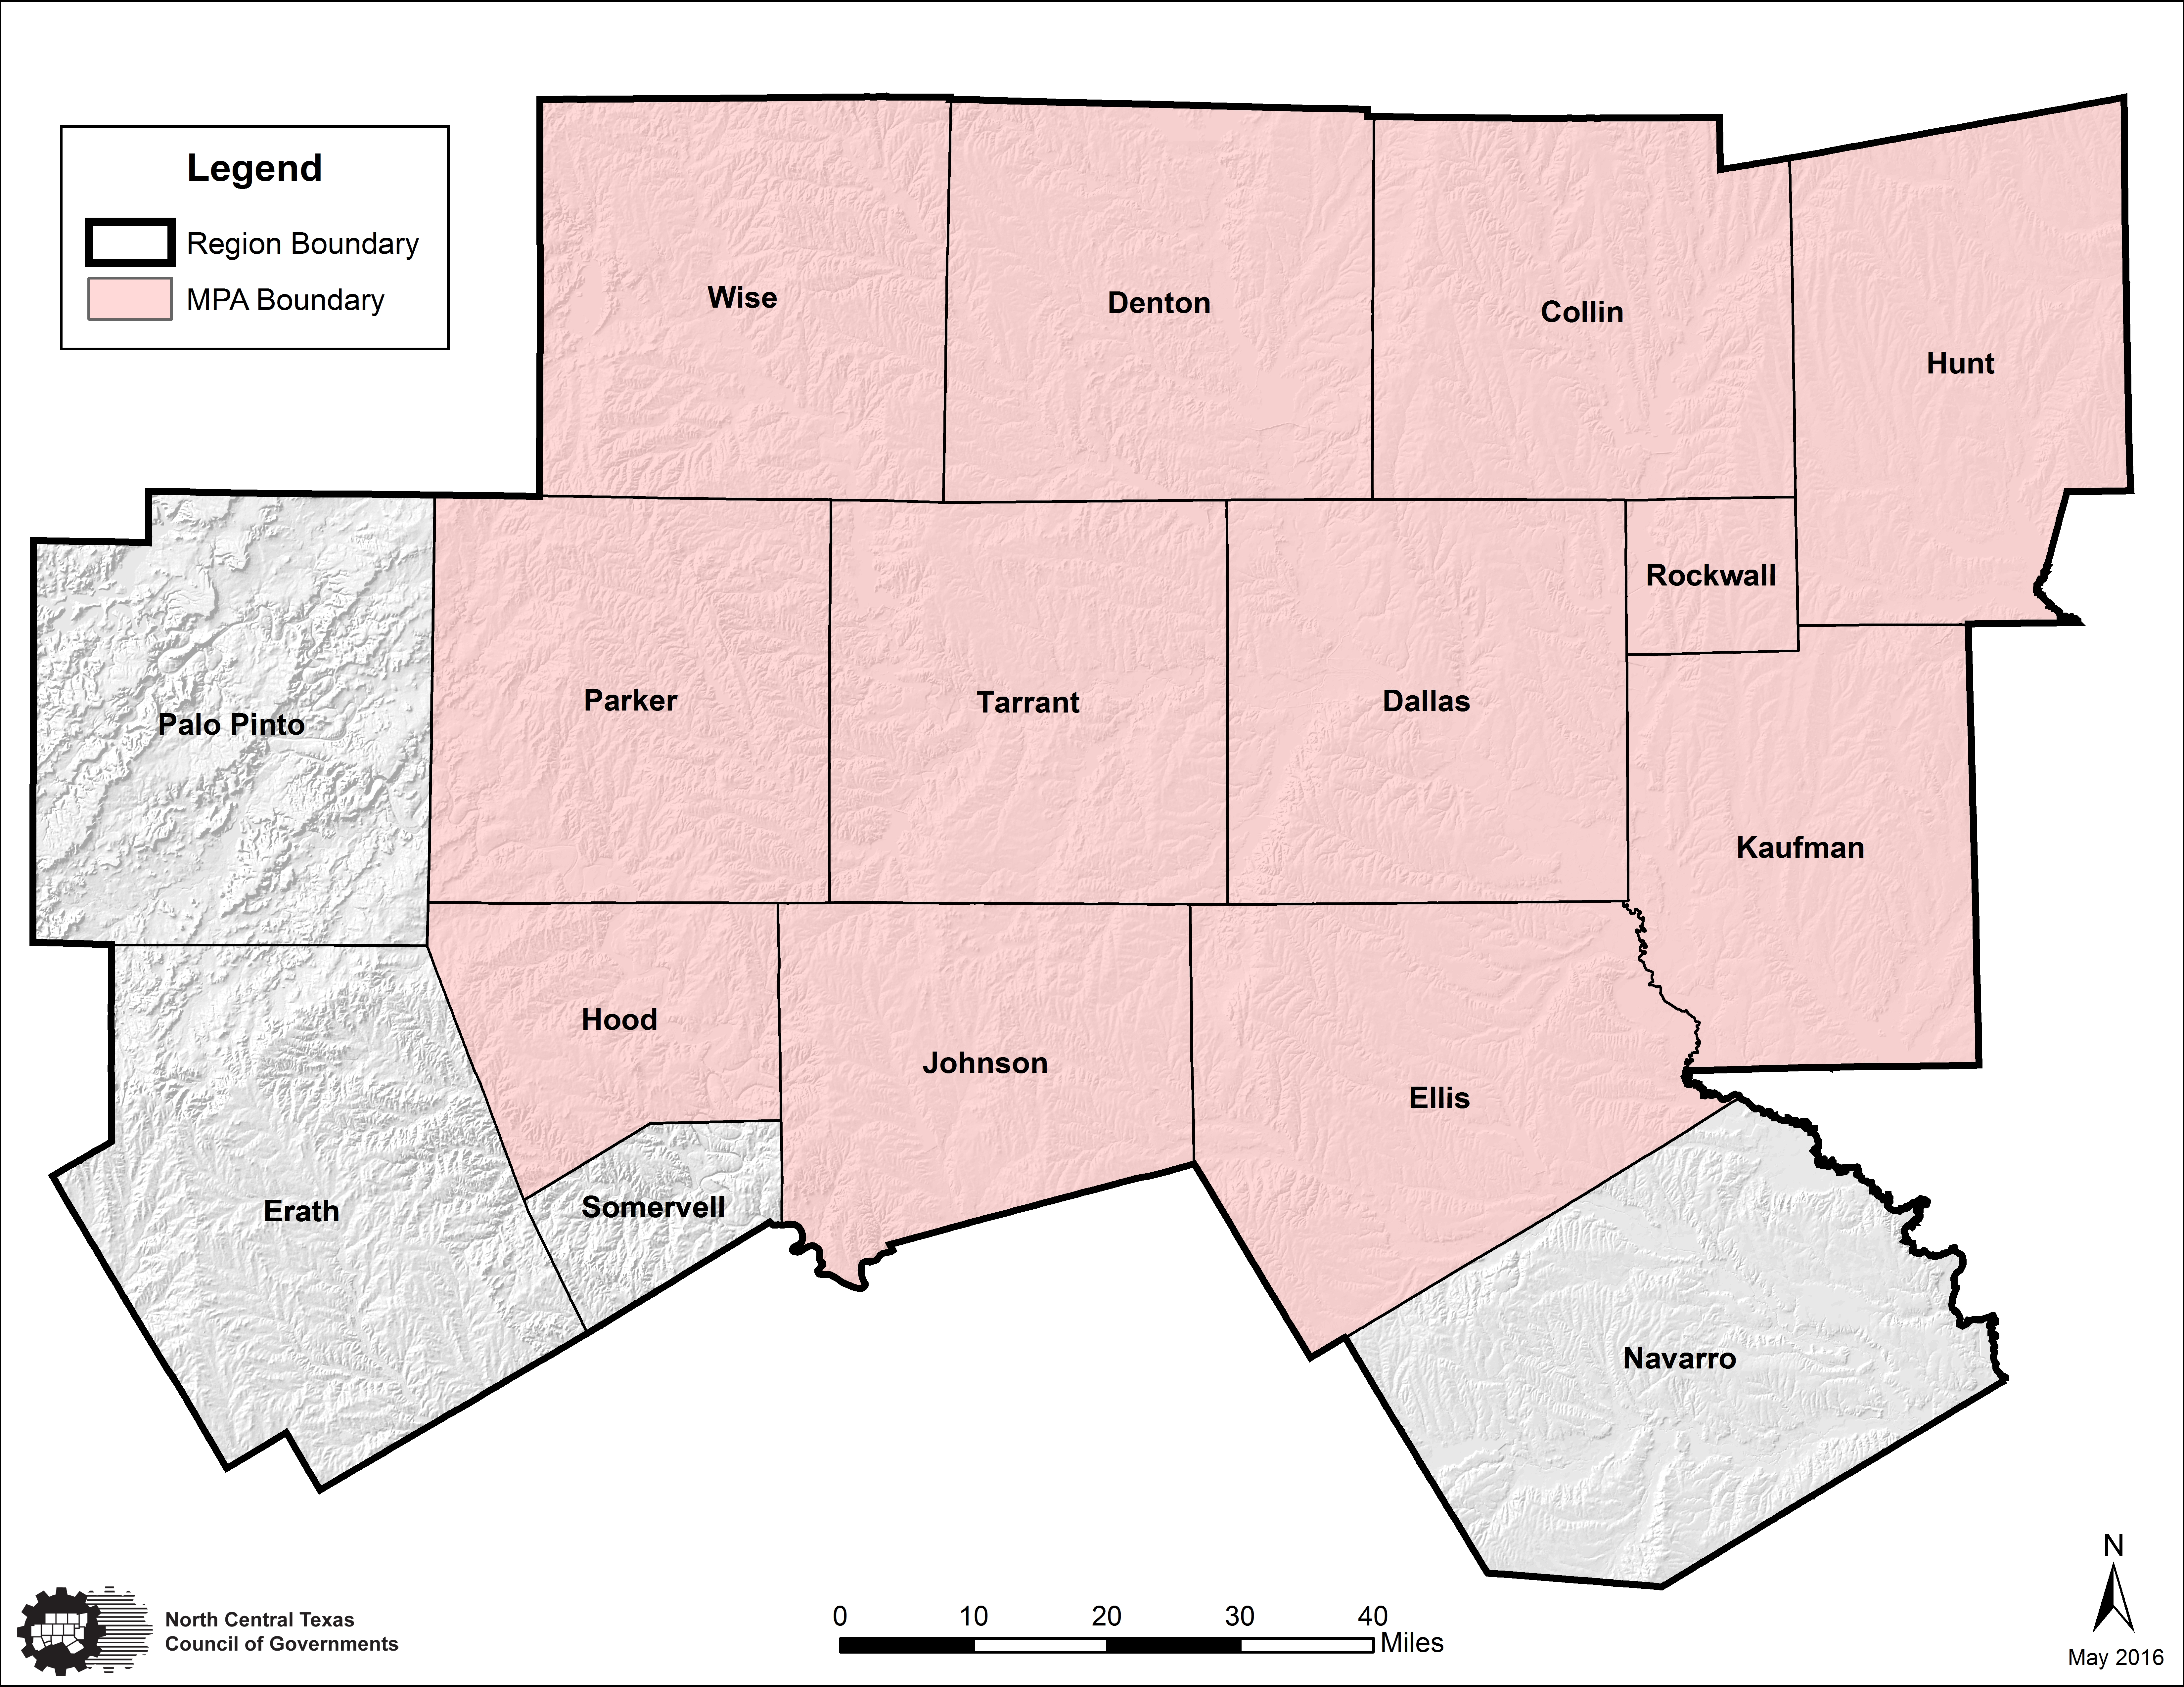
What is the north central Texas
Council of governments (NCTCOG)?
NCTCOG serves a 16-county region of North Central Texas that includes over 230 member governments including counties, numerous cities, school districts, and special districts.
Became the metropolitan planning organization for the Dallas-Fort Worth (DFW) metropolitan area in 1974.

Slide 3
Regional transportation council
The Regional Transportation Council (RTC) is the independent transportation policy body of the MPO.
Metropolitan Transportation Plan
Transportation Improvement Program
Congestion Mitigation and Air Quality Program
Unified Planning Work Program
Air Quality Conformity Determinations
Air Quality “State Implementation Plan” Strategies
Programs, Projects, and Policies Targeting Emissions Reduction Strategies from On-Road Mobile Sources
Legislative Initiatives
Map data @2016 Google, Image Capture: November 2015
http://www.nctcog.org/trans/committees/rtc/index.asp

Slide 4
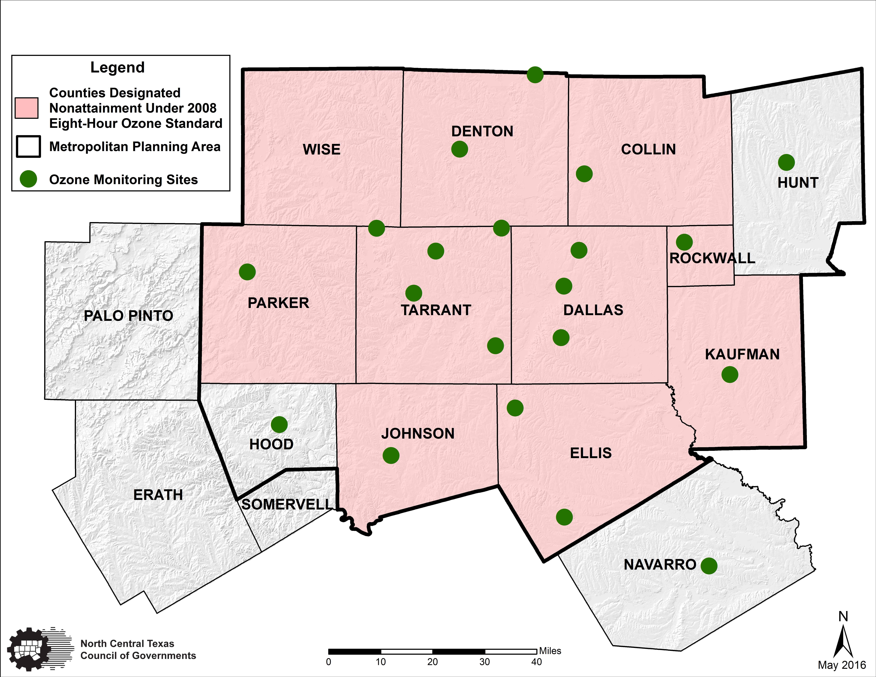
DFW 2008 Eight-Hour ozone
nonattainment region
Map data @2016 Google, Image Capture: November 2015

Slide 5
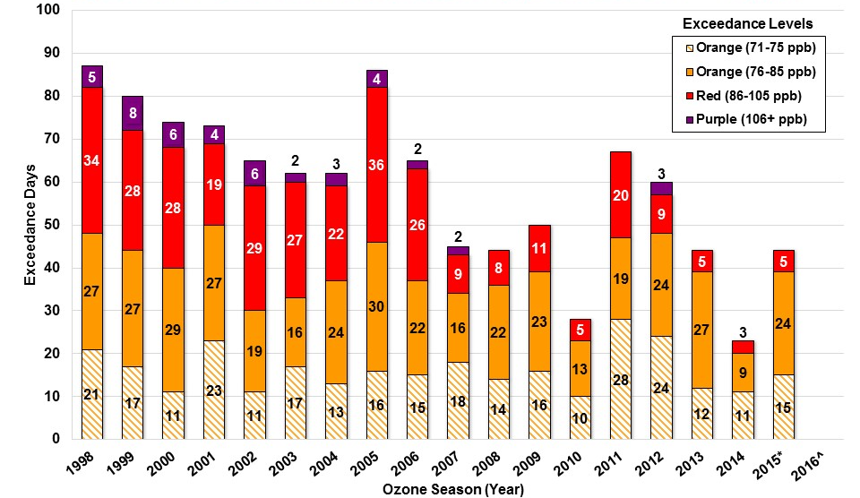
DFW Eight-Hour ozone exceedance days
Based on < 70 ppb
Map data @2016 Google, Image Capture: November 2015
Exceedance Level indicates daily maximum eight-hour average ozone concentration. Exceedance Levels are based on Air Quality Index (AQI) thresholds established by the EPA for the for the revised ozone standard of 70 parts per billion (ppb).
* Data not certified by the TCEQ
^Not a full year of data, current as of 5/23/2016
Source: TCEQ, http://www.tceq.state.tx.us/cgi-bin/compliance/monops/8hr_monthly.pl

Slide 6
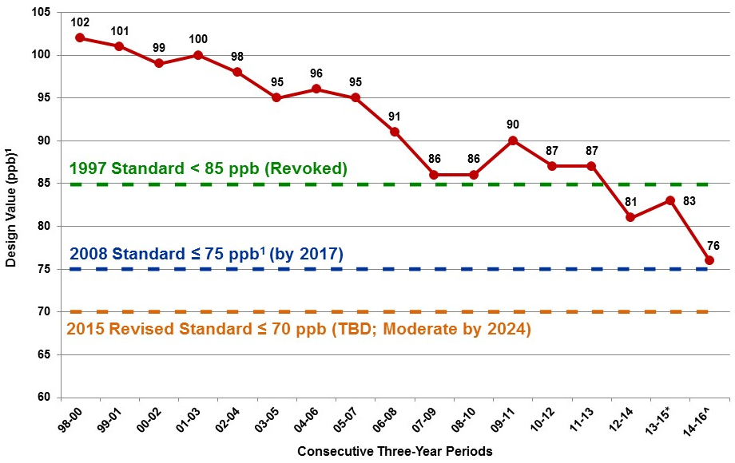
DFW 2008 Eight-Hour ozone
Historical Trends
Map data @2016 Google, Image Capture: November 2015
¹Attainment Goal - According to the US EPA National Ambient Air Quality Standards, attainment is reached when, at each monitor, the Design Value (three-year average of the annual fourth-highest daily maximum eight-hour average ozone concentration) is equal to or less than 70 parts per billion (ppb).
*Data not certified by the Texas Commission on Environmental Quality
^Not a full year of data, current as of 5/22/2016
Source: http://www.tceq.state.tx.us/cgi-bin/compliance/monops/8hr_attainment.pl

Slide 7
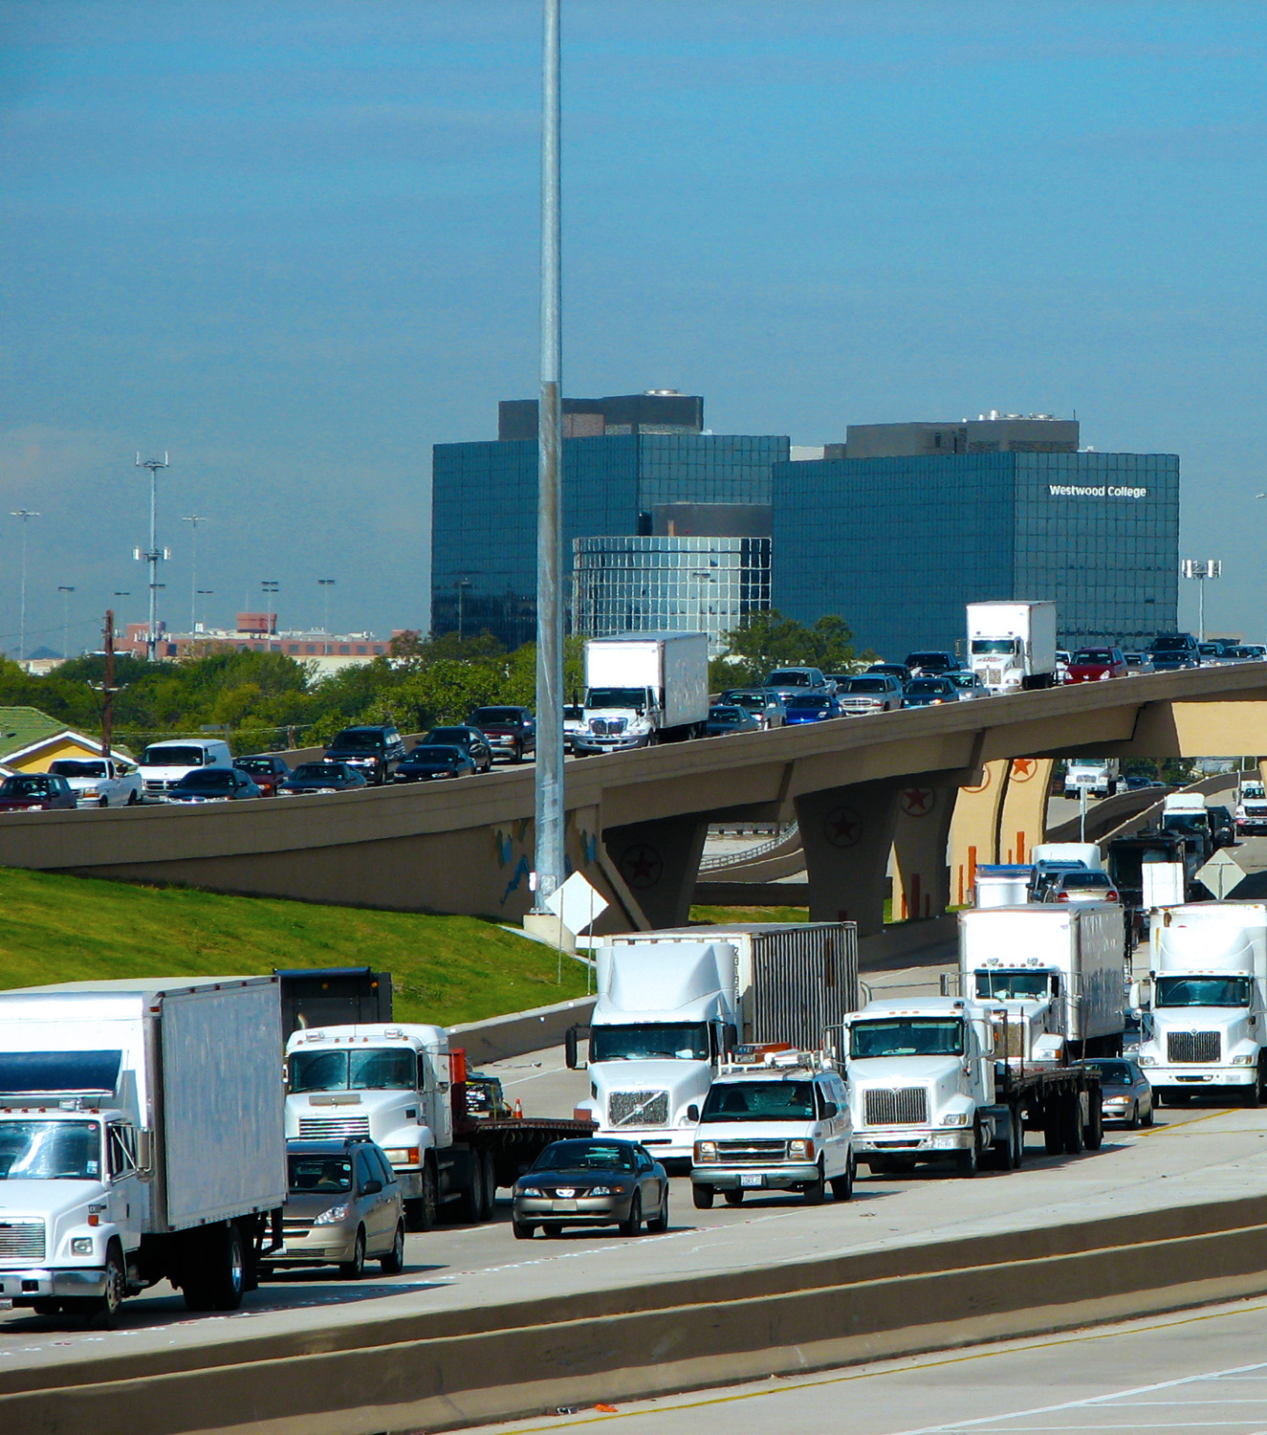
Nonattainment for ozone
Transportation Impacts
Transportation Conformity
Air Quality Programs to Reduce On-Road Mobile Emissions Contributing to Ozone Formation
Congestion Mitigation and Air Quality Improvement (CMAQ) Program
On-Road Mobile Inventories for Reasonable Further Progress and Attainment Demonstration State Implementation Plans (SIP)
Vehicle Inspection and Maintenance Program
Map data @2016 Google, Image Capture: November 2015

Slide 8
Transportation Conformity
Purpose
Ensure Transportation Activities are Consistent with
Air Quality Goals and Objectives
Responsible Agency
Regional Transportation Council of NCTCOG
Schedule/Timeframe
Prior to Transportation Plan or TIP Approval
Applicable Through Life of Transportation Plan
Air Quality Plan
Requirements
Conforms to Purpose and Specifics of SIP
Consistency with Emission Budgets Established in SIP
Timely Implementation of Transportation Control Measures
Implications
Transportation Plan and TIP Must be Consistent with SIP Budgets
If Conformity is not Demonstrated:
1. Transportation Plan may Need to be Modified
2. Additional Emission Controls may Need to be Added to SIP
3. Only Previously Conforming Transportation Projects may Proceed
Map data @2016 Google, Image Capture: November 2015

Slide 9
Transportation Conformity
Interagency consultation process
MPO
EPA
FHWA
FTA
TCEQ
TXDOT
Approximate Timeline = 90 days
MPO Initiates Review; Distributes Pre-Analysis Consensus and Holds Call
MPO Transmits Conformity Document to all Partners
Partners Submit Comments to MPO
MPO Addresses Comments
Partners Transmit Conformity Determination Letters for US DOT Approval
Map data @2016 Google, Image Capture: November 2015
FHWA and FTA serve US DOT

Slide 10
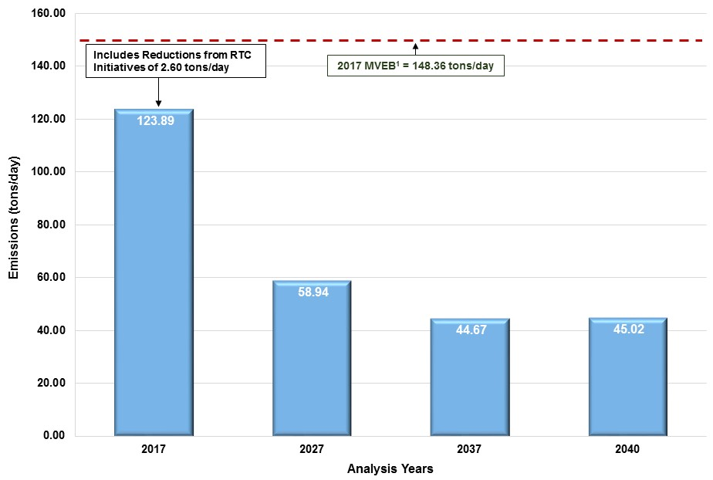
DFW 2016 transportation Conformity
Analysis draft results (NO_{X})
¹ Source: Environmental Protection Agency Notice of Adequacy Status of the Dallas-Fort Worth, TX Reasonable Further Progress 8-Hour Ozone Motor Vehicle Emission Budgets for Transportation Conformity Purposes; 81 FR 1184, https://federalregister.gov/a/2016-339.

Slide 11
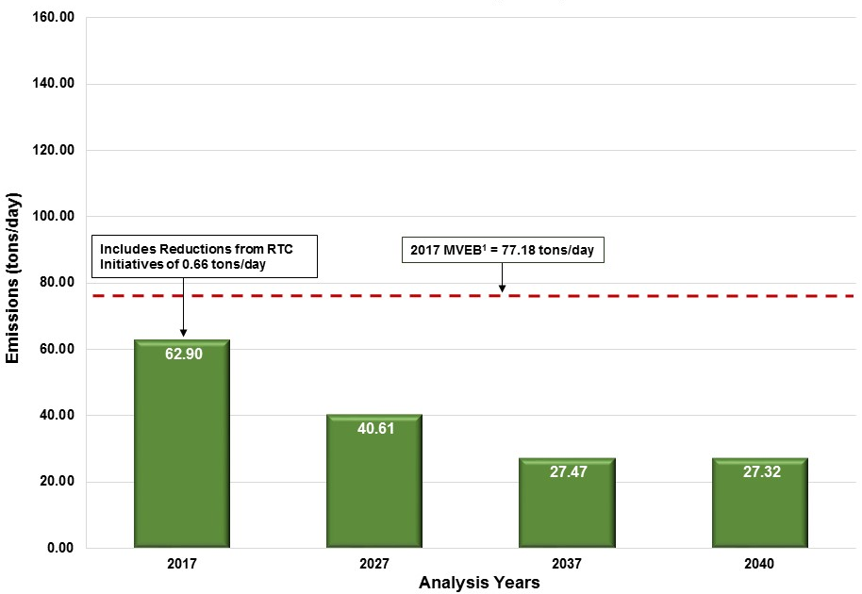
DFW 2016 transportation Conformity
Analysis draft results (voc)
¹ Source: Environmental Protection Agency Notice of Adequacy Status of the Dallas-Fort Worth, TX Reasonable Further Progress 8-Hour Ozone Motor Vehicle Emission Budgets for Transportation Conformity Purposes; 81 FR 1184, https://federalregister.gov/a/2016-339.

Slide 12
2016 transportation conformity
Sample of rtc initiatives
AirCheck Texas Program Regional
Bicycle/Pedestrian Facilities 459.14 Miles
Bus Transit Improvements Regional
Diesel Idle Reduction Regional
Electric Vehicle Program Regional
Employee Trip Reduction Program Regional
Grade Separations 75 Locations
High Occupancy Vehicle Lanes 50 Miles
Intelligent Transportation Systems Regional
Intersection Improvements 774 Locations
Park and Ride Lots 22,595 Spaces
Rail 70.2 Miles Signal Improvements Regional Audit
Vanpool 562 Vanpools
Map data @2016 Google, Image Capture: November 2015

Slide 13
Air quality emphasis areas
High-Emitting Vehicles/Equipment
Idling
Hard Accelerations
Low Speeds
Cold Starts
Map data @2016 Google, Image Capture: November 2015
Vehicle Miles of Travel
Energy and Fuel Use

Slide 14
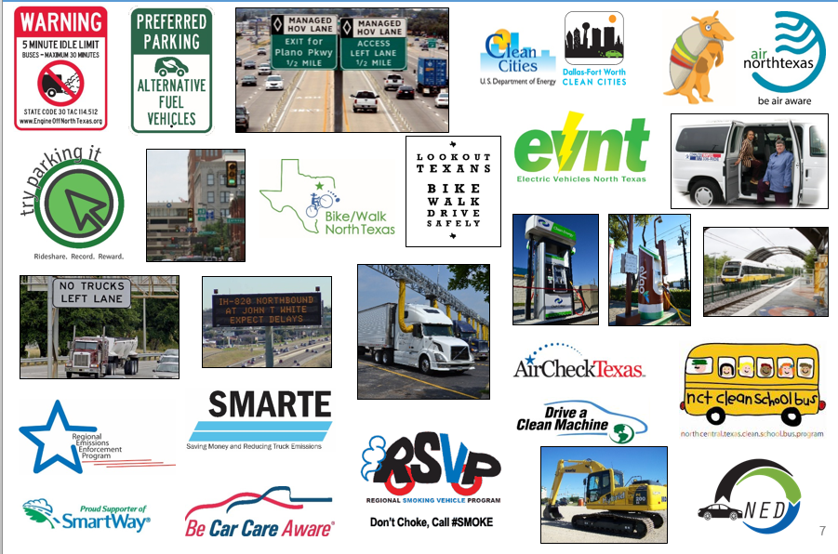
Air Quality initiatives
Map data @2016 Google, Image Capture: November 2015

Slide 15
Cmaq program
Established in 1991 to provide a funding source to State and local governments for transportation projects and programs to help meet the requirements of the Clean Air Act.
Eligible activities include but are not limited to:
Efforts to Provide Signal Systematization
Construct HOV Lanes
Streamline Intersections
Add Turning Lanes
Improve Transportation Systems Management and Operations that Mitigate Congestion and Improve Air Quality
Implement Intelligent Transportation Systems (ITS) and Other Projects that Improve Incident and Emergency Response or Improve Mobility
Transit Investments
Non-recreational Bicycle Transportation and Pedestrian Improvements that Provide a Reduction in Single-Occupant Vehicle Travel
Vehicle Inspection and Maintenance Programs
Map data @2016 Google, Image Capture: November 2015
http://www.fhwa.dot.gov/map21/guidance/guidecmaq.cfm

Slide 16
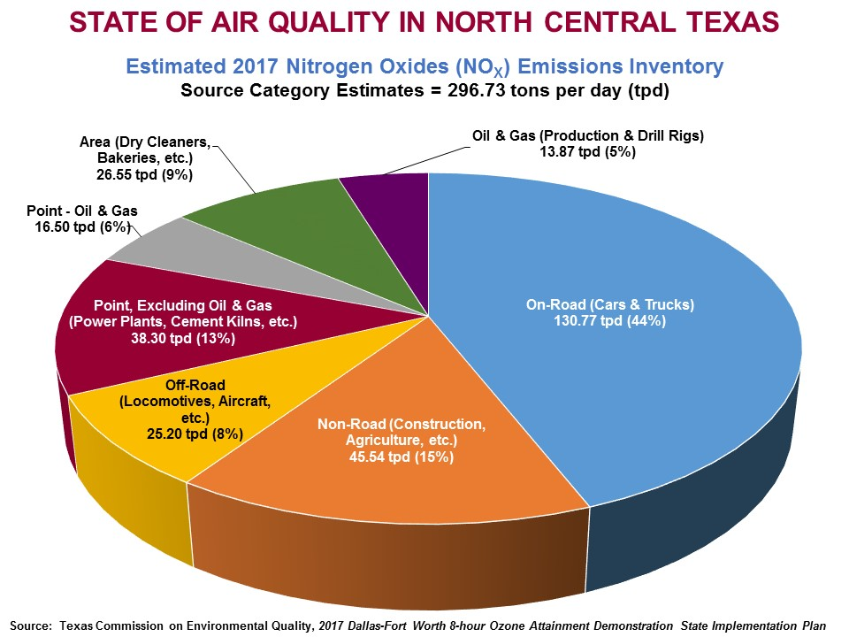
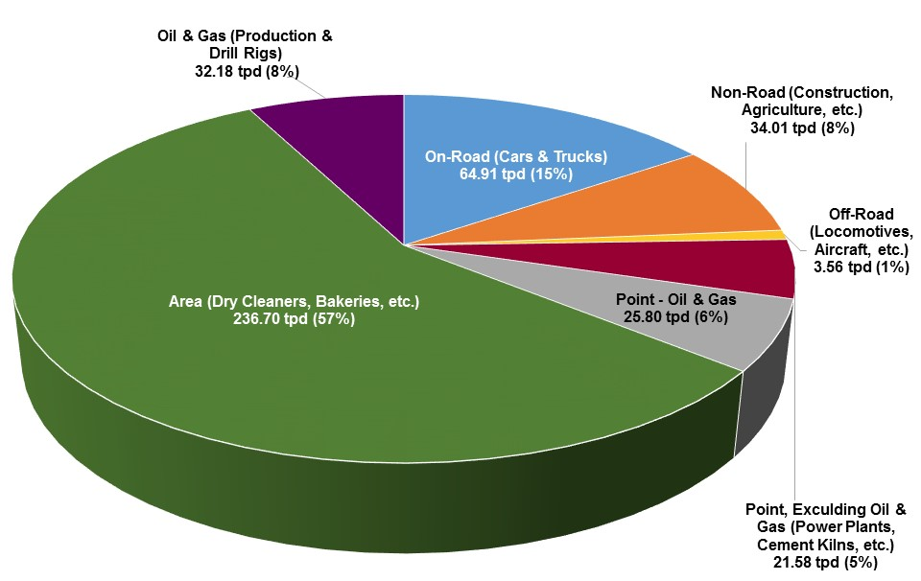
Dfw 2017 emission inventories for SIP
Source categories
Total NO_{X} = 297 tons per day (tpd)
Map data @2016 Google, Image Capture: November 2015
NO_{X} = Nitrogen Oxides
VOC = Volatile Organic Compounds
tpd = Tons per Day
Total VOC= 419 tons per day (tpd)
Source: Texas Commission on Environmental Quality (TCEQ)

Slide 17
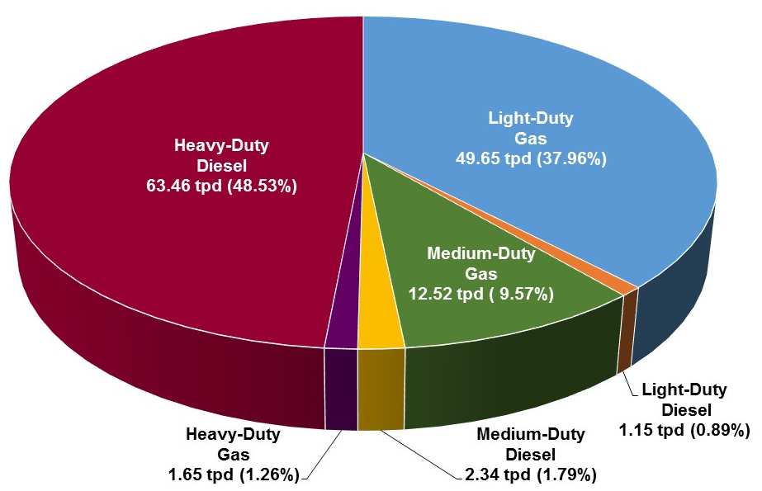
Dfw 2017 emission inventories For SIP
Estimated no_{x} emissions by source
Total NO_{X} = 297 tons per day (tpd)
Map data @2016 Google, Image Capture: November 2015
NO_{X} = Nitrogen Oxides
VOC = Volatile Organic Compounds
tpd = Tons per Day
Source: Texas Commission on Environmental Quality (TCEQ)
Total NO_{X} = 131 tons per day (tpd)

Slide 18
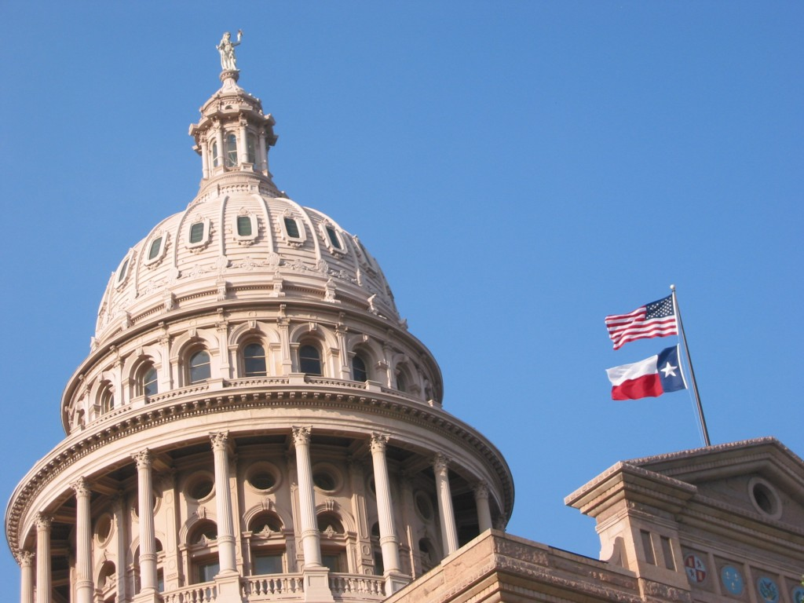
Legislative initiatives
The RTC closely monitors the Texas Legislative sessions to identify legislation related to transportation and air quality to actively pursue, support and monitor.
Past Examples:
Pursue Additional Transportation Revenue
Pursue Full Funding of the AirCheckTexas Program
Support Ban of Hand-held Communication Devices in Work Zones
Monitor Local Authority to Implement Red-light Cameras
Map data @2016 Google, Image Capture: November 2015

Slide 19
Resources
NCTCOG:
Jenny Narvaez
Principal Air Quality Planner
jnarvaez@nctcog.org
817-608-2342
Jody Loza
Senior Air Quality Planner
jloza@nctcog.org
817-704-5609
Vivek Thimmavajhala
Transportation System Modeler
vthimmavajhala@nctcog.org
817-704-2504
www.nctcog/trans/air
http://www.nctcog.org/trans/air/conformity/
Technical Working Group:
Transportation Conformity Resources:
http://www.texastwg.org/transportation-conformity-resources/
2016 TxDOT Environmental Conference
September 13-15, 2016
Corpus Christi, Texas
http://tti.tamu.edu/conferences/envr16/#registration
Texas Ozone Advance/Nonattainment Areas Conference Calls
- Occur quarterly

